Slide 1
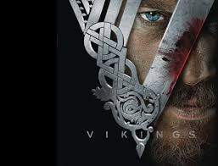
The Vikings Civilization
772-1066 A.D.

Slide 2
Essential Standard
6.H.2- Understand the political, economic and/or social significance of historical events, issues, individuals and cultural groups.
6.G.1- Understand geographic factors that influenced the emergence, expansion and decline of civilizations, societies and regions (i.e. Africa, Asia, Europe, and the Americas) over time.
6.C&G.1- Understand the development of government in various civilizations, societies and regions.
6.C.1- Explain how the behaviors and practices of individuals and groups influenced societies, civilizations and regions.

Slide 3
Clarifying Objective
6.H.2.3- Explain how innovation and/or technology transformed civilizations, societies and regions over time (e.g., agricultural technology, weaponry, transportation and communication).
6.G.1.2- Explain the factors that influenced the movement of people, goods and ideas and the effects of that movement on societies and regions over time (e.g., scarcity of resources, conquests, desire for wealth, disease and trade).

Slide 4
Clarifying Objective
6.G.1.4- Explain how and why civilizations, societies and regions have used, modified and adapted to their environments (e.g., invention of tools, domestication of plants and animals, farming techniques and creation of dwellings).
6.C&G.1.2- Summarize the ideas that shaped political thought in various civilizations, societies and regions (e.g., divine right, equality, liberty, citizen participation and integration of religious principles).
6.C.1.2- Explain how religion transformed various societies, civilizations and regions

Slide 5
Essential Question??

Slide 6
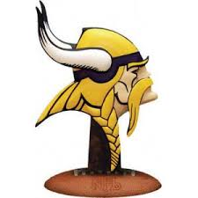
Who Were the Vikings
The Vikings or Norseman started around 793 A.D.
The were mostly farmers and colonists of Scandinavia
Scandinavia was the region that is now Norway, Sweden & Denmark

Slide 7
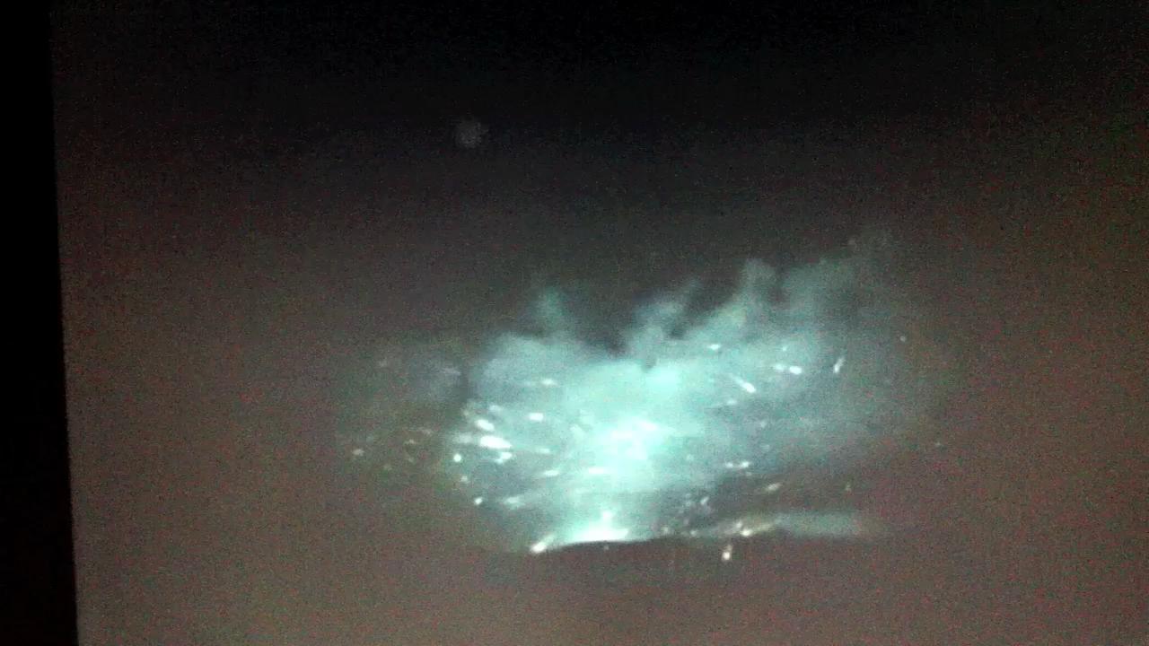
Who Were the Vikings

Slide 8
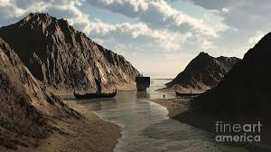
What Does “Viking” Mean
A Viking is someone from Scandinavia who took part in overseas expeditions
The word Viking derives from the word “vik” which is Scandinavian for creek, inlet, or bay

Slide 9
What Does “Viking” Mean
This is because the Vikings sailed their longboats up little creeks, inlets, or bays
It is interesting to note the Vikings didn’t call themselves Vikings at first only their enemies did

Slide 10
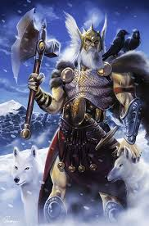
Viking Sagas, gods, & Mythology
Sagas were Viking legends about famous Viking people & Viking gods
The most famous Viking god was Odin who was a raven. He traded one of his eyes so he could see the future
Thor was another famous god. He held the hammer and was god of strength
Valhalla was the Viking heaven

Slide 11
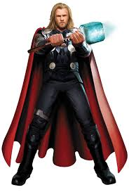
Viking Sagas, gods, & Mythology
Asgard was where all the Viking gods & goddesses lived
This is very similar to Olympus in Greece
Norns were Mythical people of wisdom
Valkayries were lesser gods who worked for Odin and carried Vikings who were killed on the battlefield to Valhalla

Slide 12
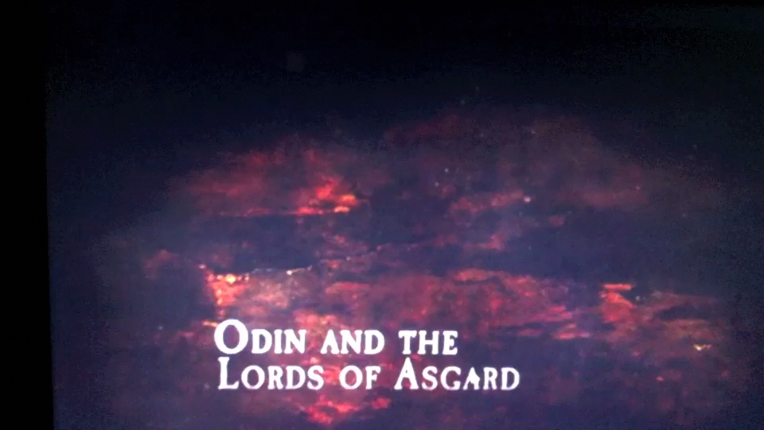
Viking Mythology & Sagas

Slide 13
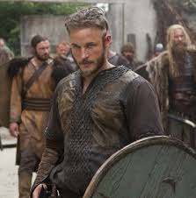
Story of the Vikings
The story of the Vikings begins with a Civil War
The Viking people began as little individual Norseman settlements that didn’t know each other
Those individual Norseman settlements would attack each other & steal from each other

Slide 14
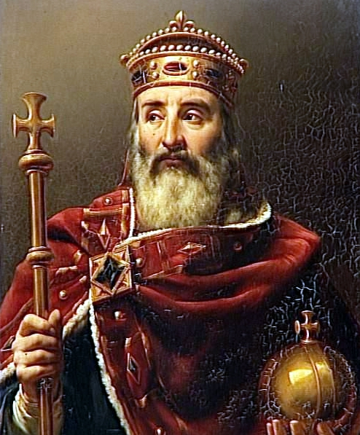
Charlemagne
Then came Charlemagne
Charlemagne was a King from France
He was trying to spread Christianity throughout all of Scandinavia
Most of the people from Scandinavia during that time were not Christian they were called Pagans

Slide 15
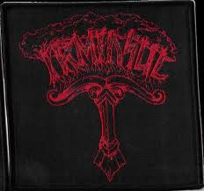
Charlemagne
Christian King Charlemagne viewed the pagans as heretics and wanted to convert all pagans
In 772 Charlemagne ordered the Irminsûl/Yggdrasil tree cut down
In Scandinavian pagan culture the Irminsûl/Yggdrasil tree was the tree that held up the sky

Slide 16
Irminsûl/Yggdrasil Tree
When the Irminsûl/Yggdrasil Tree was cut down the individual Norseman settlements banded together to form one army of Norseman to fight Charlemagne and the Christians
The group of Norseman began sailing east and attacking Christian Monasteries and stealing valuables from the monasteries

Slide 17
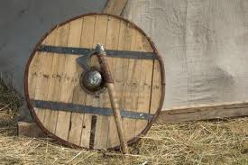
Vikings Were Born
They continued sailing to attack Christian Monasteries & settlements in search of more valuables
When the war against Charlemagne and the Christians were done the Vikings just continued attacking more villages

Slide 18
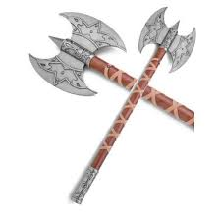
Viking Culture
The Vikings were a warrior culture
The children (both boys & girls) were taught how to use weapons at a young age
Boys when they grew up would go off on raids when they became a certain age to mark them becoming Viking men

Slide 19
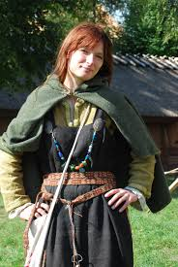
Viking Women
Viking women played a very important part in Viking culture
The Viking woman was given many rights and treated almost as an equal
Women held many important positions in Viking society
Women could fight, own land, divorce their husbands
Women were well respected in Viking society

Slide 20
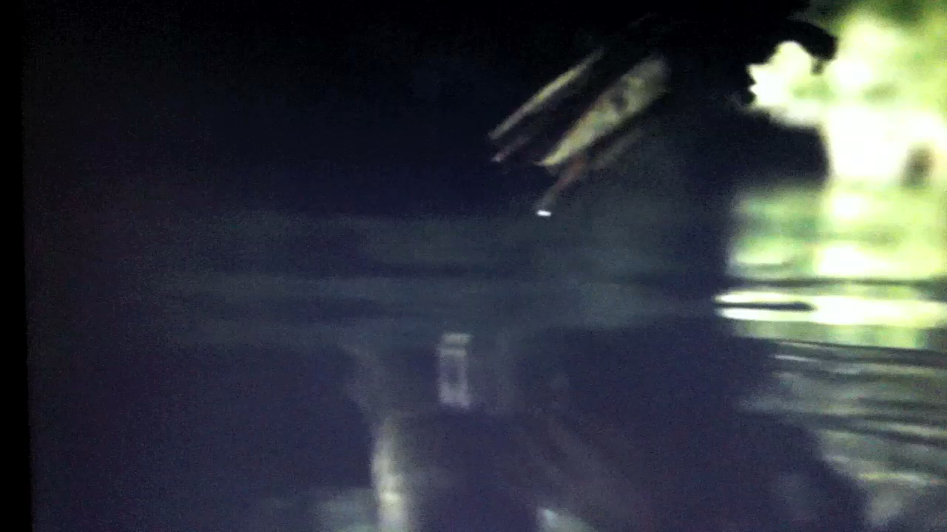
Viking Women

Slide 21
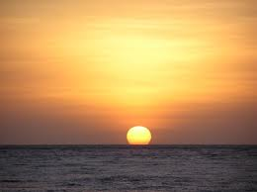
Early to Bed, Early to Rise
Because this was the time before electricity the Viking people went to bed when the sun went down
In the summer time that meant as late as 9:30PM in June or as early as 5:00PM in the winter in December
In the summertime they would get up around 6:00AM but in the winter time when they went to bed early they would get up around 4:00AM

Slide 22
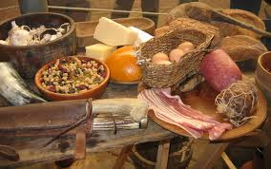
I’m Hungry, Is there anything to eat?
When the Vikings got up they had a large meal in the morning
They had one more large meal during the daytime

Slide 23
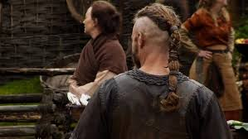
Keeping Clean & Blonde
The Vikings were actually a very clean people
They took saunas where they sat in a little wooden house and heated the house to about 120 degrees
They would sweat which cleaned their pores and then they would go jump in the river or lake and bathe
Viking men and women would dye their hair blonde as was their culture but in doing so the dye would kill any bugs that would get in their long hair (lice)

Slide 24
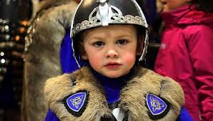
Viking Inheritance
Only the first born son would inherit any land or possessions from their father
The other children had to go make their way in life
This meant that most Vikings were given nothing and had to earn everything
This is why they raided and battled other cultures & civilizations

Slide 25
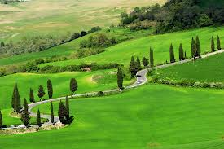
Land Lovers
Young Viking men were judged in their society by how much land they had or could steal
This meant that the more land that your could steal for your family the more popular you became
This is why the Vikings would go on raids because each Viking would be awarded part of the land that they raided

Slide 26
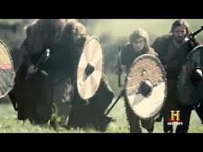
Viking Raids/Battles
Because only first sons inherited any land or possessions from their fathers the Vikings went onto raids/battles to acquire more land and possessions
The Vikings had special rituals they would conduct before they would go to raid/battle another civilization

Slide 27
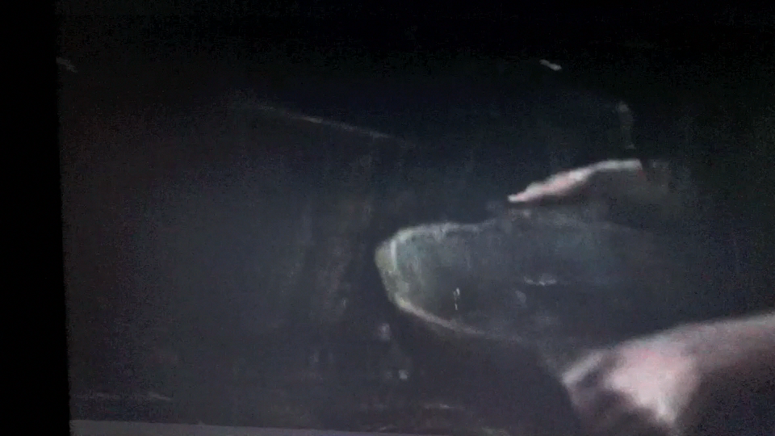
Viking Raid/Battle Traditions

Slide 28
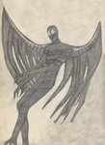
Ultimate Goal in Viking Battle
The Viking man’s ultimate goal is to be one of Odin Warriors in Valhalla
The only way to attain that was to be killed in battle
A death in battle meant that the Valkarires would come down and swoop you up to Valhalla
It was Viking warriors dream to be killed in battle so they could dine with Odin

Slide 29

Odin & Valhalla

Slide 30
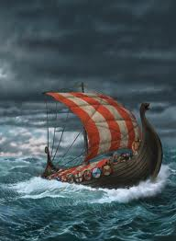
Viking Longboat
The Vikings used the Viking Longboat as stealth water vehicles to attack other villages
Because of the way the keel of the ship was built for mobility the Viking Longboat was able to move over the great waves of the ocean

Slide 31
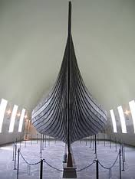
Viking Longboat
The Viking Longboat was also able to sail in shallow creeks & rivers because of how shallow the hull sat in the water
This allowed the Vikings to travel over vast oceans and discover and conquer new lands
It also allowed the Vikings to move secretly & quietly to attack villages that were located on shallow rivers or inlets

Slide 32
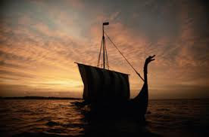
The Viking Longboat
The sight of a Viking Longboat scared the Vikings enemies
The Vikings were thought to be people of the devil by other cultures because they were much bigger than most other cultures and they stole anything they could get

Slide 33
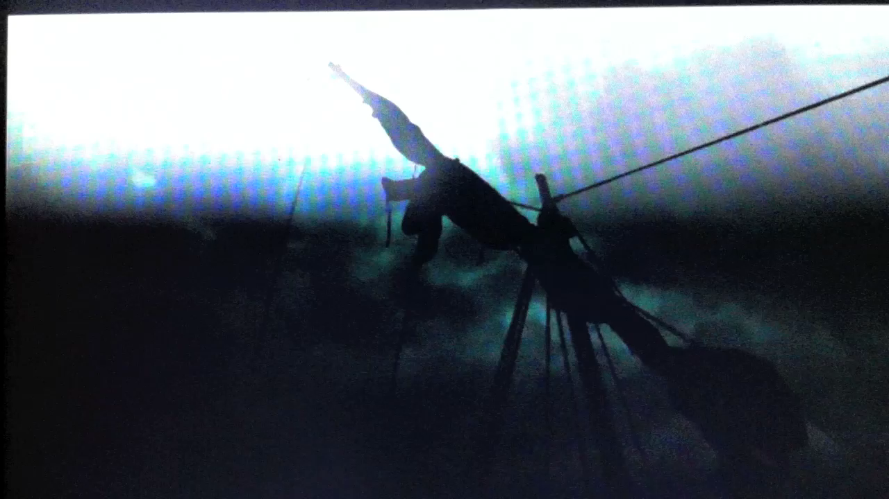
Viking Longboat

Slide 34
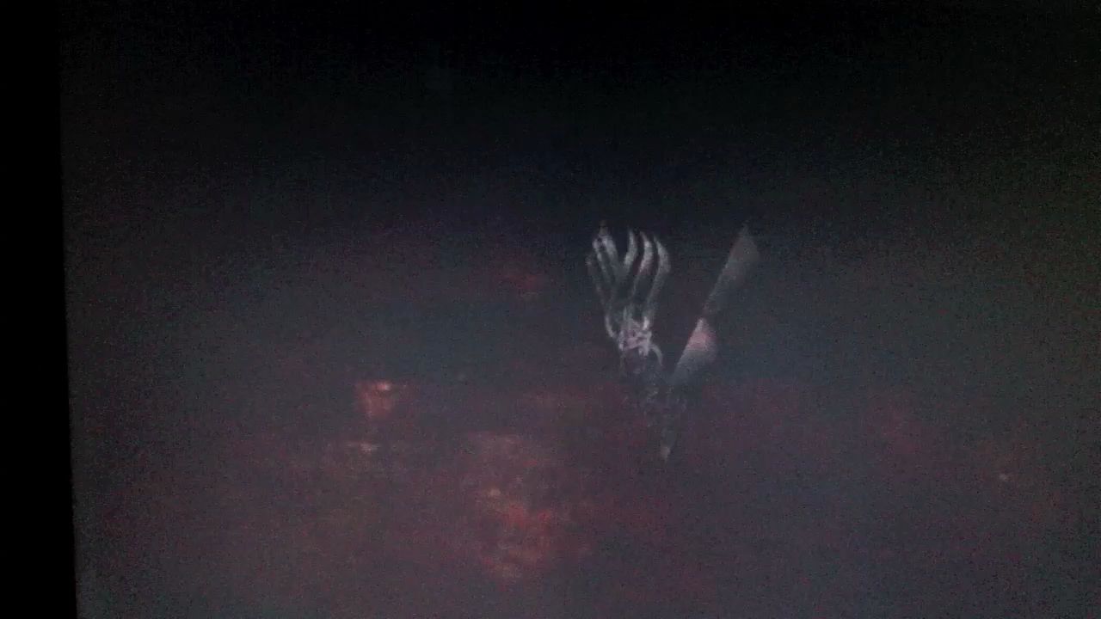
Viking Longboat

Slide 35
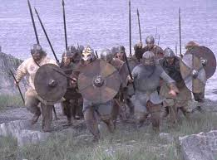
Landing on New Shores
Once the Vikings landed on new shores and encountered their first site of enemies they would not bother to talk
They would give the enemy one chance to take them to their ruler or else they would attack

Slide 36
Viking Warrior Fate
The Vikings believed that their fate had already been decided a long time ago at their birth by the Norns
This meant that they took the attitude of just fight and ask questions later
Their was an old Viking saga about the destiny of Viking warriors

Slide 37
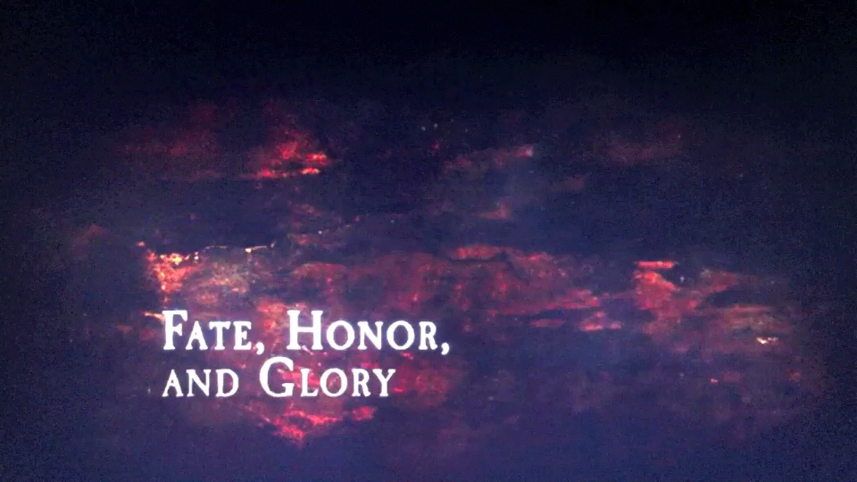
Viking Warrior Fate

Slide 38
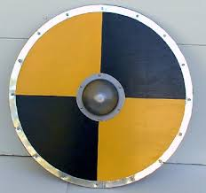
Viking Weapons
Most Vikings were farmers when they were not raiding so any of their farm tools served as weapons
The most important battle weapons however were
  Spear
  Shield
  Battle Axe

Slide 39
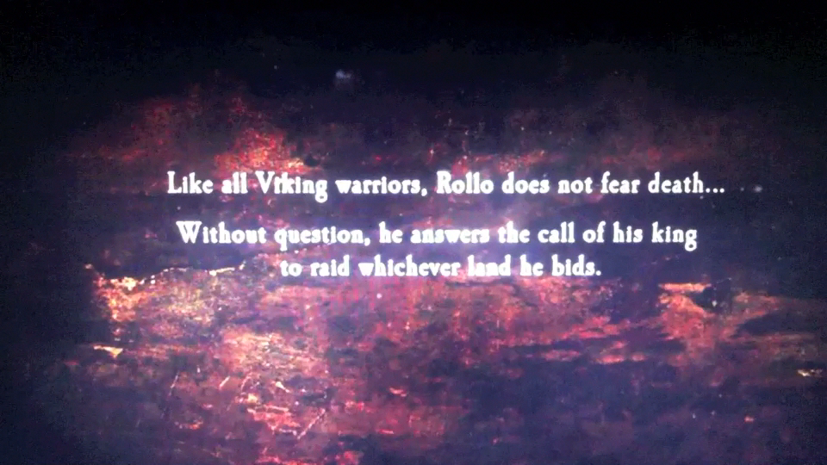
Battle Weapons

Slide 40
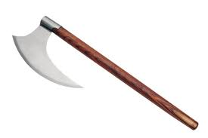
Battle Axe
The Battle was the Viking’s primary and most important weapon
The warriors used the axe in everyday life and trained themselves to fight with it
The axe was a free flowing quick weapon that only the Vikings used

Slide 41
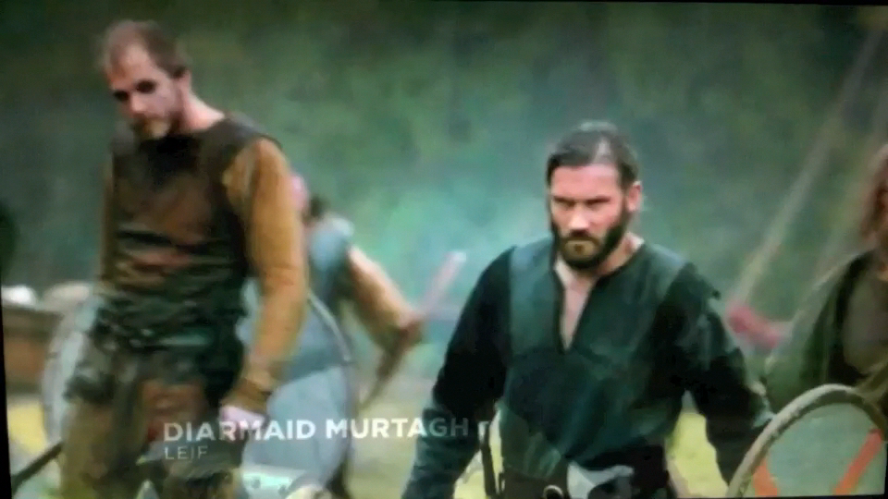
Viking Axe

Slide 42
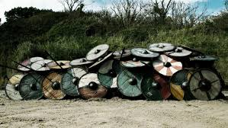
Encountering Enemies
When the Vikings encountered enemies that they needed to fight
They would get into shield formation
The Vikings fought much like the ancient Spartans using a phalanx battle technique as they moved across the battlefield behind their shields
Viking women participated in battle. These women were called shield maidens. Their job was to be behind the men and when a Viking man was killed to pick up the shield to maintain the Phalanx

Slide 43
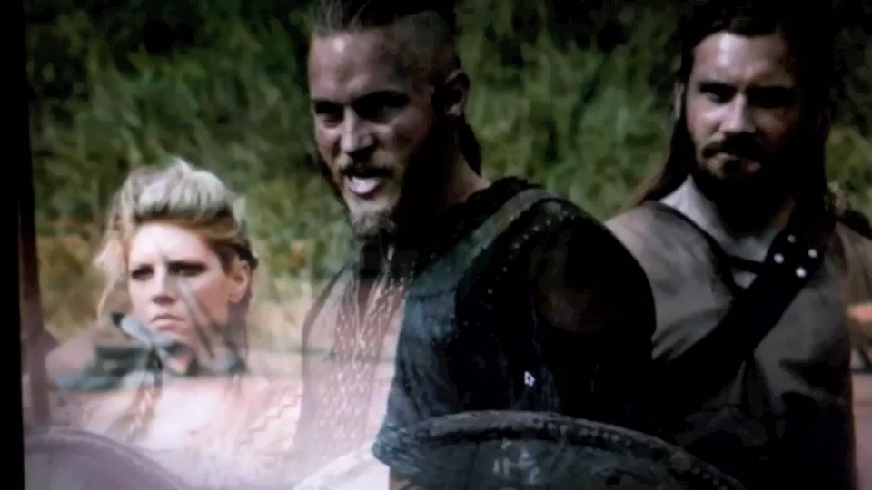
Shield Wall

Slide 44

Shield Maiden

Slide 45
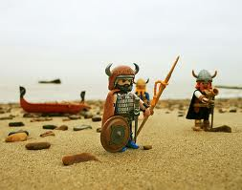
Viking March
From their the Vikings would march up to monasteries & Kingdoms and destroy pillage and plunder
They would then return to their homes with stolen goods and more lands

Slide 46
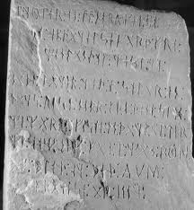
Viking Civilization Decline
Their was not really a Viking decline
Many Vikings went onto to fight for different countries as mercenaries
Leif Ericson went onto to land in Newfoundland in America and eventually the Vikings made their way to Minnesota (Kensington Ruin stone)
William the Conqueror became King of England in 1066

Slide 47
Important Points
6.H.2.3- (Transportation) Viking Longboats provided brand new technology for the Vikings. They were able to travel over huge ocean waves or little inlets to attack
6.G.1.2- (Scarcity of Resources) One of the reasons the Vikings battled other cultures was for land. This is how young Viking men made their worth in society. There was not enough land so they stole more
6.G.1.4- (Invention of Tools) The Vikings adapted their physical environment many ways but one of the most important ways was cutting down trees to make the Viking Longboat. By sacrificing a few trees the Vikings were able to travel and conquer
6.C&G.1.2- (Equality) The Vikings operated on a system of Equality. A great example is how they treated women. Women were listened to and respected but also expected to fight in battle with men
6.C.1.2- (Transformed Society) The Vikings believed very strongly in Odin, Asgard, & Valhalla. They believed they their fate had already been decided for them. Their beliefs shaped their society as they battled for their families & Odin
6.C.1.2- (Transformed Society) The Vikings also transformed the societies they were attacking. Other societies became aware & very afraid of the Vikings. They told stories of the Vikings size & brutality in England

