Slide 1
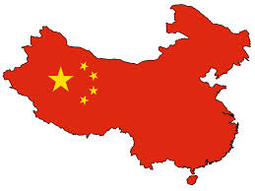
Ancient China
Warring States Period
&
Qin Dynasty (Chin)
221-206 B.C.E.

Slide 2
Essential Standards
6.C&G.1Understand the development of government in various civilizations, societies and regions.
6.C.1Explain how the behaviors and practices of individuals and groups influenced societies, civilizations and regions.
6.H.2 Understand the political, economic and/or social significance of historical events, issues, individuals and cultural groups.

Slide 3
Clarifying Objectives
6.C&G.1.2 Summarize the ideas that shaped political thought in various civilizations, societies and regions (e.g., divine right, equality, liberty, citizen participation and integration of religious principles).
6.C&G.1.1 Explain the origins and structures of various governmental systems (e.g., democracy, absolute monarchy and constitutional monarchy).
6.C.1.2 Explain how religion transformed various societies, civilizations and regions (e.g., beliefs, practices and spread of Buddhism, Christianity, Confucianism, Hinduism, Islam and Judaism).
6.C.1.1 Analyze how cultural expressions reflected the values of civilizations, societies and regions (e.g., oral traditions, art, dance, music, literature, and architecture).

Slide 4
Clarifying Objectives
6.H.2.4 Explain the role that key historical figures and cultural groups had in transforming society (e.g., Mansa Musa, Confucius, Charlemagne and Qin Shi Huangdi).
6.H.2.3 Explain how innovation and/or technology transformed civilizations, societies and regions over time (e.g., agricultural technology, weaponry, transportation and communication).

Slide 5
Essential Questions
What type of POLITICAL THOUGHT was China’s government based on?
What was China’s government structure called?
How did the “Mandate of Heaven” transform how the government of Ancient China?
How did the cultural art of the Terracotta Warriors express what China believed in the afterlife?
How did Qin Shi Huangdi transform Ancient China?
What weapon innovation led to the Unification of all of China?

Slide 6
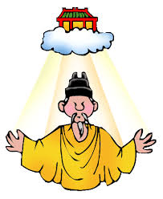
Mandate of Heaven
All beginning & endings of Dynasties are because of the “Mandate of Heaven”
This is basically
Once the Mandate is disobeyed the gods allow the dynasty to be ripped apart and a new one starts
In short be nice & don’t make the gods angry

Slide 7
Mandate of Heaven
Mandate of Heaven was like the MORAL CODE of the Chinese Emperors
All Emperors knew they must follow these Mandate (rules) to have the gods favor them and their empire continue

Slide 8
Essential Questions
Get with a partner and answer…..
How did the “Mandate of Heaven” transform how the government of Ancient China?
What type of POLITICAL THOUGHT was China’s government based on?
What was China’s government structure called?

Slide 9
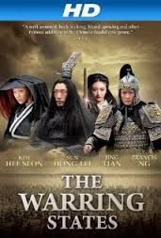
From Dynasty to Warring States
The story of the Qin Dynasty (Chin) starts with the Zhou Dynasty
Zhou Dynasty was the kingdom that came before the Qin Dynasty (Chin)
Everything was going great for the Zhou Dynasty until they decided to disobey the MANDATE OF HEAVEN

Slide 10
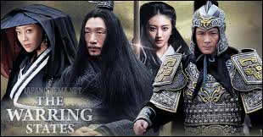
From Dynasty to Warring States
Zhou Dynasty rulers would roast & eat their enemies after victory in battle
This was not looked favorably on by the gods
Zhou Dynasty was punished leading to the Zhou Dynasty kingdom to broken into 7 different parts that created their own kingdoms

Slide 11
Warring States
These 7 different kingdoms all wanted power
This led to them killing each other and making war on each other for over 500 hundred years
Until finally one of them won ending the Warring States Period

Slide 12
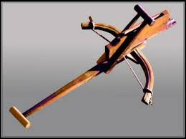
Chinese Crossbow (Weapon Innovation)
Warring States period ends because of the Chinese Crossbow
Qin Shi Huang was able to begin to MASS PRODUCE Chinese Crossbows
Standardized interchangeable parts
Each crossbow was built exactly the same way

Slide 13
Chinese Crossbow (Weapon Innovation)
This made it so there was extra parts
It was easy to make
It was fast to produce
Once a warrior learned how to use one they could use any of them
http://www.youtube.com/watch?v=eaHREgVK_G8
23:05-29:16

Slide 14
Essential Questions
Get with a partner and answer…..
What weapon innovation led to the Unification of all of China?

Slide 15
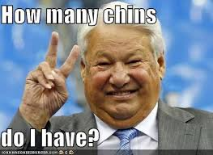
Qin Dynasty (Chin)
The kingdom that beat the other 6 kingdoms was led by a man named Qin Shi Huang
Qin Shi Huang then befriends the other 6 Warring Kingdoms and UNIFYIES CHINA

Slide 16
UNIFYING CHINA
He UNIFIES CHINA together so instead of having separate city sates
They are now ONE CHINA
This Unification marks the beginning of CHINA
http://www.youtube.com/watch?v=eaHREgVK_G8
28:40-29:48

Slide 17
Essential Questions
Get with a partner and answer…..
How did Qin Shi Huangdi transform Ancient China?

Slide 18
Great Wall of China
To defend his empire Qin Shi Huang begins construction on one of the most famous pieces of architecture in world history
The Great Wall of China
Construction of the wall kills over 1 million people
Qin Shi Huang never sees it completed
http://www.youtube.com/watch?v=eaHREgVK_G8
29:50-30:48

Slide 19
Qin Shi Huang Gets Sick
Qin Shi Huang takes mercury pills that were given to him by his doctor to make him a god are destroying his brain & body
At age 49 Qin Shi Huang China’s First Emperor dies

Slide 20
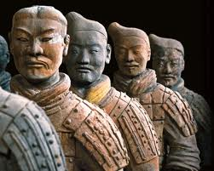
Qin Shi Huang’s Tomb
The Emperor is buried in a tomb that stretches 20 square miles
With him are the wives that never bore him any children
Also hundreds of craftsman
Army of 8000 handcrafted life sized soldiers called Terracotta Warriors

Slide 21
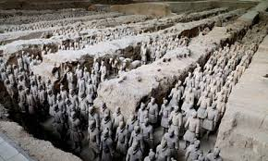
Qin Shi Huang’s Tomb
Chinese believe that you will be able to use what you are buried with in the afterlife
They were very much like the Egyptians in this regard
Qin Shi Huang’s was taking everything so he could be the Emperor of the Afterlife

Slide 22
Terracotta Warriors
8000 warriors created just for the Emperor
These 8000 warriors would be his army in the afterlife
Each warrior is handcrafted and unique
http://www.youtube.com/watch?v=eaHREgVK_G8
30:50-33:40
http://www.history.com/topics/great-wall-of-china/videos/tomb-of-chinas-first-emperor?m=528e394da93ae&s=undefined&f=1&free=false

Slide 23
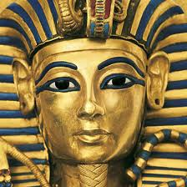
Compare & Contrast (Egypt & China)
Though these two cultures were thousands of miles away from each other they had many of the same religious beliefs
Both were polytheistic
Both believed in an afterlife that you could take things from Earth to

Slide 24
Essential Questions
Get with a partner and answer…..
How did the cultural art of the Terracotta Warriors express what China believed in the afterlife?

Slide 25
EOG Questions
Findings From Ancient Burial Sites:
•About 8,000 life-size, terra-cotta clay soldiers were found about onemile east of the first emperor of China’s tomb.
•Tombs in Egypt were found with tools, make-up, and clothing.
Based on the facts above, how were the beliefs of these societies similar?
A) The rulers of ancient civilizations were buried in pyramids.
B) Ancient people across civilizations did not appreciate the arts.
C) The rulers of ancient civilizations appeared modest or humble in death.
D) Ancient people across civilizations believed in preparing for life after death.

Slide 26
Important Points
6.C&G.1.1 (Government Structure) China operated under a Theocracy
6.C&G.1.2 (Political Thought) China’s POLITICAL THOUGHT was based RELIGIOUS PRINCIPLES of Confucianism
6.C.1.1 (Cultural Expressions) China’s Emperor EXPRESSED his beliefs about the after life by building the Terracotta Warriors to be his army in the afterlife
6.C.1.2 (Religion) Mandate of Heaven was based on Confucianism which was China’s religion & moral code
6.H.2.4 (Key Historical Figure) Qin Shi Huangdi TRANSFORMED his country by UNITING China for the first time
6.H.2.4 (Innovations & Technology) Weapons: Qin Shi Huangdi used CROSS BOWS to win in the Warring States Period

