Slide 1
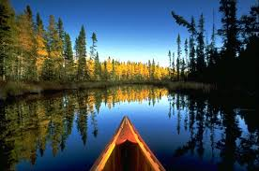
Earth Systems & Structures
Stewardship of the Earth

Slide 2
Essential Standards
6.E.2 Understand the structure of the earth and how interactions of constructive and destructive forces have resulted in changes in the surface of the Earth over time and the effects of the lithosphere on humans.

Slide 3
Clarifying Objectives
6.E.2.4 Conclude that the good health of humans requires: monitoring the lithosphere, maintaining soil quality and stewardship.

Slide 4
Essential Questions
Why is it important to monitor the quality of our soil, water & air?
How have HUMANS affected the environment when it comes to the quality of our soil?
What are some things that we can do to improve the quality of our PEDOSPHERE?

Slide 5
Good Health of All HUMANS
To continue to ensure good health of the Human Race we must do 3 things…
Take care of our LITHOSPHERE/PEDOSPHERE
Maintain good SOIL QUALITY
Stewardship

Slide 6
Lithosphere
Lithosphere is the crust of the Earth
Lithosphere extends from the upper most part of the Mantle to the Crust of the Earth
Lithosphere is where all plants and animals live

Slide 7
Pedosphere
The Pedosphere is the upper topmost part of the Lithosphere that interacts with the atmosphere, hydrosphere
The Pedosphere is where all SOIL FORMATION takes place because of the atmosphere, hydrosphere & lithosphere coming together
http://www.youtube.com/watch?v=Tvu0-a1HUXc

Slide 8
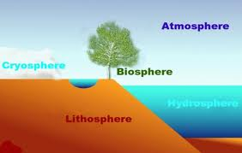
Monitoring the LITHOSPHERE/PEDOSPHERE
Monitoring the Lithosphere is so important because it is where the Pedosphere is located
Monitoring the Pedosphere is so important because it is where SOIL FORMATION takes place

Slide 9
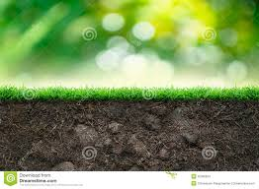
Soil Quality
Maintaining good SOIL QUALITY is so important because plants grow in Quality soil ONLY
Plants are the beginning of all Ecosystems and without plants we would all DIE
Good SOIL QUALITY = MORE PLANTS = LIFE

Slide 10
Essential Questions
Get with a partner and answer….
Why is it important to monitor the quality of our soil, water & air?

Slide 11
Killing Me Softly
For some time now HUMANS have been affecting the Lithosphere/Pedosphere which is affecting the SOIL QUALITY
Logging
Pollution
Carbon Emissions
http://www.youtube.com/watch?v=3zyizEz9XUs

Slide 12
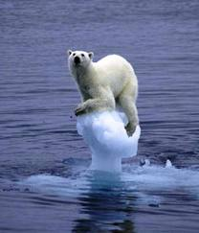
Logging
Logging has led to DEFORESTATION or cutting down of all the trees
This has led to all the good soil which is located on the top to be washed away when the rains come
Nothing can grow there anymore

Slide 13
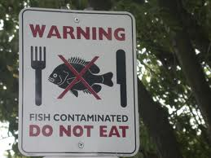
Pollution
Humans have polluted the Earth more than we can even imagine
It is killing the Lithosphere & Pedosphere
Pollution…
Puts bad gasses into our atmosphere causing acid rain
Covers up land that could be used to grow crops
Contaminates water so animals can’t live in the ocean & we can’t drink the water

Slide 14
Carbon Emissions
Carbon Emissions come from factories & cars
They are the main cause of Global Warming
The Earth’s Climate is getting warmer causing..
Loss of habitat for animals
Flooding from polar ice caps melting

Slide 15
Essential Questions
Get with a partner and answer….
How have HUMANS affected the environment when it comes to the quality of our soil?

Slide 16
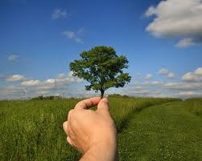
Stewardship
Humans can fix this it is not too late
We must practice good STEWARDSHIP
Stewardship is the action of protecting & taking responsibility for something

Slide 17
What can we Do?
We must save our SOIL
Quality SOIL is the key to good Human Health
So what can we do…
Rotate Crops
Soil Conservation
Not Pollute
Plant Trees
Monitor the Lithosphere

Slide 18
Stewardship
People can practice good Stewardship by…
Planting Trees
Stop Pollution
Rotating Crops
Soil Conservation
Monitor the Lithosphere

Slide 19
Planting Trees
Planting trees is a great way to practice Stewardship
Planting trees will ensure that the top soil will stay and not be eroded away

Slide 20
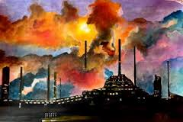
Stop Polluting
Cutting Pollution is a great way to practice Stewardship
Pollution is affecting Soil quality because factories & cars are putting higher amounts of acid in the air
Acid comes down in Acid Rain which pollutes the soil & kills plants & crops

Slide 21
Crop Rotation
Crop Rotation is a great way to practice Stewardship
Rotating Crops will make sure there is always enough nutrients in the soil

Slide 22
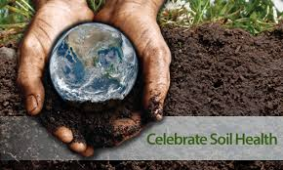
Soil Conservation
Soil Conservation is a great way to practice Stewardship
Saving the soil we have is what Soil Conservation is
We can do this by putting Earth Worms in the soil & also composting soil

Slide 23
Monitor the Lithosphere
Monitoring the Lithosphere is a great way to practice Stewardship
Monitoring the Lithosphere saves soil because the pollutants will not get into the air & water if we monitor the Lithosphere

Slide 24
Essential Questions
Get with a partner and answer….
What are some things that we can do to improve the quality of our PEDOSPHERE?

Slide 25
EOG Questions
Farming uses the land and soil to grow crops.
How can farmers maintain good, healthy soil?
Why is it important that farmers practice good stewardship of their land?

Slide 26
Important Points
Good Health of Humans going forward depends on
Monitoring the LITHOSPHERE/PEDOSPHERE
Good SOIL QUALITY
Stewardship
Humans have NEGITIVLY affected the Earth
Stewardship is the action of protecting & taking responsibility for something
5 ways to practice good Stewardship
Planting Trees
Stop Pollution
Crop Rotation
Soil Conservation
Monitoring the LITHOSPHERE

