Slide 1
Silk Road
World’s Most Famous Trading Network
1200-1453 A.D.

Slide 2
Essential Standards
6.E.1 Understand how the physical environment and human interaction affected the economic activities of various civilizations, societies and regions.
6.C.1 Explain how the behaviors and practices of individuals and groups influenced societies, civilizations and regions.

Slide 3
Clarifying Objectives
6.E.1.1 Explain how conflict, compromise and negotiation over the availability of resources (i.e. natural, human and capital) impacted the economic development of various civilizations, societies and regions (e.g., competition for scarce resources, unequal distribution of wealth and the emergence of powerful trading networks).
6.C.1.2 Explain how religion transformed various societies, civilizations and regions (e.g., beliefs, practices and spread of Buddhism, Christianity, Confucianism, Hinduism, Islam and Judaism).

Slide 4
Essential Questions
How did the availability of certain resources affect the development of powerful trading networks like the Silk Road?
Why does a powerful trading network like the Silk Road develop?
What does SCARCITY OF RESOURCES mean?
How did the emergence of the Silk Road lead to the spread of different world RELIGIONS?

Slide 5
Scarcity of Resources
Silk Road began because of SCARCITY OF RESOURCES
All powerful trading networks begin because Certain resources were not available in all areas.
Scarcity of Resources means that some cultures have extra resources & some don’t have any so they trade
http://www.youtube.com/watch?v=dj2cFelZWo0
28:57-30:15

Slide 6
Silk Road
Silk Road was a TRADING NETWORK that opened up the SCOPE of trade in the world
Many cultures traded many goods along the Silk Road
The most common good traded was SILK
http://www.history.com/shows/mankind-the-story-of-all-of-us/videos/mankind-the-story-of-all-of-us-the-silk-road?m=5189719baf036&s=All&f=1&free=false

Slide 7
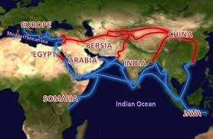
Not a Road/Not made of Silk
The silk road was not a road & it was not made of silk
It was a trading network that stretched all the way from the Mediterranean Sea all the way to China

Slide 8
Scope of Trade
Before the Silk Road cultures would only trade with other cultures that were close to their civilization
The Silk Road Trading Network allowed trade between people in the FAR EAST all the way to the MEDITERANIAN and anywhere in between
http://www.youtube.com/watch?v=dj2cFelZWo0
25:00-27:20

Slide 9
Essential Questions
Get with a partner and answer…
What does SCARCITY OF RESOURCES mean?

Slide 10
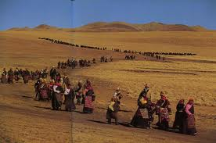
Nomads get Rich
Silk Road was run by NOMADS who would travel from place to place on camels with the goods on the camels back
Nomads would go from trading port to trading port passing goods or selling goods and marking up prices
Here is how it worked

Slide 11
Process of the Silk Road Trade
A Chinese Silk Nomad would buy some silk from a silk maker for $10 in China
He travels to the nearest trading center in India along the Silk Road and sells the Silk for $50 to Indian Nomad and travels back to China to buy more Silk

Slide 12
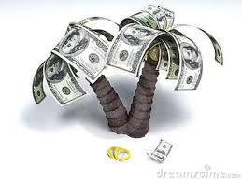
Process of the Silk Road Trade
The Indian Nomad travels along the Silk Road to Arabia to the nearest trading center and sells the Silk for $100
The Indian Nomad travels back to India to wait for the Chinese silk trader to come back with more silk the next week

Slide 13
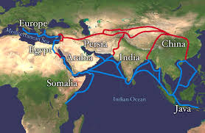
Process of the Silk Road Trade
The Arabian Nomad carries the silk along the Silk Road to the nearest Mediterranean trade center and sells the silk for $75
The Arabian Nomad travels back to Arabia to wait for the Indian Nomad to come back with more silk

Slide 14
Process of the Silk Road Trade
The Mediterranean Merchant brings the silk to his silk store and marks the price up to $100 and sells the silk

Slide 15
Mediterranean Countries Exports
The Mediterranean Countries exported…
Olives
Olive Oil
Wine

Slide 16
Arabia Countries Exports
The Arabian Countries exported…
Incenses
Spices
Salt
Tortoise Shells

Slide 17
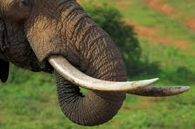
India Countries Exports
The India Countries exported…
Ivory
Cotton Textiles

Slide 18
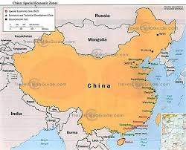
China Countries Exports
The Chinese Countries exported…
Silk
Jade
Silver
Iron

Slide 19
Essential Questions
Get with a partner and answer…
How did the availability of certain resources affect the development of powerful trading networks like the Silk Road?

Slide 20
Regular People (Nomads) Got Rich
This process allowed regular people who were not kings or queens to get rich
You no longer had to be part of a royal family or work directly for a King or Queen

Slide 21
Story of Marco Polo
Man who had made it all the way from the Mediterranean to China
Travels of Marco Polo was written by Rustacello to tell of the travels of Marco Polo
http://www.history.com/topics/marco-polo/videos#marco-polo
http://www.youtube.com/watch?v=pfjpwbCUT2Q
34:08-34:40

Slide 22
Silk Road Affects EVERYONE
Silk Road affected everyone in the world in 4 ways…
Wider Economic Impact
Spread Religion
Spread Disease
Sparked Exploration

Slide 23
Wider Economic Impact
Silk Road led to a Wider ECONOMIC Impact across the world
Even though most people couldn’t afford silk
More people devoted their lives to produce goods (like silk) instead of other things (soldiers)

Slide 24
Spread of Religion
Trading leads to traveling to new places
Traveling to new places leads to spread cultures to new places in the world
The largest part of culture that is spread through trade is a culture’s RELIGION
http://www.youtube.com/watch?v=dj2cFelZWo0
27:20-29:00

Slide 25
Essential Questions
Get with a partner and answer…
How did the emergence of the Silk Road lead to the spread of different world RELIGIONS?

Slide 26
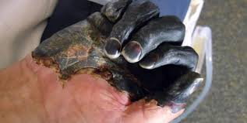
Spread of Disease
Silk Road introduced new diseases as well
For instance the Bubonic Plague had started in China centuries ago so the Chinese had immunities to it
When they traveled to new places to trade goods they were carriers of the disease and it spread to people who didn’t have immunities

Slide 27
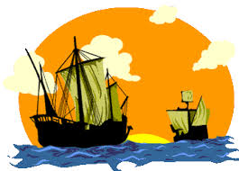
Sparked Exploration
Lastly the Silk Road got people thinking…
What if there is a shorter distance to get to China & India then to walk these long trade routes
Explorers enter the scene for the first time wanting to sail boats

Slide 28
EOG Questions
Which was a long-term effect of ancient trade routes?
A) the spread of religions throughout the trade routes
B) the spread of unifying systems of government
C) colonization of weaker nations along the trade routes
D) use of silk throughout ancient and modern societies

Slide 29
EOG Questions
Why did trading networks like the Silk Road develop?
A) Certain resources were not available in all areas.
B) The trails were used for communication between groups.
C) People wanted to take land and to keep control of that land.
D) Travelers enjoyed exploring nearby lands after trading for spices.

Slide 30
Important Points
6.E.1.1 (Powerful Trading Networks) The Silk Road developed because certain resources are not available in all areas
6.E.1.1 (Powerful Trading Networks) Scarcity of Resources is when resources are only available in certain areas
6.C.1.2 (Spread of Religion) The Silk Road spread religion by having new people in new lands sharing their religion to new people

