Slide 1
Project Unveil
Early America
Choose Your Own Adventure
Let the Competition Begin

Slide 2
Project Objective/Project Purpose
Be able to tell me what standards this project hits
Be able to tell me what your groups Essential Question is
Be able to tell me how each portion of the project answers your Essential Question

Slide 3

Project Specifications
Model (Mini Group)
Poster Board (Mini Group)
Website (Mini Group)
Research Paper (Whole Group)
Presentation (Whole Group)

Slide 4

Padea Seminars
We will use whole group Padea Seminars so that everyone is on the same page for each phase of the project
Our Padea Seminars will meet either before school or at recess time
If you choose to work on your project during recess time let me know so we can set something up

Slide 5
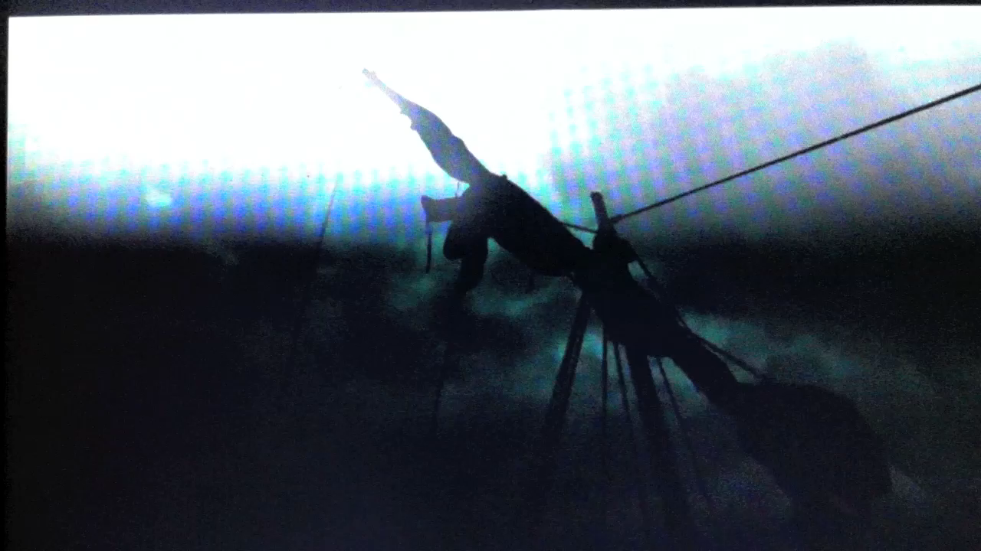
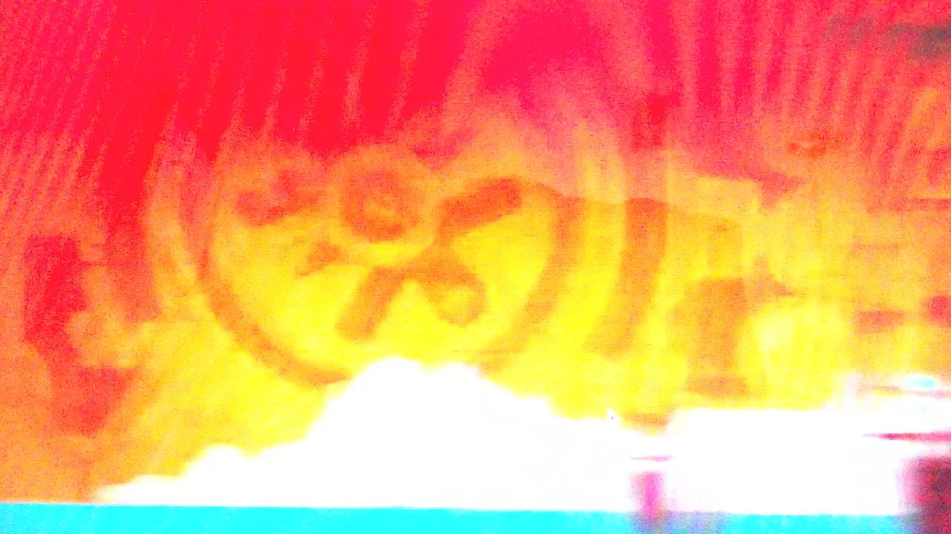
Your Choice/Your Project
Vikings
Aztecs

Slide 6
Model (Mini Group)
Detailed Model of the Aztec City of Tenochtitlan
Detailed Model of Viking Longboat
Your group will have one meeting with Mr. G to discuss building of the model
You will have 2 weeks to construct your models
Research what is important to put into your model
Decide how large you want your model
Figure out exact dimensions of the model how length, width, height
Draw a diagram of each part of your model
Decide who will build each part of your model

Slide 7
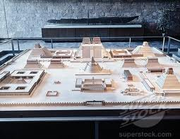
City of Tenochtitlan Model
(Mini Group)
Templo Mayor
Market Place
Chinampa Grid System
Lake Taxacco
Royal Palace of Montazuma
Pyramids of the Sun & Moon

Slide 8
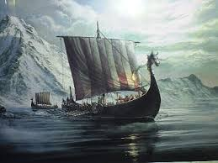
Viking Longboat Model
(Mini Group)
Hull of the ship
Mast & Sail
Shields & Ores
Deck & Seats (inside of the ship)
Head Piece (Bow piece)
Tail Piece (Stern piece
Color of the ship (painting of the ship)
Pictures & Video (Documentary)

Slide 9
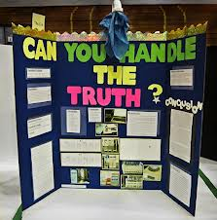
Poster Board
(Mini Group)
Look at our Social Studies Standards
Create an Essential Question
Create a Title
Create at least 6 pictorial representations answering the essential question
Create caption note cards to describe how the picture/scenario answers the Essential Question

Slide 10
Weebly Group Website
Home Page: (1) List your group members and tell a little bit about them (2) Take a picture of each group member and post it on the website (3) Title the website (4) Insert a picture for your groups website
Create a tab with the (1) name of your project (2) Box with all standards the project covers (3) 1 paragraph description of the project
Create a “Padea Seminar” sub tab with (1) 1 paragraph description of what a Padea Seminar is and how we used it in our project (2) picture and description of our Padea Seminar for building of our model (3) picture and description of our padea seminar for our poster board (4) picture and description of our padea seminar of writing our paper

Slide 11
Weebly Group Website
Create a “Model” subtab with (1) Description of the model (2)1 paragraph description of why was this important to the culture (3) At least 2 pictures of students building the model (4) Picture of the completed model
Create a “Poster Board” subtab with (1) Essential Question listed on top of the subtab (2) 1 Paragraph description on how the poster board answered the Essential Question (3) At least 2 pictures of students creating the poster board (4) Picture of the finished poster board
Create a “Presentation” subtab with (1) at least 2 pictures of students presenting the model (2) At least 2 pictures of students presenting the poster board (3) At least 2 pictures of students presenting the website

Slide 12

Research Paper
Not going to be short (Quality)
It will be the best research paper that you have ever written period!!
Research paper will contain 4 parts…
  Intro paragraph
  Body
  Conclusion
  Works Cited/Bibliography

Slide 13
Research Paper (Content)
Your Research Paper will address
  Intro paragraph explaining the (1) Project Objective/ Purpose of the project and (2) what standards the project covered and (3) what your group’s Essential Question was
  (1) Explain all Language Arts standards in the project (2) how your group used those standards in the project (3) and how the project helped you understand them
  (1) Explain all Social Studies standards you used in the project (2) how your group used those standards in the project (3) and an example of how the project helped you understand them

Slide 14
Research Paper (Content)
(1) Explain the model that your group built (2) What is it? (3) What was it used for (4) Was it fun to build? (5) How does the model relate to the Social Studies standards
(1) Explain the poster board (2) Tell how the Essential Question was answered by each of the pictures and captions
(1) Explain what 21st skills are and why they are important to your future (2) Explain how your group built the website & how that relates to 21st century skills(3) Explain the process of creating the group’s website (4) Explain how your groups website covers the Project Objective/Project Purpose

Slide 15
Research Paper (Content)
(1) Explain Padea Seminars (2) Explain how your project used Padea Seminars to help everyone have an understanding of all phases of the project
(1) Explain what problems came up as your group was creating their projects (2) Explain the pacing of the project and how we used a Tiki-Toki to manage our time (3) Explain if you were stretched for time at all (4) Give details about how working in this group to create this project is relevant to the real world

Slide 16
Research Paper (Content)
(1) Did your group enjoy working on this project or did your group feel this was a waste of time (2) How did Project Based Learning help you understand the Language Arts & Social Studies standards better than paper & pencil (3) Give a detailed example of how you have a clear understanding of the Project Purpose/Project Objective
Conclusion paragraph (1) Restate the Project Objective/Project Purpose (2) Restate the Language Arts & Social Studies standards your project covered (3) Make an overall general statement that answers you Essential Question
(1) Create a Works Cited/Bibliography page using all the websites & books that you used throughout the project

Slide 17
Research Paper (Organization)
(1) Gather all of your whole group’s notes from all phases of the project [this includes Cornell Notes, Brainstorming Notes, Padea Seminar Meeting Notes, pictures/diagrams & outlines] (2) Organize the notes by date (3) Put all notes into a plastic sleeve (4) Label this section Prewriting
(1) Get your original rough draft that your group wrote (2) put it in a plastic sleeve (3) Label it Drafting/Rough Draft
(1) Get your Revised/Proofread handwritten copy of your Research Paper and (2) put it into a plastic sleeve (3) Label it Revising/Proofreading

Slide 18
Research Paper (Organization)
(1) Get your final typed published copy of your research paper and put it into your binder
(1) Create a Cover Page (2) Create a Table of Contents (3) Create an Abstract (states the Essential Question, describes the project)
Put the Research Paper in this order (1) Cover Page (2) Table of Contents (3) Abstract (4) Final Copy of Research Paper (5) Revised/Proofread Plastic Sleeve with (6) Drafting/Rough Draft Plastic Sleeve (7) Prewriting Plastic Sleeve

Slide 19
Presentation
Every Student will present a portion of this project
You will present the portion that you worked on
Some of you will have to present on more than one content
You will all make note cards to help you
You need to decide what order you will all go in

Slide 20
Presentation
Each person must…
    List the Language Arts & Social Studies Standards they learned about
    Tell what portion of the project they did and how it relates to the Social Studies Common Core Standards
    Tell what portion of the Research Paper they worked on and how it relates to the Language Arts Common Core Standards
    Tell how your portion of the project answered the Essential Question
    Tell if you like Project Based Learning compared to Paper & Pencil Learning and why

Slide 21
Presentation
Each Group must also select one group member to…
  Introduce the project
  List the Language Arts Standards
  List the Social Studies Standards
  Introduce the Project Objective/Project Purpose
  What was it like to work in whole groups and mini groups
  Explain the Padea Seminars
  Tell why learning 21st century skills are important and how your group incorporated 21st century skills

Slide 22
Presentation
If your group does the best job and wins this competition all the members of your group will receive a prize
I will not be deciding who wins the competition
You will be presenting your projects to…
  Your Classmates
  Your Parents
  Your Teacher
  Mr. Lassiter
  Professors from East Carolina University

Slide 23
Please Read Carefully!
If you are being
  Loud
  Off Task
  If I hear that you are screwing around in the hallway or library
  Arguing with your group members
If you are warned more than 3 times you will be taken off the project and sent to another room while we are doing the project
You will do work out of the Social Studies book along with Reading Comprehension Passages for your grades while everyone else is working on their projects
I will have very high expectations for you to follow those 4 simple rules. I will kick you off the project in order for the rest of your group to complete it
If any of your group members are kicked off the project you will be disqualified from winning the group prize at the end

