Slide 1
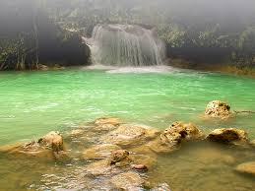
Juan Ponce DeLeon & The Fountain of Youth
The First Conquistador
1506-1513

Slide 2
Common Core
5.H.1.1- Evaluate the relationships between European explorers (French, Spanish and English) and American Indian groups, based on accuracy of historical information (beliefs, fears and leadership).
5.C.1.2 Exemplify how the interactions of various groups have resulted in borrowing and sharing of traditions and technology.

Slide 3
I Will Know
5.H.1.1- How European explorers and American Indian groups interacted with each other.
5.C.1.2- Examples of borrowing and sharing of traditions and culture (Legend of the Fountain of Youth)

Slide 4
I Will Understand
5.H.1.1- Relationships between different cultural groups can have both positive and negative effects based upon their interactions with one another.
5.C.1.2- Interactions between cultural groups may lead to the borrowing and sharing of traditions and technology.

Slide 5
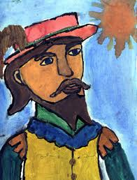
Juan Ponce DeLeon
Seeker of a Spanish Coat of Arms
Wanted to make a name for himself and return to Spain a famous Conquistador
He was businessman

Slide 6
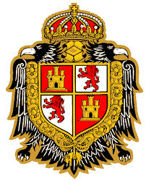
Spanish Coat of Arms
Receiving a Royal Spanish Coat of Arms was a huge honor
The coat of arms came directly from the King & Queen of Spain
It gave your family constant protection forever from the King & Queen of Spain
It could also be passed down from one generation to another so that it also protected your lineage

Slide 7
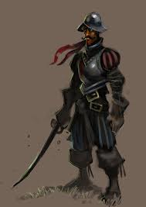
Conquistador
Tough brutal men who carved a kingdom in the New World for Spain
They were horse riding, sword wielding mercenaries
They wanted action, money, and fame
Juan Ponce DeLeon was the first Spanish Conquistador

Slide 8
Conquistador
It was the goal of every young man in Spain to become a great Conquistador
Since the discovery of the New World every young man wanted to become rich off of it
There were many legends and stories of riches beyond belief

Slide 9
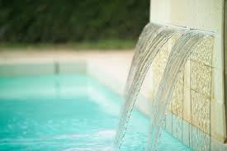
“If anyone has tasted of the Fountain he will as long as he lives be as a man of thirty years”

Slide 10
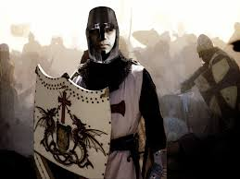
Driving out the Muslims
The story begins with King Ferdinand and Queen Isabella of Spain launching a conquest to drive out all Muslims in the Spanish Kingdom
Juan Ponce DeLeon was a Spanish soldier and Catholic who rode with the Spanish armies of 10 years
For centuries the Christians (Catholics) had been fighting the Muslims in a Holy War

Slide 11
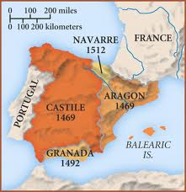
Fall of Granada
The Spanish troops had captured all cities of Muslim stronghold except the city of Granada by 1491
On January 2nd, 1492 the Spanish forces defeated the Muslims in the Battle of Granada
As Ponce DeLeon rode in celebration through the city he met a man named Cristobol Colon

Slide 12
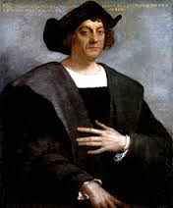
Cristobol Colon
Cristobol Colon was better known as Christopher Columbus by you
In August of 1492 in set off with his 3 ships and landed on an island 6 weeks later
The next year he brought back with him gold & natives

Slide 13
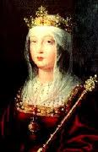
Queen Isabella
The natives that Colon brought back were quickly baptized into the Christian faith
Queen Isabella then insisted that any expedition to the New World had to be for
Find the Northwest Passage to India
Gold
5.H.1.1- Convert the Natives to Christianity

Slide 14
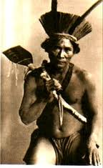
Native American Tribes
There were two types of Indian tribes
5.H.1.1- Arawak Indians were very gentle people that were willing to give and share with the White people
5.H.1.1- Carib Indians were a warrior people that were technologically advanced in weapons and fighting techniques

Slide 15
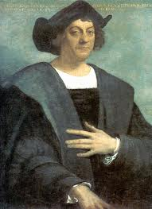
Colon 2nd Mission
Juan Ponce DeLeon quickly volunteered for Colon second mission
They set off in September of 1493 and arrived to the New World in November of 1493
Columbus went ashore to start a colony he would call Isabella named after the Queen of Spain

Slide 16
Discovery of Gold
Shortly after the colony was starting to be built gold was discovered in some of the rivers inland on the island
Columbus set up expeditions to find gold
Columbus built gold mines to try to extract gold from the ground
5.H.1.1- The Native Americans became angry with the conquistadors and attacked them

Slide 17
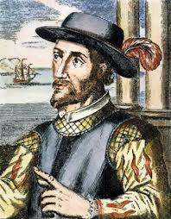
DeLeon put in Charge
To defeat the natives Colon put Juan Ponce DeLeon in charge because Colon knew of his war man ship from fighting with him at Granada
Soon Ponce DeLeon had crushed the native Americans
5.H.1.1- Columbus gave all Native Americans who lived on the island to Juan Ponce DeLeon

Slide 18
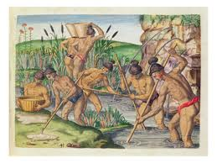
The Business of Mining
5.H.1.1- Ponce DeLeon realized that by selling his Native Americans back to Columbus as mine workers he could make a lot of money
5.H.1.1- If the Native Americans tried to escape they were tortured and killed

Slide 19
Ponce DeLeon’s Brutality
5.H.1.1- By 1497 only three years after DeLeon had arrived 3 million Native Americans had been killed
This was a result of
Disease
Starvation
Torture/Murder (DeLeon)

Slide 20
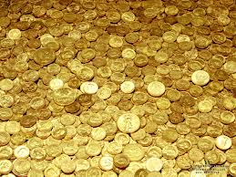
Ponce DeLeon Becomes Rich
Juan Ponce DeLeon has become rich through his human trafficking business selling Indians as mine workers
He still wants more. It becomes more about fame than riches from this point on for Juan Ponce DeLeon
He wanted to start his own colony so he could be governor

Slide 21
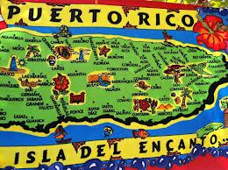
Island of Borinquen
August 12th, 1508 DeLeon set sail for the Island of Borinquen
When he arrived in Borinquen he met with the elder Arawak Chief
The chief agreed to come to Espanola to meet with the Spanish governor
The governor of Espanola met the Arawak Indian chief and granted DeLeon permission to start his own colony on Borinquen

Slide 22
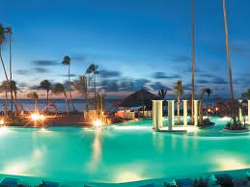
Puerto Rico
March 1509 DeLeon gets into a legal battle with the new governor of Espanol Diego Colon (Christopher Columbus son)
Diego Colon argued that since Christopher Columbus originally landed on the island of Borinquen it now belonged to Diego Colon
King Ferdinand & Queen Isabella ruled that DeLeon should keep the island

Slide 23
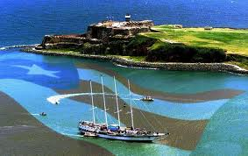
Puerto Rico
Not only did they rule he should keep the island but they gave DeLeon
More settlers
More goats, chickens, pigs
To top everything off King Ferdinand & Queen Isabella granted Juan Ponce DeLeon a Royal Coat of Arms
In show of appreciation and celebration DeLeon renamed the island Puerto Rico meaning Rich Harbor

Slide 24
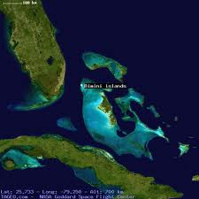
Island Bimini
After much success at Puerto Rico DeLeon once again wanted more
He had heard about a Fountain of Youth on the island of Bimini
He wanted to be the first European to discover the fountain

Slide 25
The Legend Fountain of Youth
5.C.1.2- The Legend of the Fountain of Youth exists from long ago in many cultures
Greek historian Herodotus first mentioned it in 485 B.C. placing it somewhere in Ethiopia
The Alexander Romances talk about Alexander the Great and his servant crossing the desert of darkness to find it
It also appears in Middle Eastern Legends of Al Kidhr a sage who also appears in the Quran

Slide 26
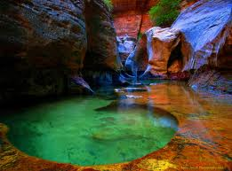
The Legend Fountain of Youth
5.C.1.2- The Arawak Indians of the Bahamas also carry the legend stating that the fountain exists on the island of Bimini
5.C.1.2- The Legend says that the Fountain of Youth will make old people young again if you bathe of drink from it

Slide 27
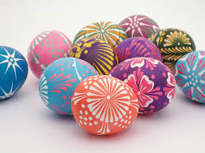
Ponce Sets Sail
Ponce and his men set sail for the island of Bimini which an Awarak chief told him was Northwest of Puerto Rico
The fleet celebrates Easter Sunday at sea on March 27th, 1509
A harsh wind blowing from the east blows the crew westward

Slide 28
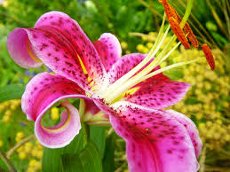
Florida
April 3rd, 1509 DeLeon spots land
Ponce realized by the terrain of the new land that this was not the land of Bimini for which he was looking
He claimed it for Spain anyway
Because it was Easter Week and the week of Pasqual de Florida (Festival of Flowers) he named the new land Florida

Slide 29
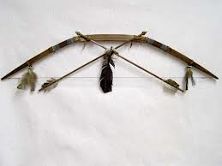
Natives Attack DeLeon
5.H.1.1- The Natives could keep an arrow in the air constantly because they shot them so fast
They also dipped their arrowheads in Rattlesnake poison
DeLeon and his men retreat and return to Puerto Rico

Slide 30
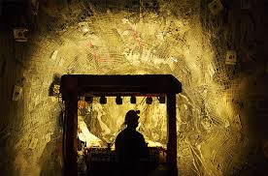
DeLeon Seeks more Riches through Mining
When DeLeon returns to Puerto Rico he decides to seek more riches in Gold Mining
But he finds the Indian populations are gone
They had all died from starvation or fled to different islands

Slide 31
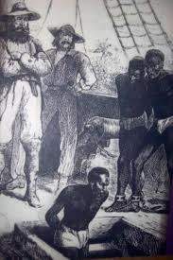
First African Slaves
The first African slaves began arriving around 1510
This was the first time African slaves were introduced to the west
Spanish Conquistadors purchased these African slaves because the Native American population began starving themselves so they would not have to work in the mines anymore
The African slaves were brought in to work in the gold mines

Slide 32
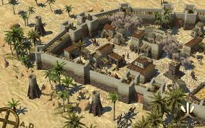
DeLeon Dreams of a New Florida Colony
After DeLeon discovers that the Native American populations have been decimated by Smallpox he moves his concentration
He now begins to plan for a new colony in Florida in which he will be Governor

Slide 33
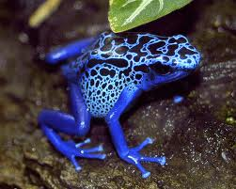
Juan Ponce DeLeon
DeLeon returns to Florida for a new Spanish settlement
5.H.1.1- Everything is going great for the first 5 months until the Natives attack unexpectedly
During the fighting DeLeon is hit in the leg with a poisonous arrow
His men rush him away from the fighting but it is no use Juan Ponce DeLeon is dead

Slide 34
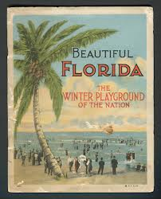
In The End
In the end Juan Ponce DeLeon never does find the fabled Fountain of Youth
He does however colonize Puerto Rico which is still a U.S. Territory to this day
He also discovers and names Florida

Slide 35
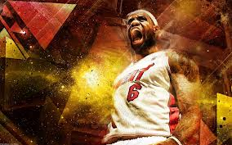
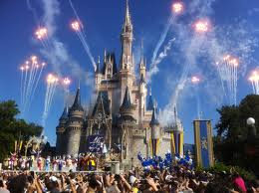
Florida Today

Slide 36
Important Points
The interaction between the Native Americans and DeLeon (Spanish Conquistador) had DeLeon believe in the Fountain of Youth
DeLeon’s relationship with the natives was not a good one. He enslaved the natives so he could get rich
DeLeon and his men were responsible for 3 million Native American deaths
DeLeon was the first Conquistador
DeLeon tries to find the Fountain of Youth
DeLeon discovers Florida
First African American slaves are brought to the west in 1510

