Slide 1
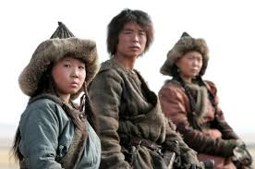
The Mongols
1206-1368 A.D.

Slide 2
Essential Standards
6.H.2Understand the political, economic and/or social significance of historical events, issues, individuals and cultural groups.
6.G.1Understand geographic factors that influenced the emergence, expansion and decline of civilizations, societies and regions (i.e. Africa, Asia, Europe, and the Americas) over time.
6.E.1Understand how the physical environment and human interaction affected the economic activities of various civilizations, societies and regions.

Slide 3
Clarifying Objectives
6.H.2.4 Explain the role that key historical figures and cultural groups had in transforming society (e.g., Mansa Musa, Confucius, Charlemagne and Qin Shi Huangdi).
6.H.2.1 Explain how invasions, conquests and migrations affected various civilizations, societies and regions (e.g., Mongol invasion, The Crusades, the Peopling of the Americas and Alexander the Great).
6.H.2.3 Explain how innovation and/or technology transformed civilizations, societies and regions over time (e.g., agricultural technology, weaponry, transportation and communication).
6.G.1.2 Explain the factors that influenced the movement of people, goods and ideas and the effects of that movement on societies and regions over time (e.g., scarcity of resources, conquests, desire for wealth, disease and trade).
6.E.1.1 Explain how conflict, compromise and negotiation over the availability of resources (i.e. natural, human and capital) impacted the economic development of various civilizations, societies and regions (e.g., competition for scarce resources, unequal distribution of wealth and the emergence of powerful trading networks).

Slide 4
Essential Questions
How did the Mongol key historical figure Genghis Kahn transform (change) the Mongols?
How did invasions, conquests, & migrations affect the Mongol people & their enemies?
What FACTORS caused the Mongols to move?
What innovations & technology did the Mongols use to help their civilization by successful? (Please give 2 examples)
How did conflict, compromise & negotiation over natural resources impact ECONOMIC development?

Slide 5
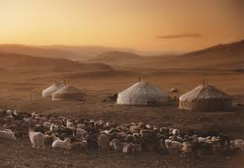
Nomads
Mongols started out as Nomadic people
They were herders of animals (sheep, goats)
They would MIGRATE according to climate conditions so they could feed their flock
They were master archers as well

Slide 6
Nomads
Nomads don’t produce manufactured goods so they needed to TRADE so they almost always live near settled people
Because they live in nature & in rough conditions they are usually good at surviving & pretty tough people

Slide 7
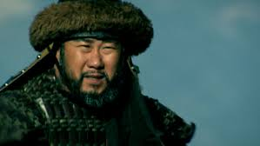
Genghis (Kahn) (King)
The story of the Mongols starts with Genghis Kahn
Born around 1152 A.D.
His father was poisoned to death leaving Genghis under the care of his older brother who he killed

Slide 8
Genghis Kahn UNITES Mongols
By age 19 he was married to his first & most important wife but she got kidnapped by a rival nomadic clan (which was extremely common)
He rescued his wife proving his militarily skill & he became a leader of his tribe
http://www.history.com/shows/mankind-the-story-of-all-of-us/videos/mankind-the-story-of-all-of-us-genghis-khan?m=5189719baf036&s=All&f=1&free=false

Slide 9
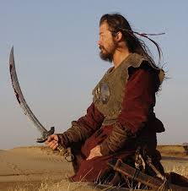
Uniting the Mongol Tribes
This led to a civil war between tribes which Genghis Kahn won for two reasons
Promoted people based on doing a good job instead of based on who your family member were
He brought conquered people into his army while killing the leaders of the conquered clans (made peasants love him)

Slide 10
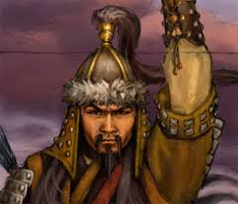
Great Kahn
In 1206 Genghis Kahn becomes the Great Kahn or (King)
He was voted on by his clansmen
Genghis called a council to meet
If you wanted Genghis to be the Kahn you would show up on your horse if you didn’t you didn’t show up
Genghis Kahn UNITES all Mongol Tribes

Slide 11
Essential Questions
Get with a partner and answer….
How did the Mongol key historical figure Genghis Kahn transform (change) the Mongols?

Slide 12
Expanding the Empire
From the time he became Great Kahn in 1206 to the time he died 1227 Genghis Kahn expanded the Mongol Empire from Mongolia all the way to the Caspian Sea
He INVADES & CONQUORS over 4.5 million square miles of territory
Even conquers the Persians
Wow!!!
http://www.youtube.com/watch?v=szxPar0BcMo
3:55-4:07

Slide 13
Essential Questions
Get with a partner and answer….
How did invasions, conquests, & migrations affect the Mongol people & their enemies?
What FACTORS caused the Mongols to move?

Slide 14
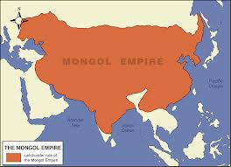
How did they Expand so Fast
Mongol Empire expanded from Mongolia all the way to the Caspian Sea in less than 20 years
That’s FAST
How did they do that?

Slide 15
Interrogation/Gun Powder
The Mongols had two huge advantages that nobody else had
Horse
Interrogation
Brutality
Gun Powder
Bubonic Plague
They INTEROGATED their enemies to find out what battle tactics to use & how many men their enemies had
Gun Powder was the ultimate scare tactic
http://www.history.com/shows/mankind-the-story-of-all-of-us/videos/mankind-the-story-of-all-of-us-gunpowder-to-guns

Slide 16
Horses
Horses were possibly the most important aspect of the Expansion of the Mongol Empire
Horses allowed the Mongols
http://www.history.com/shows/mankind-the-story-of-all-of-us/videos/taming-the-horse?m=518971d79ac04

Slide 17
Interrogation
Mongols interrogated their enemies using brutal tactics
They would find out valuable information that they could use against their enemy
Nobody had ever interrogated their enemies before

Slide 18
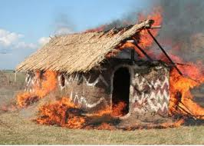
Brutality
Mongols when they did fight were extremely brutal
They would burn entire cities to the ground
They would kill everyman in a village & rape women & enslave children

Slide 19
Gunpowder
They also used gunpowder
They didn’t invent the gun however
They used the gunpowder to scare their enemies into surrendering without a fight
Most of the territories they conquered they didn’t even have to fight the people of the territory would simply surrender when they saw the fire stick

Slide 20
Bubonic Plague
Mongols used the Bubonic Plague to their advantage
It was the first case of germ (biological warfare) documented
They would purposely spread the Bubonic Plague to their enemies to kill them

Slide 21
Essential Questions
Get with a partner and answer….
What innovations & technology did the Mongols use to help their civilization by successful? (Please give 2 examples)

Slide 22
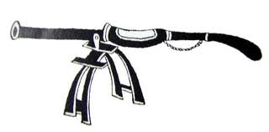
Downfall of the Mongols
Mongols failed to set up any kind of government
No GOVERNMENT STRUCTURE
The First GUNS
They had 4 huge territories
Yuan Dynasty (China)
Ilkhanate (Persia)
Chagtai Kahnate (Central Asia)
Golden Horde (Russia)

Slide 23
Downfall of the Mongols
Eventually these territories fell to other civilizations because they would argue & fight with each other on decisions that had to be made
Mongols fell fast
Mongols emerged & expanded incredibly fast but they also declined fast
By 1368 the Mongols had declined because they didn’t have a GOVERNMENT STRUCTURE

Slide 24
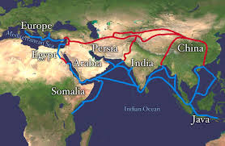
Why are the Mongols Important?
Mongols were important for 5 main reasons
Trade Routes (Silk Road)
Innovating Communication
Culture Sharing (Food/People)
Religious Tolerance

Slide 25
Trade Routes Tax Managers
Mongols benefited world history by making sure the Silk Road was safe
This made trade a popular thing to do
Mongols would ensure safety of merchants traveling on the Silk Road for a fee (tax)
Trading made different people from different places share their cultures & religions

Slide 26
Essential Questions
Get with a partner and answer….
How did conflict, compromise & negotiation over natural resources impact ECONOMIC development?

Slide 27
Innovating Communication
Mongols developed a better way of COMMUNICATING long distances across Asia, the Middle East & Europe
It was the Mongol pony express
Every 30 miles there was a relay post with over 400 fresh horses
Mongols carrying a passport could claim a fresh horse & food by order of the Khan
http://www.youtube.com/watch?v=EXu3q5mySPw
11:17-12:22

Slide 28
Essential Questions
Get with a partner and answer….
What innovations & technology did the Mongols use to help their civilization by successful? (Please give 2 examples)

Slide 29
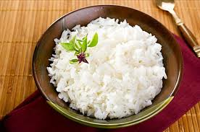
Sharing Cultures
Throughout their conquests & trade the Mongols share their culture
They bring RICE to where ever they conquer
They also bring their RELIGION

Slide 30
Religious Tolerance
Mongols were also very tolerant of other religions
They allowed the conquered people to practice their own religions

Slide 31
EOG Questions
How did technology change communication in the late thirteenth century?
A) It helped all citizens learn to read.
B) It allowed people to quickly contact others around the world.
C) It enabled people to get information about other places and ideas.
D) It helped people to improve the living conditions in their societies.

Slide 32
EOG Questions
Exploration and conquests occurred in the middle ages. How did they affect relations between ancient societies?
A) They caused long-lasting peace with the help of religion.
B) They caused empires to close off access between their societies.
C) They caused outbreaks of violence that closed all trade routes.
D) They caused trade routes and communication to open between societies.

Slide 33
EOG Questions
Which statement shows how trade routes influenced ancient societies?
A) As travel over land became easier, trade by water became unnecessary.
B) As different civilizations traded goods, they also shared cultural values and beliefs.
C) As trade developed, long-distance travel became safe and easy for each civilization.
D) As silk grew popular, it became a common material used in clothing across civilizations.

Slide 34
EOG Questions
Why did trading networks like the Silk Road develop?
A) Certain resources were not available in all areas.
B) The trails were used for communication between groups.
C) People wanted to take land and to keep control of that land.
D) Travelers enjoyed exploring nearby lands after trading for spices.

Slide 35
EOG Questions
Which was a long-term effect of ancient trade routes?
A) the spread of religions throughout the trade routes
B) the spread of unifying systems of government
C) colonization of weaker nations along the trade routes
D) use of silk throughout ancient and modern societies

Slide 36
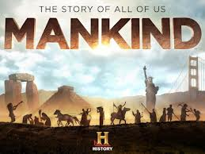
http://www.youtube.com/watch?v=EXu3q5mySPw
0:00-12:22

Slide 37
Important Points
6.H.2.4 (key historical figure) Genghis Kahn UNITED the Mongol tribes creating the Mongol Civilization
6.H.2.1 (invasions, conquests, migrations) The Mongol Empire grew by invading & conquering other people & then migrating to their newly conquer lands
6.H.2.3 (Innovations of Weapons) Mongols INTEROGATED their enemies to find out valuable information
6.H.2.3 (Innovations of Weapons) Mongols developed GUN POWDER to scare their enemies
6.H.2.3 (Innovations of Communication) Mongols started a Pony Express to COMMUNICATED messages across the Mongol Empire
6.G.1.2 (Factors of Movement) The Mongols wanted to move from their homelands to CONQUER & they had a DESIRE FOR WEALTH

