Slide 1
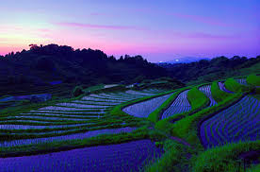
Medieval Japan
Japanese Feudalism
1300’s

Slide 2
Essential Standards
6.C.1 Explain how the behaviors and practices of individuals and groups influenced societies, civilizations and regions.

Slide 3
Clarifying Objectives
6.C.1.3 Summarize systems of social structure within various civilizations and societies over time (e.g., Roman class structure, Indian caste system and feudal, matrilineal and patrilineal societies).

Slide 4
Essential Questions
How did the Japanese Feudal System affect the Peasants (One positive affect, Once negative affect)?

Slide 5
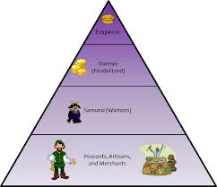
Social Structure
A Social Structure is how the people of a certain civilization are organized
It usually involves people being put into a class of people
Most Social Structures of civilizations fall into the categories of ….
Class Systems
Caste Systems
Feudalism
Matrilineal
Patrilineal

Slide 6
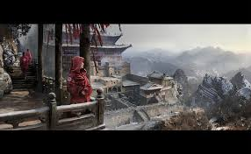
Medieval Japan Social Structure
Medieval Japan’s Social Structure was Feudalism
Feudalism is a Social System based on….
Land Ownership
Loyalties
Different Classes

Slide 7
Japanese Feudalism
Japanese Feudalism was based on being loyal to the Emperor & Shogun
If you were loyal to the Emperor & Shogun you were given land (as long as you were not a peasant)

Slide 8
Japanese Feudalism
The Japanese people were broken down into 5 different classes
Emperor (King)
Shogun (Military Leader)
Daimyo (Nobles)
Samurai (Warriors)
Peasants (Slaves)

Slide 9
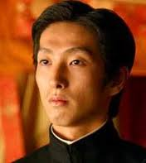
Emperor (King)
Emperor was the “king” of Japan
He was also considered to be a descendent of the gods
This made him DIVINE

Slide 10
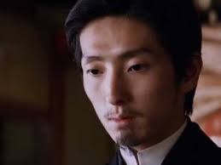
Emperor (King)
Although he was king he really didn’t have any power because Emperors were often very young boys
All the power & decision making went to the…..

Slide 11
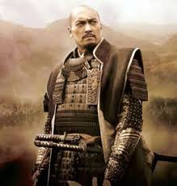
Shogun (Military Leader)
Shogun was the military leader of Japan
He was the general & because Japan was a warrior culture he had all the POWER
He was even more powerful than the Emperor
If the Shogun needed warriors for battle he would offer land to….

Slide 12
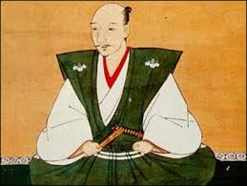
Daimyo (Land Owners)
Daimyo were the land holders of Japan
They had much land because every time that the Shogun needed soldiers he had to give land to the Daimyo in exchange for warriors
These Japanese warriors were called the….

Slide 13
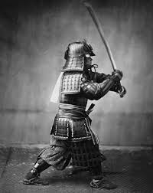
Samurai (Warriors)
Samurai were the property of the Daimyo that they worked for
Samurai warriors would go to war for the Daimyo

Slide 14
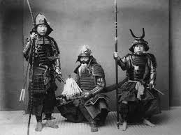
Samurai (Warriors)
If the Samurai did a good job & won a battle or brought back the heads of their enemies they would be given land as well to farm rice
Samurai would not work that land that was left to the….

Slide 15
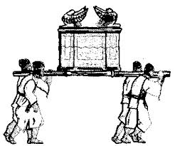
Peasants (Slaves)
Peasants worked the land of both the Daimyos & Samurai
They worked the land in exchange for protection
They kept a little bit of the rice they grew & animals they raised for themselves and the rest was given to the people above them

Slide 16
Population Breakdown
Only 10% of the Japanese population was either a Emperor, Shogun, Daimyo, or Samurai
90% of the population were peasants

Slide 17
Essential Questions
Get with a partner and answer…
How did the Japanese Feudal System affect the Peasants (One positive affect, Once negative affect)?

Slide 18
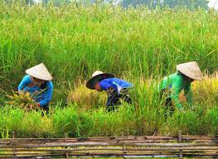
Keys to Feudalism
If you lived in Medieval Japan you would be broken down into one of 5 CLASSES
You were LOYAL to the CLASS above you
If you did well you were given LAND (unless you were a peasant)

Slide 19
EOG Questions
Japanese Feudal Class Structure
The Shogun owned the land.
The Shogun granted land to nobles in exchange for protection.
Daimyo owned manors.
Peasants were bound to the manors.
Peasants worked the land in exchange for protection.
Peasants paid rent and farmed the land for nobles.
Peasants gave a percentage of their crops to nobles.
How did the feudal class structure affect the lives of the peasants? Explain one positive and one negative effect.

Slide 20
Important Points
6.C.1.3 (Social Structure) Japan’s Social Structure was FEUDALISM
6.C.1.3 (Social Structure) FEDUALISM was based on LAND & LOYALTY

