Slide 1
Ancient India
Indian Caste System

Slide 2
Essential Standards
6.C.1 Explain how the behaviors and practices of individuals and groups influenced societies, civilizations and regions.

Slide 3
Clarifying Objectives
6.C.1.3 Summarize systems of social structure within various civilizations and societies over time (e.g., Roman class structure, Indian caste system and feudal, matrilineal and patrilineal societies).
6.C.1.2 Explain how religion transformed various societies, civilizations and regions (e.g., beliefs, practices and spread of Buddhism, Christianity, Confucianism, Hinduism, Islam and Judaism).

Slide 4
Essential Questions
What did the Indian Caste System depend on?
Why is it important to do your Dharma and not somebody else's?

Slide 5
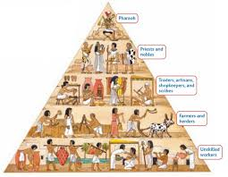
Social Structure
A Social Structure is how the people of a certain civilization are organized
It usually involves people being put into a class of people
Most Social Structures of civilizations fall into the categories of ….
Class Systems
Caste Systems
Feudalism
Matrilineal
Patrilineal

Slide 6
Caste System
A Caste System is a Social Class System that solely depends on….
YOU ARE WHAT YOUR PARENTS ARE
If you were born into a certain class of people you would never be able to be a part of another SOCIAL CLASS in your lifetime

Slide 7
Essential Questions
Get with a partner and answer….
What did the Indian Caste System depend on?

Slide 8
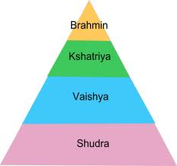
Indian Caste System
In Ancient India the Social Class Structure was a CASTE SYSTEM
As you remember a CASTE SYSTEM is….
You are what your parents were
If your parents were kings you would be a king if your parents were slaves you will be a slave

Slide 9
Indian Caste System
Indian Caste System was based from the Universe Pervading Spirit Purusha
They broke the Spirit into 4 different parts
Each of these parts were a different part of the Indian Caste System

Slide 10
Indian Caste System
(Brahmin) Purusha’s head was the top of the pyramid/Indian Cast System & was called Brahmin
(Kshatriyas) Next part of the pyramid/Caste System were his arms called Kshatriyas
(Vaisyas) Next was the 3rd section of the pyramid/Caste System which was the thighs of Purusha
(Sudras) Lastly were the feet of Purusha which was the bottom of the Indian Caste System

Slide 11
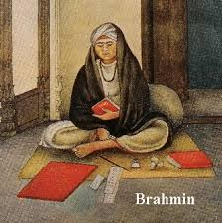
Indian Caste System (Brahmins)
Brahmins which were at the top of the pyramid
Head
Priests
They spoke to the god(s)

Slide 12
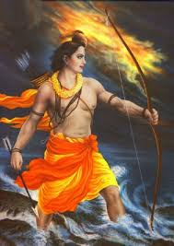
Indian Caste System (Kshatriyas)
Kshatriyas were the second layer of the pyramid
Arms
Warriors of the religion

Slide 13
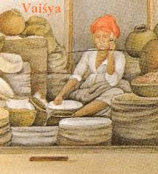
Indian Caste System (Vaisyas)
Vaisyas was the 3rd layer of the Indian Caste System
Thighs
Merchants (storeowners) Artisans (building designers)
They provide money for the priests & warriors

Slide 14
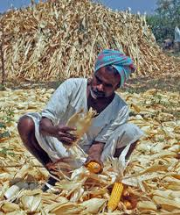
Indian Caste System (Sudras)
Sudras was the last layer of the Indian Caste System
Feet
Slaves & farmers
Foundation of the Indian Caste System
Provided food for everyone & built everything

Slide 15
Dharma (JOB)
An individuals role (job) in LIFE & SOCIETY
Dharma is solely dependent by birth/caste
If you are a sudra that will be your role & you should never try to be anything but a sudra
Doing your Dharma would give you chance to have a better “Next Life”

Slide 16
Essential Questions
Get with a partner and answer….
Why is it important to do your Dharma and not somebody else's?

Slide 17
EOG Questions

Slide 18
Important Points
6.C.1.3 (Social Structure: Indian Caste System) The Indians had a Caste System. Your social status in this system is whatever your parents status was
6.C.1.2 (Religion: Hinduism) The Indians believed in Hinduism which utilizes Dharma or one’s job on Earth. You must do YOUR job & not someone else's so you can have a better life next time

