Slide 1
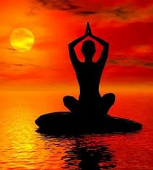
World Religions
Hinduism

Slide 2
Essential Standards
6.C.1 Explain how the behaviors and practices of individuals and groups influenced societies, civilizations and regions.
6.C&G.1 Understand the development of government in various civilizations, societies and regions.

Slide 3
Clarifying Objectives
6.C.1.2 Explain how religion transformed various societies, civilizations and regions (e.g., beliefs, practices and spread of Buddhism, Christianity, Confucianism, Hinduism, Islam and Judaism).
6.C.1.3 Summarize systems of social structure within various civilizations and societies over time (e.g., Roman class structure, Indian caste system and feudal, matrilineal and patrilineal societies).
6.C&G.1.4 Compare the role (e.g. maintain order and enforce societal values and beliefs) and evolution of laws and legal systems (e.g. need for and changing nature of codified system of laws and punishment) in various civilizations, societies and regions.
6.C&G.1.2 Summarize the ideas that shaped political thought in various civilizations, societies and regions (e.g., divine right, equality, liberty, citizen participation and integration of religious principles).

Slide 4
Essential Questions
How role has religion played in shaping Ancient India?
How does India’s Social Structure (Caste System) relate to their religion?
What role does KARMA have in Hinduism?
What is the POLITICAL THOUGHT behind Karma?

Slide 5
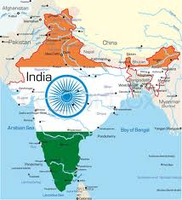
Ancient India
Hinduism is a religion that originated in Ancient India
People live their lives based on Hinduism
It is the reason for their existence

Slide 6
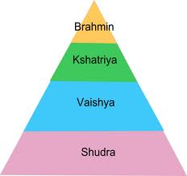
Ancient India
It is based on the way an INDIVIDUAL lives their life
It is based on the Vedas (Hindu Bible)
It is based on the INDIAN CASTE SYSTEM

Slide 7
Essential Questions
Get with a partner and answer….
How role has religion played in shaping Ancient India?

Slide 8
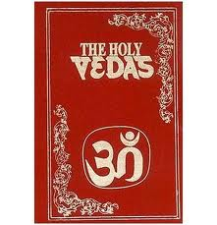
Vedas (Hindu Bible)
The Vedas was an Ancient text (book) written that had different rules to live an individuals life
Vedas was like the Hindu Bible
If rules were followed one could move their way up the INDIAN CASTE SYSTEM by being reincarnated (reborn)

Slide 9
Caste System
As you remember a CASTE SYSTEM is….
You are what your parents were
If your parents were kings you would be a king if your parents were slaves you will be a slave

Slide 10
Indian Caste System
Indian Caste System was based from the Universe Pervading Spirit Purusha
They broke the Spirit into 4 different parts
Each of these parts were a different part of the Indian Caste System

Slide 11
Indian Caste System
(Brahmin) Purusha’s head was the top of the pyramid/Indian Cast System & was called Brahmin
(Kshatriyas) Next part of the pyramid/Caste System were his arms called Kshatriyas
(Vaisyas) Next was the 3rd section of the pyramid/Caste System which was the thighs of Purusha
(Sudras) Lastly were the feet of Purusha which was the bottom of the Indian Caste System

Slide 12
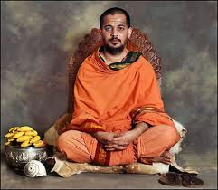
Indian Caste System (Brahmins)
Brahmins which were at the top of the pyramid
Head
Priests
They spoke to the god(s)

Slide 13
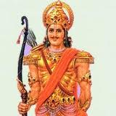
Indian Caste System (Kshatriyas)
Kshatriyas were the second layer of the pyramid
Arms
Warriors of the religion

Slide 14
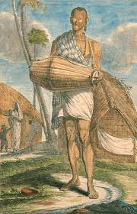
Indian Caste System (Vaisyas)
Vaisyas was the 3rd layer of the Indian Caste System
Thighs
Merchants (storeowners) Artisans (building designers)
They provide money for the priests & warriors

Slide 15
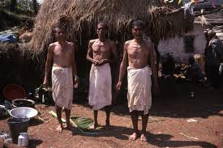
Indian Caste System (Sudras)
Sudras was the last layer of the Indian Caste System
Feet
Slaves & farmers
Foundation of the Indian Caste System
Provided food for everyone & built everything

Slide 16
Dharma
An individuals role (job) in LIFE & SOCIETY
Dharma is solely dependent by birth/caste
If you are a sudra that will be your role & you should never try to be anything but a sudra

Slide 17
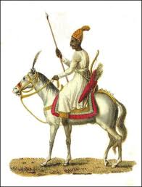
Example of Dharma
(General Krishna) “Having regard to your own duty also, you ought not to falter, for there is nothing better for a Kshatriya then a righteous battle.”
General Krishna telling a soldier who is part of the Kshatriya part of the Caste System that to fulfill his personal Dharma he should fight because he is a member of that part of the Caste System

Slide 18
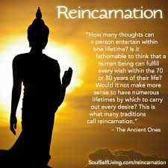
Personal Reasons for doing your Dharma (job)
There were many personal reasons for carrying out your Dharma to the best of your ability
People of Ancient India were constantly worried about their Samsara
They also eventually wanted to achieve their Moksha
They were very aware of Karma

Slide 19
Samsara (Reincarnation)
Samsara is the cycle of rebirth or Reincarnation
When you die your Soul is transferred to another living thing as it is being born
If you do a good job at fulfilling your Dharma things will improve for you

Slide 20
Samsara (Reincarnation)
If you have done well you will be born into a higher class in the Indian Caste System
You may eventually be born into the Brahmin
If you do a bad job fulfilling your Dharma you will either be born into a lower part of the Caste System when you reincarnate or out of the Caste System & have to work your way back into it

Slide 21
Essential Questions
Get with a partner and answer….
How does India’s Social Structure (Caste System) relate to their religion?

Slide 22
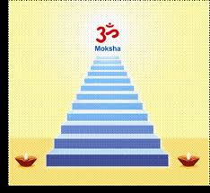
Moksha (Release)
The ultimate goal is to achieve Moksha
Moksha is the release out of the rebirth cycle
It sends you to the Indian afterlife

Slide 23
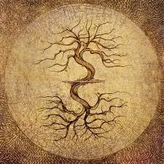
Karma (Law of Life)
Karma is the religious law that holds all this together
“The doer of good becomes good, the doer of evil becomes evil, One becomes virtues' by virtues action, bad by bad action”
Out of the Veda

Slide 24
Essential Questions
Get with a partner and answer….
What role does KARMA have in Hinduism?
What is the POLITICAL THOUGHT behind Karma?

Slide 25
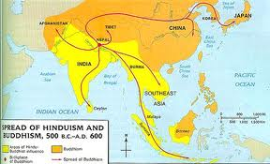
Spread of Hinduism
Hinduism spread much like other religions
Merchants from India spread Hinduism (culture) as they traveled on trading networks
Missionaries also spread Hinduism later after it was more established

Slide 26
EOG Questions
How did early Hinduism spread around the world?
A) Missionaries followed conquerors and colonists.
B) Bibles were published in all languages.
C) Christian sea captains sold fares to other Christians.
D) European monarchs practiced the religion when they traveled.

Slide 27
Important Points
6.C.1.2 (Religion) Hinduism was a way of life to the people of Ancient India
6.C.1.3 (Social System) Ancient India operated under a Caste System where your social class was dependent on the social class of your parents
6.C&G.1.4 (Coded Law System) Hinduism operated on Karma. This was their law system. It was based on their religion
6.C&G.1.2 (Political Thought) Karma was based RELIGIOUS PRINCIPLES

