Slide 1
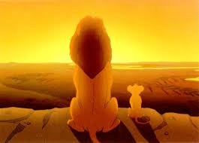
Energy in Ecosystems
Flow of Energy through
Food Chains

Slide 2
Essential Standards
6.L.2 Understand the flow of energy through ecosystems and the responses of populations to the biotic and abiotic factors in their environment.

Slide 3
Clarifying Objectives
6.L.2.1 Summarize how energy derived from the sun is used by plants to produce sugars (photosynthesis) and is transferred within food chains and food webs (terrestrial and aquatic) from producers to consumers to decomposers.

Slide 4
Essential Questions
What is a Food Chain?
What is a Food Web?
What are the Roles of Producers, Consumers, & Decomposers?

Slide 5
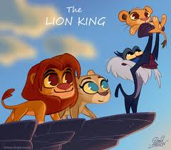
Ecosystems
http://www.youtube.com/watch?v=cWh-XKhh8xo

Slide 6
What is a Food Chain
Food Chain- a feeding hierarchy used to illustrate how ENERGY is passed in an ecosystem
Food Chains consist of 4 key things through which ENERGY will TRANSFER
Sunlight
Producers
Consumers
Decomposers
http://www.youtube.com/watch?v=pasB5FxhVUk
What's wrong with this video??

Slide 7
What is a Food Web
Food Web- Multiple food chains that depend on each other for survival
http://www.youtube.com/watch?v=sVB82laAJl0
1:40-2:53

Slide 8
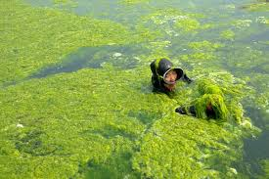
Producers
The Role of a Producer in an Ecosystem MAKE THEIR OWN FOOD
Plants & Algae are the only thing in an Ecosystem that are considered producers
They make their food through Photosynthesis

Slide 9
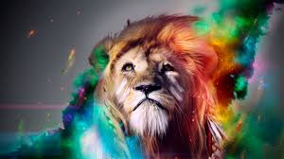
Consumers
The Role of a Consumer is to pass on ENERGY through eating a producer or another consumer
There are 3 types of consumers in an Ecosystem which all require Energy
Herbivores (Eat Plants)
Carnivores (Eat Meat/Animals)
Omnivores (Eat Plants & Meat)

Slide 10
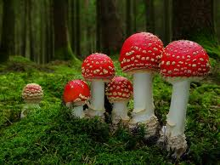
Decomposers
Decomposers are organisms that break down material after it has died
The Role of a decomposer is to break down either dead plant or dead animal material & put NITROGEN back into the soil
There are 3 common decomposers
Fungi
Bacteria
Insects

Slide 11
Essential Questions
Get with a partner and answer…..
What is a Food Chain?
What is a Food Web?
What are the Roles of Producers, Consumers, & Decomposers?

Slide 12
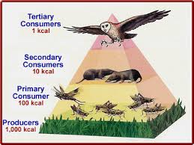
Flow of Energy in a Food Chain
The flow of energy in a food chain goes…
Sun
Producer (plant)
Consumer
Decomposer

Slide 13
Sunlight Provides 1st Energy
All energy comes from the sun either directly or indirectly
Energy comes from the sun directly to plants as they use the sunlight in photosynthesis
Energy comes from the sun indirectly to animals through eating plants (that got their energy from the sun) or other animals

Slide 14
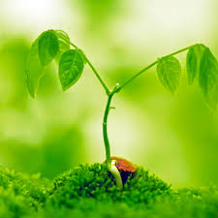
Sunlight Plants or Algae
Sunlight energy shines on plants which triggers photosynthesis
This is the first way in which energy is transferred in an ecosystem
Suns energy has FLOWED to the plant
Plants are PRODUCERS because they produce their own food from the sun’s energy

Slide 15
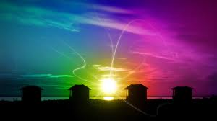
Photosynthesis
Plants food making process
Photosynthesis is a chemical reaction where ENERGY from light (sun) is changed to CHEMICAL ENERGY which plants can use
The converted chemical energy is turned into sugar which is called glucose

Slide 16
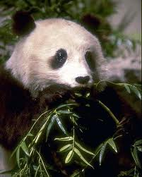
Plant Animal
A plant transfers energy to an animal when the animal EATS the plant
The sugars (glucose) that the plant made during photosynthesis are transferred to the plant eating animal
The plant’s ENERGY has FLOWED to the animal
This plant eating animal is the PRIMARY CONSUMER because it ate (consumed) the plant

Slide 17
Animal Animal
An animal can transfer ENERGY to another animal if one animal EATS another animal
The animals ENERGY has FLOWED from one animal to another
The animal that ate the other animal is called the SECONDARY CONSUMER because the first animal ate the plant
http://www.youtube.com/watch?v=4h9re1bHt40

Slide 18
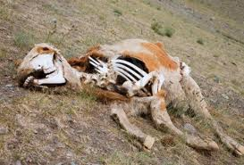
Animal Decomposer
When the animal dies it is EATEN by a DECOMPOSER
The animal’s ENERGY FLOWS to the decomposer

Slide 19
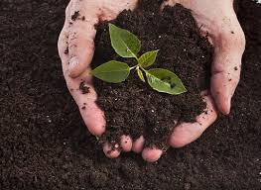
Decomposer Soil
The Decomposer does get ENERGY from the dead animal
More importantly though it GIVES BACK NITROGEN to the soil through RECYCLING
This makes the soil more FERTILE so plants can grow
Now the Energy in Ecosystem cycle can start over

Slide 20
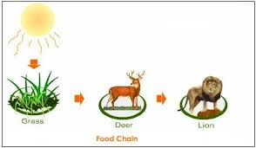
Terrestrial Food Chains/Food Webs
Terrestrial Food Chains/Food Webs
All this means is that this is a food chain or food web of plants & animals that LIVE ON LAND

Slide 21
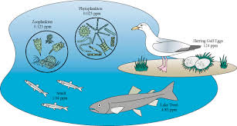
Aquatic Food Chains/Food Webs
Aquatic Food Chain/Food Web
All this means is that this is a food chain or food web of plants & animals that LIVE IN WATER

Slide 22
Food Chain Song
http://www.youtube.com/watch?v=iWfEn8J5xKM

Slide 23
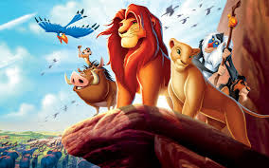
Ecosystem
http://www.youtube.com/watch?v=bW7PlTaawfQ

Slide 24
EOG Questions
Which best summarizes the order of energy flow in the good chain?
A) sun to decomposers to producers to consumers
B) sun to consumers to decomposers to producers
C) sun to producers to consumers to decomposers
D) sun to producers to decomposers to consumers

Slide 25
Important Points
Food Chains/Food Webs transfer ENERGY through an ECOSYSTEM
All energy comes from the SUN
TERRESTRIAL (land) AQUATIC (water)
The energy is transferred from
Sunlight
Producer (plants or Algae)
Consumer
Decomposer
Producers- plants or Algae that MAKE THEIR OWN FOOD through PHOTOSYNTHESIS
Consumers- get & transfer their energy from eating producers or other consumers
Herbivore
Carnivore
Omnivore
Decomposers- break down dead plants and animals and put back NITROGEN into the soil through RECYCLING

