Slide 1
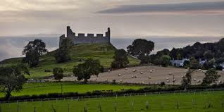
Europe in the Middle Ages
European Social Structure
Feudalism
800 -1400 A.D.

Slide 2
Essential Standards
6.C.1Explain how the behaviors and practices of individuals and groups influenced societies, civilizations and regions.

Slide 3
Clarifying Objectives
6.C.1.3 Summarize systems of social structure within various civilizations and societies over time (e.g., Roman class structure, Indian caste system and feudal, matrilineal and patrilineal societies).

Slide 4
Essential Questions
What does a Feudal System depend on?
What is the difference between a Feudal System & a Caste System?
How does the Feudal System affect the life of a peasant/serf

Slide 5
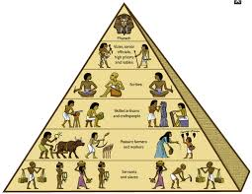
Social Structure
A Social Structure is how the people of a certain civilization are organized
It usually involves people being put into a class of people
Most Social Structures of civilizations fall into the categories of ….
Class Systems
Caste Systems
Feudalism
Matrilineal
Patrilineal

Slide 6
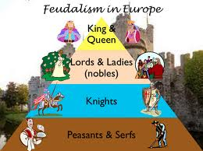
Feudalism
Feudalism is a Social Structure that is based on the OWNERSHIP of LAND by different people
Feudalism was the Social Structure of Europe in the Middle Ages

Slide 7
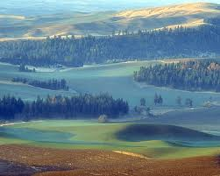
How much land do you own?
The more land you owned in Medieval Europe the higher you were in the Feudal System
Kings & Queens were at the top of the Feudal System & Peasants were at the bottom

Slide 8
Structure of European Feudalism
Feudalism in Medieval Europe had 5 classes of people
Kings & Queens
Nobles
Knights
Craftsman
Serfs

Slide 9
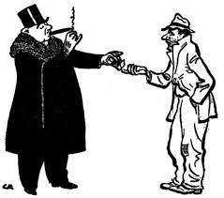
Upper Class & Lower Class
Upper Class of the Medieval European Feudal System were….
King & Queen
Nobles
Knights
Lower Class in the Feudal System were…
Craftsmen
Vassals/Peasants/Serfs

Slide 10
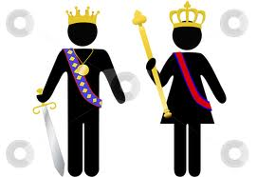
Kings & Queens
King & Queen owned all the land
They were at the very top of the Feudal Social Structure
King & Queen would reward Nobles by giving them land
They could take it back at anytime

Slide 11
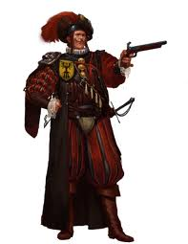
Nobles
Nobles were very high class people that owned a large amount of land
Nobles oversaw the Knights and the army & decided when to send them to battle
They would give land to a Knight for bravery in battle as a reward

Slide 12
Manors
Manors were large plantations that vassals had to work on
Manors usually included a beautiful house where the noble lived
Also included hundreds of acres of land for farming land

Slide 13
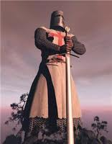
Knights
Knights provided the protection
Knights were professional warriors
Different from other warriors because they came from wealthy families & were skilled fighters

Slide 14
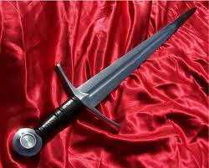
Craftsmen (Builders)
Craftsmen were part of the lower class
They still were very skilled
They were builders & makers of tools
They owned a small amount of land usually on a farm

Slide 15
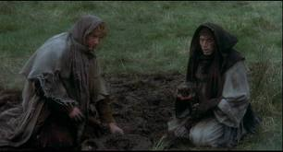
Vassals/Peasants/Serfs (Slaves)
Peasants/Serfs were the laborers of the land
They were essentially slaves
They worked on large plots of land that was owned by a Noble or Knight (plantation)

Slide 16
Vassals/Peasants/Serfs (Slaves)
They gave all the food they grew to the vassal for which they worked
In exchange the vassals protected them from enemies
They were never allowed to own any land

Slide 17
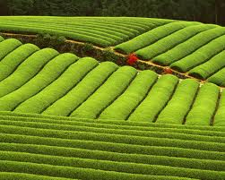
Respect/Rewards
People of the lower class showed their RESPECT of people in higher classes by SERVING them
The more you served your higher ups the more REWARDS you would get

Slide 18
EOG Questions
European Feudal Class Structure
The king owned the land.
The king granted land to nobles & knights in exchange for protection.
Nobles owned manors.
Peasants were bound to the manors.
Peasants worked the land in exchange for protection.
Peasants paid rent and farmed the land for nobles.
Peasants gave a percentage of their crops to nobles.
How did the feudal class structure affect the lives of the peasants? Explain one positive and one negative effect.

Slide 19
Important Points
6.C.1.3 (Feudal System) Europe in the Middle Ages operated their society on a Feudal System
6.C.1.3 (Feudal System) Feudal System depended on how much LAND you OWNED
6.C.1.3 (Feudal System) King gave land to the Nobles who controlled the Knights
6.C.1.3 (Feudal System) Nobles gave land to the Knights in exchange for fighting wars & protection
6.C.1.3 (Feudal System) peasants/slaves worked & lived on the land for the Nobles & Knights and provided food

