Slide 1
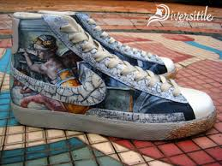
Europe in the Middle Ages
Trade, Banking & Renaissance
European Advancement Period
1350-1480 A.D.

Slide 2
Essential Standards
6.C&G.1.4 Compare the role (e.g. maintain order and enforce societal values and beliefs) and evolution of laws and legal systems (e.g. need for and changing nature of codified system of laws and punishment) in various civilizations, societies and regions.
6.C.1 Explain how the behaviors and practices of individuals and groups influenced societies, civilizations and regions.
6.E.1 Understand how the physical environment and human interaction affected the economic activities of various civilizations, societies and regions.
6.H.2 Understand the political, economic and/or social significance of historical events, issues, individuals and cultural groups.

Slide 3
Clarifying Objectives
6.C&G.1.4 Compare the role (e.g. maintain order and enforce societal values and beliefs) and evolution of laws and legal systems (e.g. need for and changing nature of codified system of laws and punishment) in various civilizations, societies and regions.
6.C.1.1 Analyze how cultural expressions reflected the values of civilizations, societies and regions (e.g., oral traditions, art, dance, music, literature, and architecture).
6.E.1.1 Explain how conflict, compromise and negotiation over the availability of resources (i.e. natural, human and capital) impacted the economic development of various civilizations, societies and regions (e.g., competition for scarce resources, unequal distribution of wealth and the emergence of powerful trading networks).
6.E.1.2 Explain how quality of life is impacted by economic choices of civilizations, societies and regions.
6.H.2.3 Explain how innovation and/or technology transformed civilizations, societies and regions over time (e.g., agricultural technology, weaponry, transportation and communication).

Slide 4
Essential Questions
What was the role of the MAGNA CARTA & why was it written?
How did the development of a banking system impact ECONOMIC DEVELOPMENT?
How did TRADE with Africa & the Development of a banking system lead to a better QUALITY OF LIFE?
How did the invention of the Printing Press change communication forever?

Slide 5
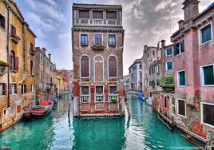
Venice, Italy
Venice, Italy is a thriving city built on African gold from Mansa Musa’s kingdom of Mali
Venice is the TRADING center of all of Europe
It is built on African Gold & European Salt

Slide 6
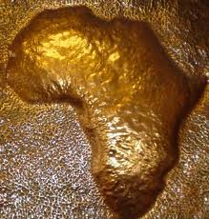
African Gold
Mansa Musa’s Kingdom of Mali has traded with the begins to trade with the Venetians
What are the Africans looking for?
They are looking for salt

Slide 7
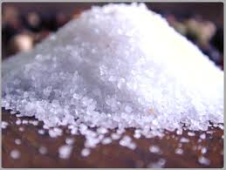
European Salt
Venice is located right on the coast of Italy
It is a perfect place for salt deposits
Salt is able to preserve food & therefore is highly demanded
When Mansa Musa makes his Hajj journey he travels through Venice & sees they have a lot of salt

Slide 8
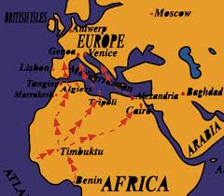
Scarcity of Resources
Europe & Africa begin to trade
Europe trades salt for African gold
Africans are able to preserve their food
Europeans are able to collect a lot of gold

Slide 9
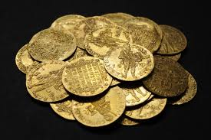
African Gold (Ducats)
Once the African gold comes into Venice in exchange for salt it is turned into a coin
These coins are called Ducats
This is the first international currency of Europe

Slide 10
So Many Ducats
So much salt is being traded for gold that there is so much gold coming in that rich Venetian salt traders don’t know where to put it all
Banking is born

Slide 11
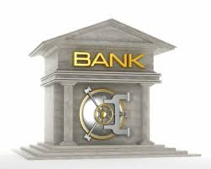
Modern Banking
Rich traders & merchants bank their Ducats with the world’s first bankers
In exchange for keeping the money safe the banker would get to have a portion of the trader or merchants Ducats

Slide 12
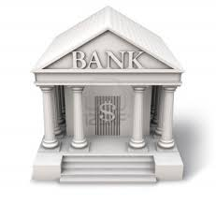
Modern Banking
Other people would come to the bank to barrow many that they agree to pay back later
The barrowers would have to pay the money back plus a little bit more money as a fee for borrowing from the banker (interest)

Slide 13
Essential Questions
Get with a partner and answer….
How did the development of a banking system impact ECONOMIC DEVELOPMENT?
How did TRADE with Africa & the Development of a banking system lead to a better QUALITY OF LIFE?

Slide 14
Books
During this time period in Europe books were rare
Books were only for the rich & people of the church
All books were hand written & hand copied
Books carried key knowledge that was crucial information for mankind’s survival

Slide 15
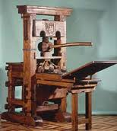
Gutenberg Printing Press
Printing Press was a device that had individual carved out letters
These carved out letters could be arranged in different words & sentences
To print he would line up letters into sentences & soak them in black ink

Slide 16
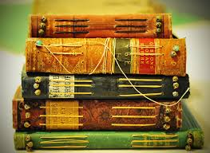
Gutenberg Printing Press
He would then turn a large handle with paper attached to it
The letters would press onto the piece of paper and the words would appear
Now instead of people having to copy books down word by word books could now be MASS CREATED

Slide 17
Gutenberg Printing Press
This meant thousands of books could be created quickly
This also meant that they would be cheaper
Cheaper books meant that more people would have access to the information in them
The INFORMATION AGE begins
http://www.history.com/shows/mankind-the-story-of-all-of-us/videos/mankind-the-story-of-all-of-us-the-printing-press?m=5189719baf036&s=All&f=1&free=false

Slide 18
Innovating Communication
Gutenberg has brought INFORMATION to everyone
You didn’t have to be rich anymore
Books are now produced 2000 times faster than before

Slide 19
Essential Questions
Get with a partner and answer….
How did the invention of the Printing Press change communication forever?

Slide 20
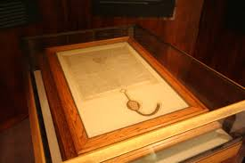
Magna Carta
Magna Cart was a coded system of law
It reflected the values & beliefs of the Europeans of that time
It was famous for protecting the rights of the INDIVIDUAL & ensuring a TRIAL so you were innocent until proven guilty

Slide 21
Essential Questions
Get with a partner and answer….
What was the role of the MAGNA CARTA & why was it written?

Slide 22
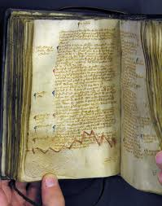
European Renaissance Period
Many Europeans would now go to bankers and barrow some money and pick up a book and learn how to either build something or make something and sell it
They could then pay the money to the banker and keep the rest as profit

Slide 23
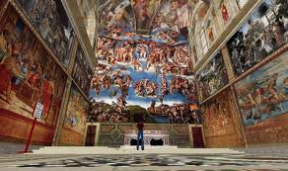
European Renaissance Period
African Gold & Venetian Banking allow people to buy & sell things
Books make it possible for people to know how to make things & create things
This leads to a period of knowledge, building, creation of artwork that Europe had never seen

Slide 24
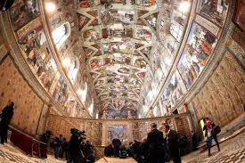
Money & Information
People now had the money & the information to create beautiful pieces of European culture
Many still exist today

Slide 25
Booming European ECONOMY
African gold trade, banking, printing, & books led to a
Booming European ECONOMY
Now just 70 years after the Bubonic Plague/Black Death wiped out half of Europe they have fully recovered and are thriving
http://www.youtube.com/watch?v=pfjpwbCUT2Q
12:00-17:33

Slide 26
EOG Questions
poor management by leaders
hoarding of wealth
too much debt
How did the economic factors listed affect the ancient empires?
A) Empires weakened and were eventually destroyed.
B) Empires forced wealthy citizens to forfeit money in taxes.
C) Armies searched other empires for new leaders to govern.
D) Armies of the empires were sent to other lands to increase wealth.

Slide 27
EOG Questions
Why did some ancient civilizations write and publish their laws?
A) to allow patricians and plebeians to read and vote for the laws
B) to record the laws so that historians would understand ancient culture
C) to ensure that citizens of the civilization would read and understand the laws
D) to guarantee that each politician received a personal copy of the printed laws

Slide 28
EOG Questions
No freeman shall be taken, imprisoned . . . or in any way destroyed. Nor will we proceed against or prosecute him, except by the lawful judgment of his peers . . .
Magna Carta, 1215
Based on this quote, how were the legal rights of freemen changed?
A) Freemen were given the right to live without government interference.
B) The king was granted the power to exclude freemen from the laws.
C) The king acquired the power to imprison freemen at his will.
D) Freemen gained the right to trial by a jury of citizens.

Slide 29
EOG Questions
Exploration and conquests occurred in the middle ages. How did they affect relations between ancient societies?
A) They caused long-lasting peace with the help of religion.
B) They caused empires to close off access between their societies.
C) They caused outbreaks of violence that closed all trade routes.
D) They caused trade routes and communication to open between societies.

Slide 30
EOG Questions
Which was a long-term effect of ancient trade routes?
A) the spread of religions throughout the trade routes
B) the spread of unifying systems of government
C) colonization of weaker nations along the trade routes
D) use of silk throughout ancient and modern societies

Slide 31
EOG Questions
Which statement shows how trade routes influenced ancient societies?
A) As travel over land became easier, trade by water became unnecessary.
B) As different civilizations traded goods, they also shared cultural values and beliefs.
C) As trade developed, long-distance travel became safe and easy for each civilization.
D) As silk grew popular, it became a common material used in clothing across civilizations.

Slide 32
Important Points
6.C&G.1.4 (Coded Law System) Development of the MAGNA CARTA ensured that peace & laws were followed & it is also important because it ensured INDIVIDUAL RIGHTS & a TRIAL to prove you are guilty
6.C.1.1 (Art/Architecture/Literature) During this time Europeans created timeless pieces of art, architecture & books reflecting their values & beliefs
6.E.1.1 (Negotiation over Resources= Trade Networks) Europe & Africa created their own powerful trading network making both places rich
6.E.1.2 (Quality of Life) Banking system in Venice allowed people in Europe to be able to barrow & payback so they good do the things they wanted to with their money and live a better QUALITY OF LIFE
6.H.2.3 (Innovating Communication) Invention of the PRINTING PRESS allowed ANYBODY to be able to have access to information that only rich people had access to before

