Slide 1
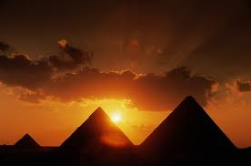
Ancient Egypt
The Story of Ancient Egypt
3050-332 B.C.E

Slide 2
Essential Standards
6.G.2 Apply the tools of a geographer to understand the emergence, expansion and decline of civilizations, societies and regions.
6.C.1 Explain how the behaviors and practices of individuals and groups influenced societies, civilizations and regions.
6.H.2Understand the political, economic and/or social significance of historical events, issues, individuals and cultural groups.
6.E.1Understand how the physical environment and human interaction affected the economic activities of various civilizations, societies and regions.

Slide 3
Clarifying Objectives
6.G.2.1Use maps, charts, graphs, geographic data and available technology tools to draw conclusions about the emergence, expansion and decline of civilizations, societies and regions.
6.C.1.2 Explain how religion transformed various societies, civilizations and regions (e.g., beliefs, practices and spread of Buddhism, Christianity, Confucianism, Hinduism, Islam and Judaism).
6.C.1.3 Summarize systems of social structure within various civilizations and societies over time (e.g., Roman class structure, Indian caste system and feudal, matrilineal and patrilineal societies).

Slide 4
Clarifying Objectives
6.H.2.3 Explain how innovation and/or technology transformed civilizations, societies and regions over time (e.g., agricultural technology, weaponry, transportation and communication).
6.C.1.1 Analyze how cultural expressions reflected the values of civilizations, societies and regions (e.g., oral traditions, art, dance, music, literature, and architecture).
6.E.1.1 Explain how conflict, compromise and negotiation over the availability of resources (i.e. natural, human and capital) impacted the economic development of various civilizations, societies and regions (e.g., competition for scarce resources, unequal distribution of wealth and the emergence of powerful trading networks).

Slide 5
B.C.E. & A.D.
B.C.E.
A.D.
B.C.E. stands for “Before the Common Era”
This simply means that it was the history before Jesus died
It is a count down to Jesus death
B.C.E. is like a negative number
[Example] 5000 B.C.E. is much OLDER than than 500 B.C.E.
A.D. stands for after Jesus death
The year Jesus died was year 0
We are now in year 2013, so it has been 2013 years since Jesus died

Slide 6
Kingdoms & Intermediate Periods
Ancient Egypt’s history is divided into Kingdoms and Intermediate Periods
All Kingdoms and Intermediate Periods existed in the Bronze Age
There were 3 Kingdoms and 3 Intermediate Periods
Old Kingdom
Middle Kingdom
New Kingdom
During the time of the Kingdoms was the time Egypt enjoyed great success & prosperity
The time of the Intermediate Periods is when Egypt was unsuccessful

Slide 7
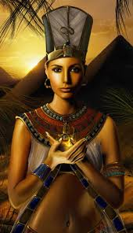
Many Pharaohs & Dynasties
Pharaohs were Ancient Egyptian Kings
They were believed to be more then men but less than gods
They were the connection between Ancient Egyptians and their gods
During the time of Ancient Egypt their were 332 known Pharaohs
There were men & women Pharaohs
Over that time period there was also 31 dynasties

Slide 8
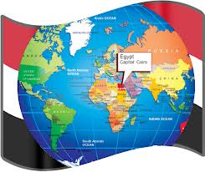
Location of Ancient Egypt
Ancient Egypt is located on the Nile River in Africa
It is located to the West of Mesopotamia & South of Europe

Slide 9
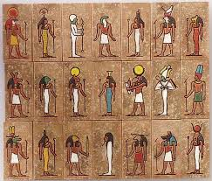
Polytheistic
The Egyptians were Polytheistic meaning that they believed in more than one God
They were also an agricultural people
They believed that the gods controlled whether their harvests would be good or not (life & death)

Slide 10
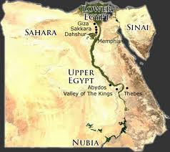
The Old Kingdom
The story of Ancient Egypt starts in 3050 B.C.E.
Two Native tribes occupied land near the Red Sea & the Mediterranean Sea
Bedari
Gerzeh
Bedari were very good farmers & good in animal husbandry
Gerzeh were able to make tools to hunt with

Slide 11
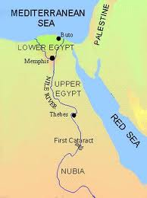
Old Kingdom
The Mythical Pharaoh named Meni wanted to unite the Upper part with the Lower part
The Bedari & Gerzeh united and formed Upper & Lower Egypt
This allowed the Kingdom to have the tools for building & designing & the fertile Nile River delta for farming

Slide 12
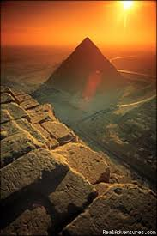
Memphis
The Pharaoh Meni built Memphis to be his capital
He built Memphis about halfway between the Red Sea & the Mediterranean Sea so he could control both the workers of the Nile River Delta & the Trade Routes by the Red Sea Levent (to the east)

Slide 13
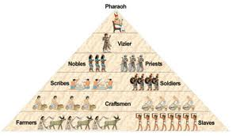
Pharaoh Controls Laborers
The Egyptian labor system shaped society
It was the first time in history a Monarchy/Caste system was developed
A Monarchy/Caste system is a societal system where your class is determined by what your parents were and there is a King (Pharaoh)

Slide 14
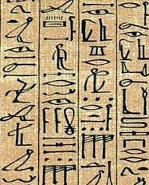
Old Kingdom Pharaoh Builds an Empire
The Old Kingdom saw a huge advancement in Agriculture and and the development of Hieroglyphics & Papyrus
They also used the plow which helped them create rows for the seeds that they planted. This made their gardens yield even more crops
Hieroglyphics were pictures that universally meant the same thing to all Egyptians
Papyrus was the first paper like material made from the Papyrus plant used for writing, making mattresses, sandals & rope

Slide 15
Surplus In Food
The extra food sparked a mathematical & Engineering enlightenment period
An enlightenment period which is a cultural movement of intellectuals perfecting something
The extra food allowed Egypt to trade for things from other civilizations and learn things from other civilizations
The Ancient Egyptian Enlightenment Period was based on Building & Math

Slide 16
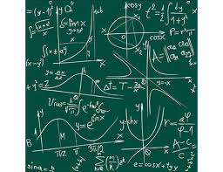
Egyptian Enlightenment Period
It was during this period that a new caste system class of scribes emerged
Scribes were smart people who knew how to read & write & study
Scribes wrote down history of the culture and studies things like mathematics & building
The scribes were given large estates by the Pharaoh for their contributions to society

Slide 17
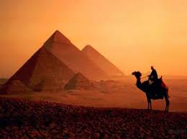
Great Pyramids
It was during this period that the Great Pyramids began construction
Some of the Pharaohs wanted grand palaces for sarcophaguses
Pharaoh Khufu had the Pyramid of Giza constructed for himself during the Old Kingdom
It remains today as one of the 7 Wonders of the Ancient World
The Pyramids are so important/amazing because of the precise mathematics needed to build them

Slide 18
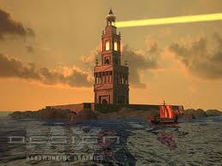
Lighthouse at Alexandria
The Lighthouse at Alexandria was built during this time
It was a lighthouse and a library that was the largest library in the world
It was also a trading market where other civilizations would come to trade (Romans)
It remains one of the 7 wonders of the Ancient World
Nobody has ever found the Lighthouse at Alexandria

Slide 19
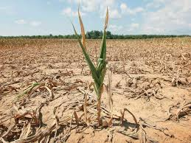
1st Intermediate Period
The 1st Intermediate Period was a period of unsuccessful events for Ancient Egypt
A great drought swept over the Nile River basin and crops stopped growing
Also the Pharaoh had given so much to the scribes that Pharaoh’s power had begun to collapse and the scribes power had begun to rise

Slide 20
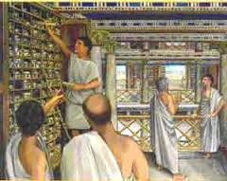
Middle Kingdom
The Middle Kingdom was ushered in by the individualism of the Egyptian people
This was the first time in Egyptian history that they believed that all Egyptian people had souls and could enter the afterlife
There was a resurgence in Art, Literature, & Building projects to advance society

Slide 21
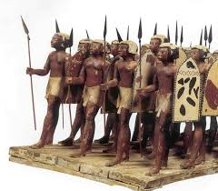
Middle Kingdom
Egyptian Pharaohs developed an army of the servants & peasants
They carried wooden shields and spears made of a long stick and a copper spear head
They used that army to conquer the Nubians to the South
They made the Nubians join their army and set up gold mines in their newly conquered territory

Slide 22
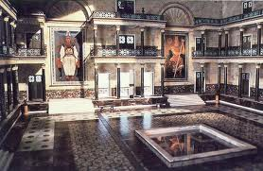
Middle Kingdom
Because of their newfound mineral wealth (gold) their kingdom flourished
Gold and other precious metals were used to make jewelry
The first books were written using hieroglyphics that had complicated plots and used eloquent style
The “Walls of the Ruler” were build which was a huge wall around all of Ancient Egypt to defend the city
Ancient Egypt was becoming the world power

Slide 23
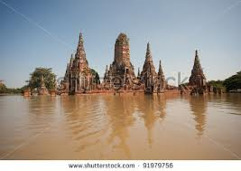
2nd Intermediate Period
Just when they were becoming the world power a huge flood of the Nile swept over Ancient Egypt drowning their crops
This led to the 2nd Intermediate Period which was the 2nd period of unsuccessful events for Ancient Egypt

Slide 24
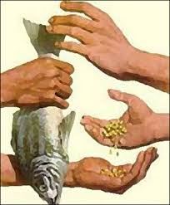
New Kingdom
The Pharaohs ushered in a period of unprecedented wealth
The new Kingdom prospered behind the fortifications of the “Walls of the Rulers” built during the Middle Kingdom and strengthening relationships with neighboring countries
This allowed Egypt to become heavily involved in trading with their neighboring countries

Slide 25
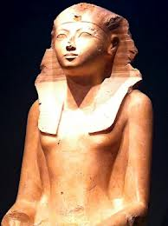
Powerful & Peaceful Pharaohs
During the New Kingdom Egypt had a period of conquering and peace among Egypt (nobody attacked them)
Powerful Pharaohs Tutankhamen, Hatshepsut, & Ramses the Great ruled during the New Kingdom
Hatshepsut became the first woman ruler in history ruling a peaceful dynasty during the New Kingdom

Slide 26
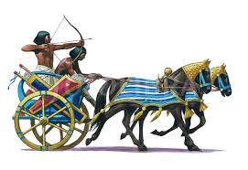
Egypt’s New Military
Egypt had been strengthening their army through the Old & Middle Kingdoms but Tuthmosis III & Ramses The Great made Egypt a military power
Egypt introduced a Chariot Cavalry which was the first cavalry in history
Egypt’s cavalry would ride to the sides or flanks of the enemy firing arrows at the enemy
Then the main infantry army would charge in from the front

Slide 27
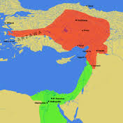
Egypt’s New Military
The new and improved army was very successful and Egypt expanded their territory to the most land that they would ever have
Egypt’s territory had expanded as far North as present day Turkey & as far South into Africa

Slide 28
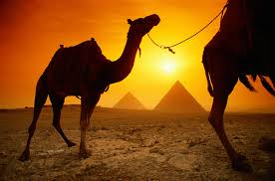
Peace with Powerful Civilizations
Egypt conquered the civilizations it could but they were smart enough during this time period to make peace with the large civilization that would be hard to conquer
They built up trading with these civilizations to the North & East allowing them to import bronze & salt

Slide 29
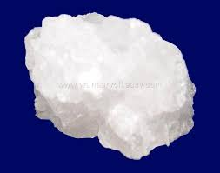
Salt
Salt was used by Egyptian Pharaohs to salt their food
Salt was also used to preserve meat as it would keep up to one year after it had been salted.
Salt was used before the refrigerator
Later in history salt was highly sought after to the point of having wars over salt and creating a salt road and salt city

Slide 30
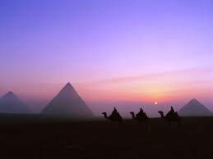
Egypt Becomes too Rich & too Big
Egypt’s downfall of the New Kingdom started because their territory had expanded too far and the pharaohs were unable to control it from so far away
On the edges of the Egyptian Kingdom other civilizations start attacking to try to steal Egypt’s wealth
There were attacks from
Sea Peoples
Canaanites
Libyans
Phoenicians

Slide 31
The Great Exodus
Part of the downfall was when Moses led the Great Exodus of the Jews from Egypt where they had been enslaved
Many historians believe that this took place during the time of the New Kingdom under Ramses the Great
Egypt lost a large amount of slave laborers when the Jews fled east through the Red Sea
This stopped a lot of building projects because their were no slaves to build structures

Slide 32
3rd Intermediate Period
As a result Egypt entered their 3rd Period of no success known as the 3rd Intermediate Period
The third Intermediate Period was marked with war
The Assyrian Empire was taking over the Egyptian Territory
Egypt along with many other civilizations tried to repel the Assyrians but they were too powerful
This led to the Late Period

Slide 33
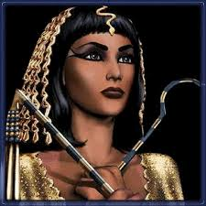
The Late Period
The Late Period marks an end to the Ancient Egyptian Civilization
After Egypt was conquered by Persians
It would never again be in Egyptian control until the 1800’s

Slide 34
Important Points
6.C.1.2 (Religion) Egyptians were Polytheistic & believed that Pharaoh was the civil leader given to the Egyptian people by the Gods
6.C.1.2 (Religion) Egyptians believed the gods controlled whether the harvest would be good or bad
6.H.2.3 (Communication) Egyptians developed the second language known to man called Hieroglyphics
6.H.2.3 (Weaponry) Egyptians created the first CAVALRY which they used chariots for
6.C.1.1 (Architecture) Egyptians created Pyramids which still stand today. This was an engineering feat
6.E.1.1 (Scarcity of Resources) Egyptians opened up powerful trading networks making their civilization RICH & SPREADING their CULTURE to other regions
6.C.1.3 (Society) Egyptian society was a CASTE SYSTEM with the Pharaoh on top & the farmers on the bottom

