Slide 1
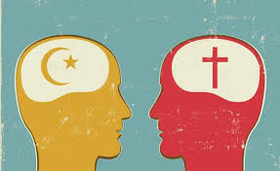
Europe in the Middle Ages
Crusades
Holy War
Christians vs. Muslims

Slide 2
Essential Standards
6.C.1 Explain how the behaviors and practices of individuals and groups influenced societies, civilizations and regions.
6.G.1 Understand geographic factors that influenced the emergence, expansion and decline of civilizations, societies and regions (i.e. Africa, Asia, Europe, and the Americas) over time.
6.H.2 Understand the political, economic and/or social significance of historical events, issues, individuals and cultural groups.

Slide 3
Clarifying Objective
6.C.1.2 Explain how religion transformed various societies, civilizations and regions (e.g., beliefs, practices and spread of Buddhism, Christianity, Confucianism, Hinduism, Islam and Judaism).
6.G.1.2 Explain the factors that influenced the movement of people, goods and ideas and the effects of that movement on societies and regions over time (e.g., scarcity of resources, conquests, desire for wealth, disease and trade).
6.H.2.1 Explain how invasions, conquests and migrations affected various civilizations, societies and regions (e.g., Mongol invasion, The Crusades, the Peopling of the Americas and Alexander the Great).
6.H.2.4 Explain the role that key historical figures and cultural groups had in transforming society (e.g., Mansa Musa, Confucius, Charlemagne and Qin Shi Huangdi).

Slide 4
Essential Questions
What were the LONG TERM affects of the Crusades?
How did religion transform societies in Europe & the Middle East?
What factor influenced movement by Christians to the Holy Land?
How did Invasions, conquests & migrations affect both the regions of the Middle East & Europe?

Slide 5
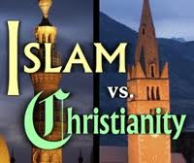
Crusades
Series of military expeditions that went from Europe to the Eastern Coast of the Mediterranean Sea
The Crusades put Christians against Muslims in a Holy War

Slide 6
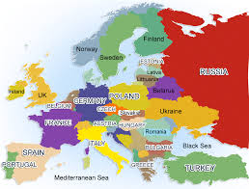
Europe
During this time Europe was going through the Dark Ages
Dark Ages were a terrible time for Europe
There was unrest & constant fighting between the towns of Europe
Pope Urban used this to his advantage

Slide 7
Christians vs. Muslims
Remember that the Christians Holy City of Jerusalem was over taken by the Muslims
The Muslims now held the holy city & the Pope wanted it back
It didn’t start as a Holy War though
http://www.history.com/shows/mankind-the-story-of-all-of-us/videos/mankind-the-story-of-all-of-us-the-first-crusade?m=5189719baf036&s=All&f=1&free=false

Slide 8
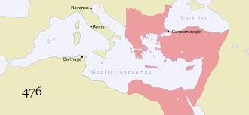
Byzantines
Byzantines were friends of the Christians because of their relationship with Rome
If you remember Constantinople was the Eastern half of the Roman Empire before it fell
Constantinople was Christian because the Emperor Constantine converted to Christianity

Slide 9
Byzantines
After the fall of the Roman Empire Constantinople eventually became the Byzantine Empire
They were defeated by a Muslim army in 1071 A.D. called the Pope for help

Slide 10
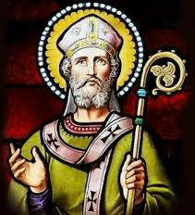
Pope Urban Wanted to Unite Europe
Pope Urban wanted to UNITE Europe together to make it stronger and wanted to bring all of Europe to the Catholic faith
He saw this as an opportunity to UNITE Europe

Slide 11
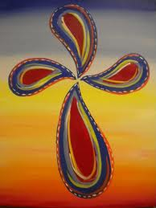
How was he going to get enough soldiers
Pope Urban had one problem he didn’t know how he would get enough people to buy into his plan
He advertised it DIVINE (directed by God himself)

Slide 12
Offering a Ticket to Heaven
Pope Urban offered a free ticket to heaven if you committed yourself to fighting in the Holy Wars
Spiritual Reward
Millions of men, whole towns of men pledged their commitments to the Holy War on Islam
http://www.history.com/topics/crusades/videos#roots-of-the-crusades

Slide 13
Knights Templar
Men of the Knights Templar started out as doctors
They began to act as escorts for Europeans traveling to Jerusalem
They became the Christian’s best military member
Christian Special Forces
http://www.history.com/videos/origins-of-the-knights-templar#origins-of-the-knights-templar
http://www.history.com/topics/crusades/videos#knights-templar-defend-holy-land
http://www.history.com/topics/crusades/videos#weapons-of-the-middle-ages

Slide 14
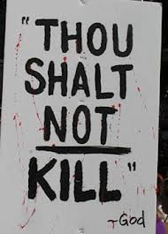
Though Shall not Kill
6th Commandment in the Christian Bible reads Though Shall not Kill
Many people had been killing during this time in Europe
Pope Urban says you must make up for your sins and fighting in the Holy War is the way to do it

Slide 15
Europe was UNITED by a Common Enemy
Pope Urban had been successful he had UNITED EUROPE under Christianity
He had done this by creating a COMMON ENEMY
The Muslims

Slide 16
Essential Questions
Get with a partner and answer….
How did religion transform societies in Europe & the Middle East?

Slide 17
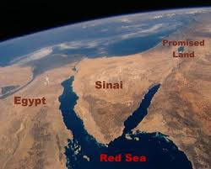
What the Pope didn’t Realize
Pope Urban couldn’t have realized that he had just opened up Pandora’s Box
Huge 100 year problem and fueled a problem that still exists today in the Holy Land

Slide 18
1st Crusade
1st Crusade started with the goal of taking back the Holy City of Jerusalem
1187 the Battle of Antioch took place between the Christians & the Muslims
http://www.youtube.com/watch?v=k37EFBEA6mo

Slide 19
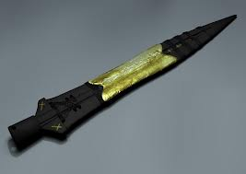
Holy Lance
The Christians had stormed the castle but the Muslims had more men on the way (a lot)
The Muslims launched a counter attack and were killing all the Christians
Then one of the Christian soldiers found the Holy Lance (legend)
This rallies the Christians & they win at the Battle of Antioch
http://www.history.com/topics/crusades/videos#search-for-the-holy-lance

Slide 20
Christians Take back Jerusalem
This was the battle that ended the 1st Crusade
Duke Godfrey takes back Jerusalem
http://www.history.com/topics/crusades/videos#fall-of-jerusalem
http://www.history.com/topics/crusades/videos#duke-godfrey-leads-the-first-crusade

Slide 21
Saladin & the Muslims Regroup
After the fall of Jerusalem to the Christians Saladin of Islam regroups his men
Much like Pope Urban had done he makes a rallying cry to all Muslims to take arms against Christians under Jihad (struggle)
This is the beginning of the 2nd & 3rd Crusades
http://www.history.com/topics/crusades/videos#saladin

Slide 22
Essential Questions
Get with a partner and answer….
What factor influenced movement by Christians to the Holy Land?

Slide 23
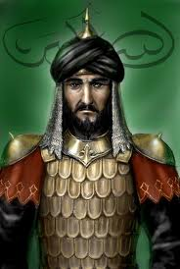
Saladin takes back Jerusalem
2nd Crusade ends in disaster for the Christians as Saladin stomps the Christians and takes back Jerusalem
The Christians are nearly wiped out by Saladin & his huge army

Slide 24
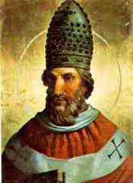
European Response
European Response to the leads to the 3rd Crusade
Pope Gregory then calls for a 3rd Crusade (Holy War)
Europe's Kings wanting to get Saladin back for destroying them during the 2nd Crusades
3 European Kings take Responsibility for fighting back against Saladin

Slide 25
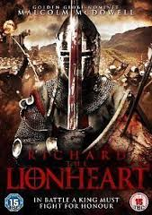
We 3 Kings
The 3 Kings of Europe who promised to defeat Saladin
King Phillip II (Coward)
King Fredrick Barbarossa
King Richard I of England
Unfortunately for the Christians Phillip II was named Phillip the Coward for a reasons
King Fredrick Barbarossa dies by drowning during the march while he is bathing in a river (boo)
This leaves only King Richard I of England to lead the Christians

Slide 26
Richard the Lion Heart
Richard 1st of England is nicknamed Richard the Lion Heart for his bravery & heroics
He eventually leads the Christians to the doorstep of Jerusalem but realizes he doesn’t have enough men to take it
http://www.history.com/topics/crusades/videos#richard-the-lionheart

Slide 27
Richard the Lion Heart
Richard the Lion Heart attacks & takes some of the Muslim stronghold cities
Saladin is impressed by Richard the Lion Heart’s bravery & offers a Truce

Slide 28
The Truce (Agreement)
Saladin & Richard the Lion Heart agree in a truce that….
Richard the Lion Heart can keep the towns around Jerusalem that he had captured
Saladin will get Jerusalem

Slide 29
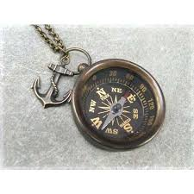
Over the Years
Over the years there were 5 more Crusades but none of them were at all successful for the Christians
They could not establish a Kingdom in the Holy Land & to this day it is largely controlled by the Muslims
It did lead to the European Age of Discovery (by accident) though

Slide 30
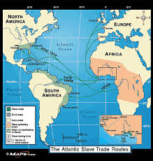
Effects of the Crusades
The one good affect of the Holy War between the Christians & Muslims is it eventually opened up….
Communication
Trade Routes
Culture
United all Muslims together
United all Christians together

Slide 31
Essential Questions
Get with a partner and answer….
What were the LONG TERM affects of the Crusades for the people?
How did Invasions, conquests & migrations affect both the regions of the Middle East & Europe?

Slide 32
EOG Questions
Exploration and conquests occurred in the middle ages.
How did they affect relations between ancient societies?
A) They caused long-lasting peace with the help of religion.
B) They caused empires to close off access between their societies.
C) They caused outbreaks of violence that closed all trade routes.
D) They caused trade routes and communication to open between societies.

Slide 33
EOG Questions
Which statement shows how trade routes influenced ancient societies?
A) As travel over land became easier, trade by water became unnecessary.
B) As different civilizations traded goods, they also shared cultural values and beliefs.
C) As trade developed, long-distance travel became safe and easy for each civilization.
D) As silk grew popular, it became a common material used in clothing across civilizations.

Slide 34
Important Points
6.C.1.2 (Religion) Pope Urban used religion to UNITE Europe against a common enemy
6.G.1.2 (Conquests) the desire to conquer the Muslims led to MIGRATION by the Christians during the Crusades
6.G.1.2 (Conquests) Muslims & Christians were able to share culture & open up trade routes after the Crusades were done
6.H.2.1 (Invasions, conquests & migrations) Muslims & Christians were both affected by the Crusades because they both UNITED their regions to fight
6.H.2.4 (Key Historical Figures) Many Key Historical Figures on both sides (Muslims & Christians)
Saladin
Richard the Lionheart

