Slide 1
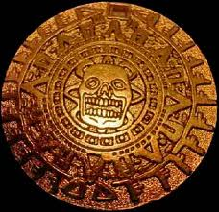
Hernan Cortez & The Aztecs
Taking Tenochtitlan
1519-1521

Slide 2
Common Core
5.G.1.1 Explain the impact of the physical environment on early settlements in the New World.
5.H.1.1- Evaluate the relationships between European explorers (French, Spanish and English) and American Indian groups, based on accuracy of historical information (beliefs, fears and leadership).
5.C.1.4 Understand how cultural narratives (legends, songs, ballads, games, folk tales and art forms) reflect the lifestyles, beliefs and struggles of diverse ethnic groups.

Slide 3
What I Will Know
5.G.1.1- Physical environment includes climate, landforms, soils, hydrology, vegetation, and animal life.
5.G.1.1- How the physical environment impacted settlement patterns and daily life in the New World.
5.H.1.1- How European explorers and American Indian groups perceived each other.
5.C.1.4- The historical background of cultural narratives in order to understand their context.

Slide 4
What I Will Understand
5.G.1.1- Physical environment affects settlement patterns.
5.G.1.1- Physical environment can determine the way that people meet basic needs such as food and shelter.
5.C.1.4- Cultural expressions can reveal the values, lifestyles, beliefs, and struggles of diverse ethnic groups.

Slide 5
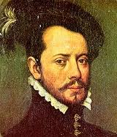
Hernan Cortez
Hernan Cortez was a Spanish Conquistador
He was sent by King Ferdinand & Queen Isabella of Spain to set up a Spanish colony, to mine gold in Espanola, and convert the natives to Christianity
Above all else he was to maintain good relations with the natives and not leave the island of Espanola
Because Espanola is such a small island it does not have much gold and the Spanish mine all the gold very quickly

Slide 6
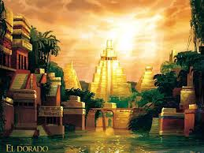
Chasing the City of Gold
(El Dorado)
5.C.1.4- He had heard of a city of gold called Piatiti (El Dorado) from a native girl called and immediately set up an expedition to find it
He set off with 11 ships, 100 sailors, and 530 soldiers to South America
He did not go far enough south and landed on the Yucatan Peninsula instead of South America where he wanted to be
However he fully believed he was in South America

Slide 7
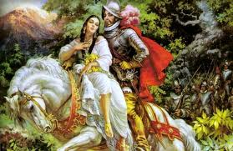
Chasing the City of Gold
(El Dorado)
Cortez’s crew is very nervous and skeptical about the expedition
Upon arriving on the Yucatan Peninsula he burns all 11 ships so that the crew has no choice but to conquer the new lands
One of the first natives he meets is a woman named La Malinche who proves to be very valuable to Cortez

Slide 8
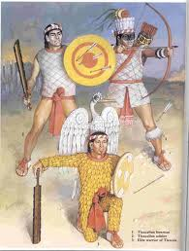
Chasing the City of Gold
(El Dorado)
La Malinche serves as Cortez’s translator to the Aztecs and also bears him a son
About a month into the expedition Cortez and his men come across the Talaxcalan people who immediately attack him
After two weeks of fighting the Talaxcalan surrender

Slide 9
Chasing the City of Gold
(El Dorado)
Cortez meets with the Talaxcalan leader who surprisingly decides to have his men join Cortez’s men because the Talaxcalan people hate the Aztecs so much
This increased Cortez’s small army to about 6,500 men
Cortez would never have been able to take the Aztecs without the help of the Talaxcalan people

Slide 10
The Aztec People
The Aztecs started out a small group of nomadic people
They grew into the most powerful group of people in Mexico
Their capital city Tenochtitlan had about 250,000 people in it
They had crops that Europeans had never seen such as corn, chocolate, & vanilla
http://www.history.com/topics/aztecs/videos#the-aztecs

Slide 11
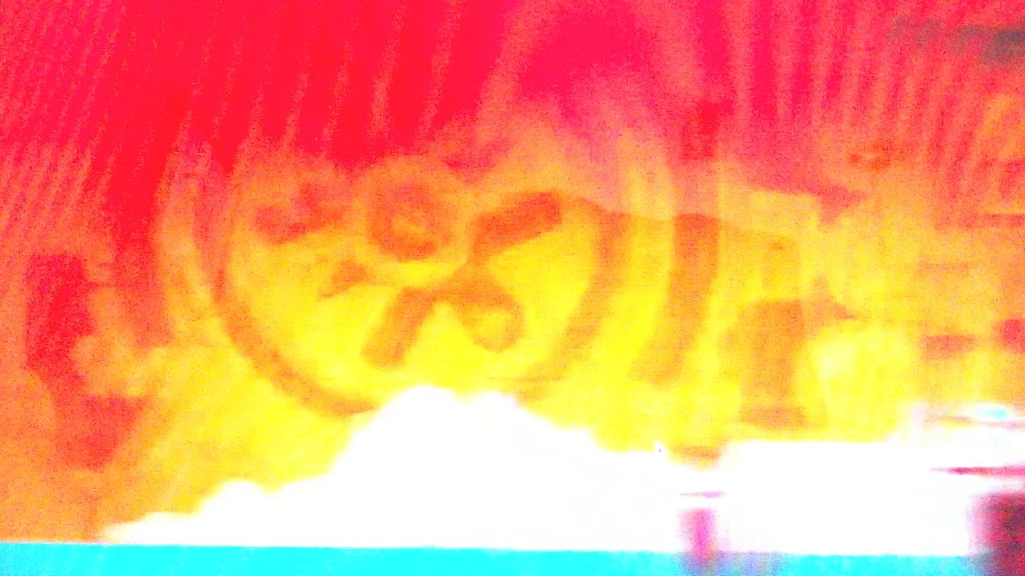
The Aztec People

Slide 12
Aztec Sacrifice
Aztec culture involved human sacrifice
They scarified humans to many of their gods but mostly to Quetzalcoatl
Quetzalcoatl the sky god (omnipotent god). He was a light skinned god
http://www.history.com/topics/aztecs/videos#aztec-sacrifice

Slide 13
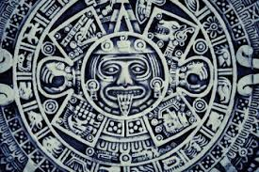
Mayan Calendar Prediction
The story of the Aztec destruction begins long before Cortez set foot in Mexico
The Mayan people of Central America predicted that a large meteorite would fall from the eastern skies in the year 1519

Slide 14
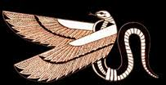
Mayan Prediction
5.C.1.4- In that year (1519) the White god of the cross and the plume of the serpent was predicted to arrive in the East
Native civilizations and their gods would be destroyed

Slide 15
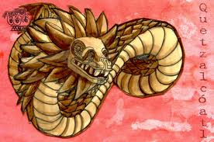
Montezuma is Frightened
When Aztec King Montezuma is told that Cortez and his men were there he is terrified
5.C.1.4- Montezuma believes the Aztec prophecy that Quetzalcoatl will angrily come to destroy

Slide 16
Aztec Legend
5.C.1.4- Legend had said that Quetzalcoatl had forbidden human sacrifice
5.C.1.4- He would come to destroy the Aztec people if they made human sacrifices
http://www.history.com/topics/aztecs/videos#prophecy-of-quexalcote

Slide 17
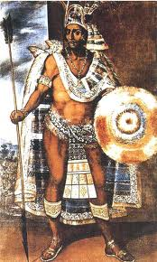
Montezuma Stands on a Hillside
5.C.1.4- As legend has it Montezuma stands on a hillside overlooking the great Aztec Capital city of Tenochtitlan in 1519
5.C.1.4- He sees the meteorite streaking across the sky
5.C.1.4- The meteorite looks like a long snake winding and bending its way across the sky
5.C.1.4- Montezuma immediately realizes that this is the Plume of the Serpent Quetzalcoatl and the white god of the cross would be there soon

Slide 18
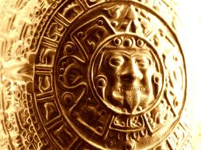
Quetzalcoatl in Disguise
5.C.1.4- Montezuma now believes that Cortez must be the white god of the cross that is sent by Quetzalcoatl in his image
5.H.1.1- Because Montezuma is at Tenochtitlan he sends men to meet Cortez giving him rare Aztec gifts
No gift more important than gold
Cortez thought immediately this must have come from the city of gold called Piatiti

Slide 19
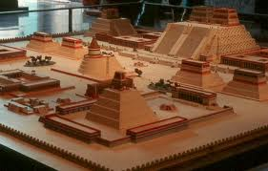
Cortez sets out for Piatiti
Cortez is told of the great capital city of Tenochtitlan which he immediately believes is Piatiti (FYI: Tenochtitlan was not Piatiti)
Cortez and the Talaxcalan set out for Tenochtitlan

Slide 20
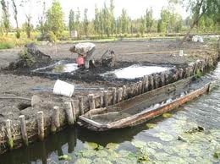
Tenochtitlan
5.G.1.1Tenochtitlan was built in the middle of lake Texcoco
5.G.1.1Tenochtitlan was built on the principle of Chinampas
5.G.1.1Chinampas’s were constructed by weaving a web of sticks in the water and piling reeds on top of them and then covering them with mud to make everything stick together
http://www.history.com/videos/aztec-ingenuity#aztec-ingenuity

Slide 21
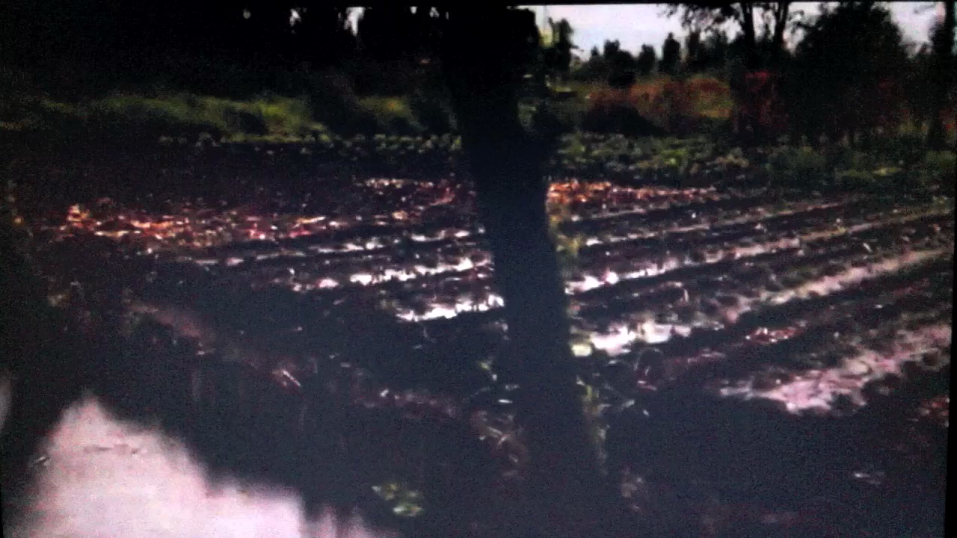
Chinampas

Slide 22
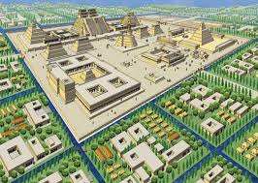
Tenochtitlan
5.G.1.1- The Chinampas were built in a grid system across the city which was right on the lake
This was their irrigation system. This gave the crops the water they needed to grow (much like the Mayans did)
5.G.1.1- This made sure that all the crops planted on the Chinampa would never need to be watered because the lake was right underneath them providing the water

Slide 23
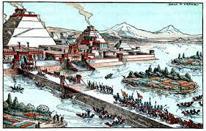
Tenochtitlan
5.G.1.1- As the crop (corn) was harvested there would be canoes with seedlings parked adjacent to the Chinampa so the seedlings could be immediately transferred and planted right after the harvest
5.G.1.1- The Chinampas would produce about 7 crops a year where as crops on dry land would produce about 1 or 2 crops a year

Slide 24
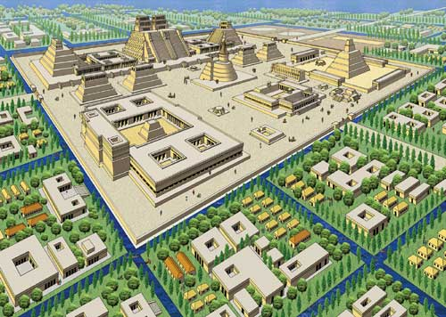
Tenochtitlan
5.G.1.1- This insured that no matter how many people lived in Tenochtitlan they would always have more than enough food
In those days the biggest threat to cites were fighting, disease (Smallpox), and starvation
To this day it remains as one of the most effective ways to create a high food supply for large populations

Slide 25
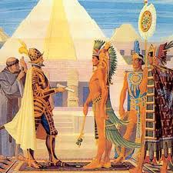
Cortez Arrives in Tenochtitlan
On November 8th, 1519 Cortez arrives at Tenochtitlan
The city was so much larger than any of them had envisioned the Conquistadors thought they must be dreaming

Slide 26
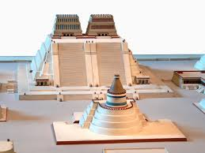
Montezuma Superstition
5.H.1.1- Upon meeting Cortez Montezuma treats Cortez as if he is Quetzalcoatl and houses him in one of the royal palaces of Tenochtitlan
Cortez believes he has found the Piatiti as gold is everywhere

Slide 27
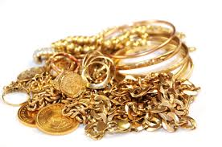
Montezuma Gives Cortez Gifts
5.H.1.1- Montezuma hoped very much that Cortez and his men would go away so he gave them a small gift of gold & jewels
The gift had the opposite affect provoking Cortez’s greed even more
After just 9 days Cortez and his men marched into the palace of Montezuma and arrest him and take control of the great city of Tenochtitlan

Slide 28
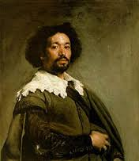
Diego Velazquez
Meanwhile, King Ferdinand & Queen Isabella had heard that Cortez disobeyed orders and left the island of Espanola
They sent Diego Velazquez & 1,400 Spanish soldiers to arrest Cortez for disobeying Spain’s King & Queen
Cortez catches wind of this and goes to the coast to battle Diego Velazquez
He leaves Pedro de Alvarado in charge of Tenochtitlan

Slide 29
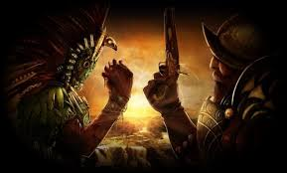
Pedro de Alvarado & The Aztec Revolt
Pedro de Alvarado murders hundreds of Aztecs when Cortez is gone
The Aztecs revolt and start fighting back
Tenochtitlan becomes a battle ground of Aztecs against Spanish & Tlaxcalan

Slide 30
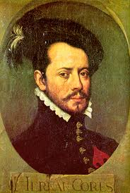
Cortez the Persuader
Cortez captures Diego Velazquez and convinces him to join him by promising gold
Now Cortez’s men number about 7,500 and they again march to Tenochtitlan

Slide 31
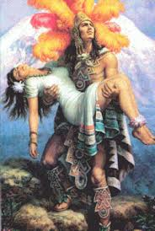
Death of Montezuma
Upon arriving back in Tenochtitlan in June of 1520 Cortez orders Montezuma to make the Aztecs stop fighting or he would be killed
Montezuma gives a speech telling the Aztec people to give up and let the Spanish be their allies
The Aztecs revolt against Montezuma considering him a traitor and stone him to death

Slide 32
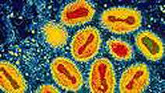
Cortez Takes Advantage of Smallpox
While Cortez was in Mexico a sweeping pandemic of Smallpox was taking place
Cortez and his men were immune to the disease because it had been in Europe for centuries
The native peoples of Mexico & South America were not immune and were dying by the thousands
An estimated 95% of the deaths during the conquest of America were from “Old World Disease”

Slide 33
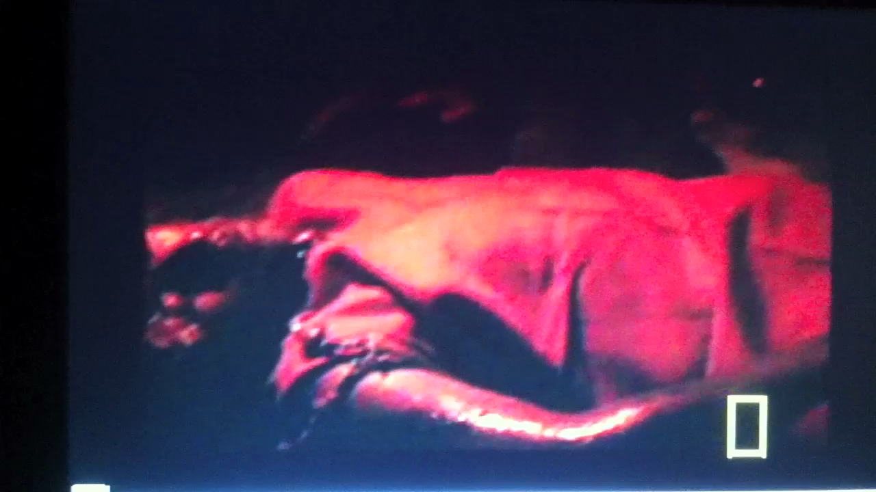
Smallpox Pandemic

Slide 34
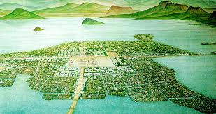
Cortez the Conqueror
Within a year Cortez has conquered every part of the Aztec Empire except Tenochtitlan
Smallpox had finally reached Tenochtitlan and the Aztecs were dying left & right
Finally on August 13th, 1521 Cortez storms into Tenochtitlan with 20,000 men and takes it easily as the Aztecs were too sick to defend

Slide 35
In The End
In the end the Great City of Tenochtitlan lie in ruins
The legendary prophecy had come true and the second most powerful civilization was destroyed
Much of the gold stolen out of Tenochtitlan by the Cortez’s Conquistadors fell into Lake Texacoco
Cortez never found the fabled city made of gold (El Dorado)

Slide 36
Important Points
The physical environment (the fact that they were on a lake) influenced the Aztecs choice on where to settle because they were able to build Chinampas
Chinampas provided a way to feed thousands of people without ever running out of food
Cortez’s Conquistadors befriended Talaxaco Indians to provide them with enough soldiers to conquer the Aztec Indians
Montezuma believed in the Mayan legend of the Plume Serpent & white god of the cross
Cortez believed in the Legend of El Dorado
Cortez would have never been able to defeat the Aztecs without
  Disease (Smallpox)
  Indian Allies

