Slide 1
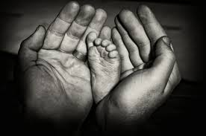
World Religion
Confucianism
551 B.C.E.-Today

Slide 2
Essential Standards
6.H.2 Understand the political, economic and/or social significance of historical events, issues, individuals and cultural groups.
6.C&G.1Understand the development of government in various civilizations, societies and regions.
6.C.1Explain how the behaviors and practices of individuals and groups influenced societies, civilizations and regions.

Slide 3
Clarifying Objectives
6.H.2.4 Explain the role that key historical figures and cultural groups had in transforming society (e.g., Mansa Musa, Confucius, Charlemagne and Qin Shi Huangdi).
6.C&G.1.1 Explain the origins and structures of various governmental systems (e.g., democracy, absolute monarchy and constitutional monarchy).
6.C&G.1.2 Summarize the ideas that shaped political thought in various civilizations, societies and regions (e.g., divine right, equality, liberty, citizen participation and integration of religious principles).
6.C.1.2 Explain how religion transformed various societies, civilizations and regions (e.g., beliefs, practices and spread of Buddhism, Christianity, Confucianism, Hinduism, Islam and Judaism).

Slide 4
Essential Questions
Why was Confucius a Historical figure to Ancient China?
What form of government structure did China have during the time of Confucius?
What is a Theocracy?
What Political Thought was the idea behind Theocracy?
How did Confucianism TRANSFORM Chinese society & government?

Slide 5
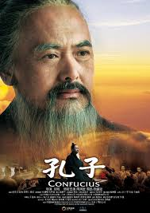
Confucius
Confucius was a Noble that lived right during the warring states period of Chinese history
He was tired of the Civil War that continued on & on in China during that time
He believed that there was a peaceful answer to all the fighting by creating a new peaceful society

Slide 6
Confucianism
Confucianism is a religion based on the “MANDATE of HEAVEN”
Confucianism taught that god in heaven wanted Chinese rulers to act with moral values instead of doing whatever they wanted
Confucianism was a SOCIETAL STRUCTURE as much as a religion that started with the Chinese Emperor

Slide 7
Religion & Government
Confucianism became the government & the religion of the Chinese people
It became a THEOCRACY
This is a government based upon RELIGIOUS PRINCIPLES

Slide 8
Confucianism (Theocracy)
Confucianism became a Theocracy
Theocracy is a government that is based on Religion
The Political Thought behind Theocracies are RELGIOUS PARTICIPATION

Slide 9
Essential Questions
Get with a partner and answer….
What form of government structure did China have during the time of Confucius?
What is a Theocracy?
What Political Thought was the idea behind Theocracy?

Slide 10
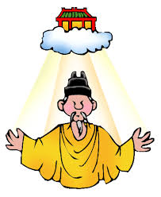
Mandate of Heaven
Mandate of Heaven was a book that was created that told how to create a peaceful government
It centered around everyone acting morally and the relationships everyone had with the people above them & below them in society
It was like the Confucian BIBLE

Slide 11
Mandate of Heaven
The Mandate of Heaven book was based on the Ancient Chinese Emperors called the SAGE EMPORERS
These were the very first emperors of China and led peaceful China by acting morally toward everyone

Slide 12
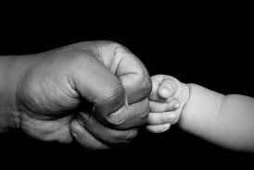
Ren
The idea of REN is understanding & practicing proper behavior in every individual situation
These have to do with how you act depending on what your relationship is & if you are SUPERIOR or INFERIOR

Slide 13
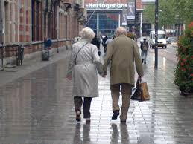
Lee
Lee has to do with rituals in Ancient China
Rituals usually centered around Elders of China (old people)
Lee is characterized by saying “RESPECT & HONOR YOUR ELDERS”

Slide 14
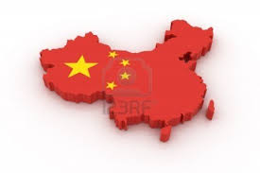
Health of the Chinese State
Confucius believed that Confucianism could cure the problems of all the wars in China by creating a new SOCIETAL STRUCTURE
He believed this would fix China & make it peaceful

Slide 15
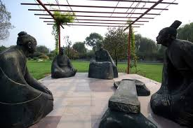
Confucianism Religious Society
Confucianism was based on MORAL UPRIGHT BEHAVIOR
Everyone lived their life in relationship to other people
You were either a SUPERIOR or INFERIOR
You had to know your place in Society

Slide 16
5 Relationships of Confucianism
The 5 most important Relationships to Confucians are…
Father & Son
Ruler & Ruled
Husband & Wife
Older Brother & Younger Brother
Friend & Friend

Slide 17
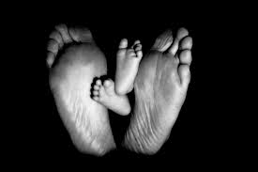
Filial Piety (Respect your Elders)
Filial Piety is respecting your parents or ancestors and treating them well
This was the basis of Confucianism
In the Societal model everyone had to give respect to the people that were either older or above them in Society

Slide 18
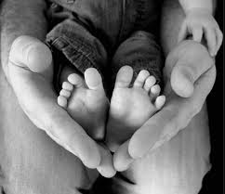
Father & Son Relationship
Son must act respectfully at all times to his father
Father will act respectably but the son must earn the respect of his father
The ultimate goal is that all boys will become SUPERIOR men in society (JUNZE)
If all men or future men make JUNZE their goal society will run smoothly

Slide 19
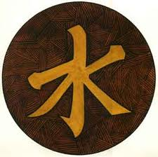
Confucian Government
The same concept was true in Confucian Government
The Emperor or king acted as the father & his people the sons
If everyone made it their goal to achieve JUNZE than government would function peacefully

Slide 20
Confucian China
Eventually Confucianism caught on in China which led to a peaceful state & a new form of government
Confucius principles of moral behavior & respecting ancestors lives today in modern China

Slide 21
Confucian China
Confucianism became the basis for Chinese…
Government
Education
Almost everything in China

Slide 22
Essential Questions
Get with a partner and answer….
Why was Confucius a Historical figure to Ancient China?
How did Confucianism TRANSFORM Chinese society & government?

Slide 23
Important Points
6.H.2.4 (Key Historical Figure) Confucius was a Chinese man that transformed Chinese government & religion by creating peace through a new religion/society
6.C&G.1.1 (Government Structure) A THEOCRACY is a government based on RELIGION
6.C&G.1.2 (Political Thought) The political thought behind a Theocracy is acting based on RELIGIOUS PRINCIPLES
6.C.1.2 (Religion) Confucianism became a Chinese religion based on having high moral values & treating everyone nicely

