Slide 1
Columbus Day
Who was Christopher Columbus

Slide 2
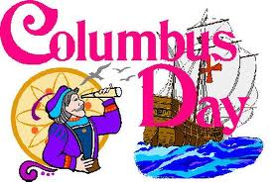
Columbus Day
Every October 8th Americans celebrate Columbus Day even though the traditional Columbus Day is not until October 12th
What can you tell me about Columbus Day
Lets Find Out if you are right

Slide 3
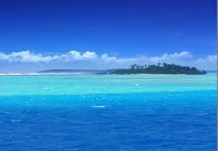
Columbus Day
Columbus Sailed the Ocean Blue into 1492
http://www.teachingheart.net/columbus.htm

Slide 4
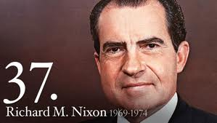
United States Decides to Honor Columbus
In 1937 President Franklin Delino Roosevelt proclaimed October 12th as Columbus Day to honor the Italian Explorer
In 1971 President Richard Nixon declared Columbus Day a National Holliday

Slide 5
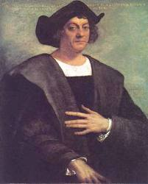
Christopher Columbus
Cristobol Colon
Born in Italy
1450
Famous Explorer
Cartographer (Map Maker)
Navigator
Has a Holliday named after him

Slide 6
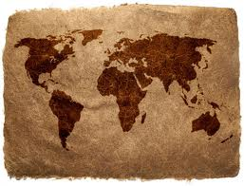
Why is Columbus so Popular
Because He discovered North America
Because He discovered that the earth wasn’t flat but was actually round
Because He made friends with the Indian Cultures
Right??

Slide 7
Lets Set Some Things Straight
Columbus may have sailed the Ocean Blue in 1492 but he did not…
Discover that the earth was round
Was not nice to the Native American Tribes
He DID NOT DISCOVER NORTH AMERICA (That’s Right I said it) (If you were sleeping you can wake up now because I said Columbus did not discover North America)

Slide 8
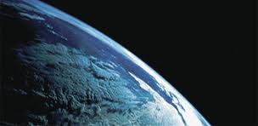
We Already Knew the Earth was Round
A couple of Greek Guys
Pythagoras figured out that the earth was round in the 6th century B.C. (600 years before Jesus Christ was born)
Aristotle backed him up in the 4th century B.C. (400 years before Christ was born)

Slide 9
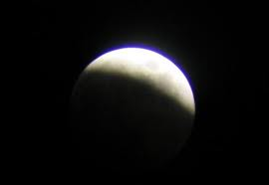
The Lunar Eclipse
These two Greek guys really liked to look at the stars and planets
Back in those times you were considered extremely smart if you understood astronomy (Heck in these times you are considered really smart if you understand astronomy, that stuff is hard)
One day when they were looking at a lunar eclipse (when the earth blocks out the moon) they noticed that the earth’s shadow was round and didn’t create a sharp edge so the earth had to be round

Slide 10
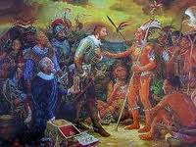
Well What About The Natives & Discovering North America
I will tell you the story of how he treated the Natives he found and about how he never even set foot in North America

Slide 11
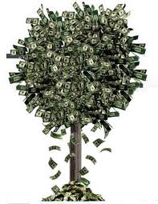
Why Did Columbus Go To America Then??
So You may be asking yourself why Columbus went to America
One Reason and one reason only
MONEY

Slide 12
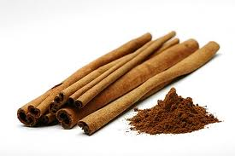
Spices
When Columbus lived in Spices were for rich people (pepper, cinnamon, salt)
In those times they used for a lot of things
Flavor Food
Medicine
Essences
Preserve Food (because they didn’t have refrigerators yet)

Slide 13
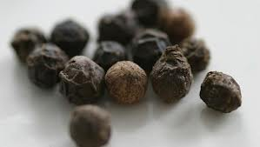
Spices
Asia & India had all the spices that Europe wanted
A man could get rich brining spices from Asia & India to Europe (filthy rich)

Slide 14
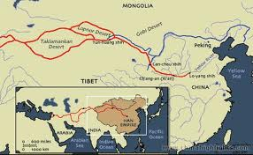
Traders & Silk Road
People called Traders would walk (or ride a camel sometimes) hundreds of miles across the desert from Europe to Asia & India on the Silk Road
Then they would load up their camels with spices to sell and walk back to Europe
They would get rich fast

Slide 15
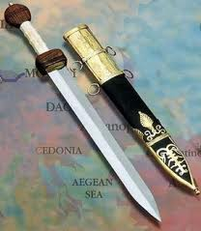
The War
Everything was going great until the war in Constantinople
Constantinople was right in the path that people used to walk or camel themselves over to Asia & India
It became too dangerous for traders

Slide 16
Columbus Opportunity
Columbus realized that if he could find a water route to Asia & India he could get rich fast
Because he knew the earth was round he knew that he could sail west and eventually get to Asia & India by sailing “around” the World

Slide 17
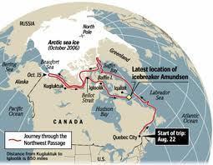
Northwest Passage
Columbus opportunity is known as the Northwest Passage
This is an all waterway Northwest of Europe
This Northwest Passage would lead to Asia & India by going west by sea instead of East by land (Silk Road)

Slide 18
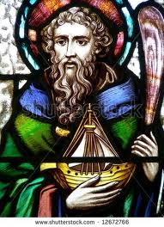
Columbus Does His Research
He has heard that an Irishman St. Brendan had gotten lost at sea and claimed he had discovered a new land
St. Brendan had anticipated that there was another land that was rich in fruit and flowers

Slide 19
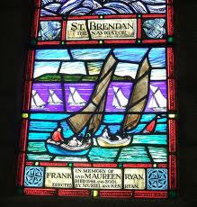
Columbus Does His Research
Columbus makes a trip to Galway Ireland to hear the legends of St. Brendan
There he decides that he will make the trip to try to find the same land that Brendan supposedly found hundreds of years before
Columbus thinks that this land is China
But Columbus still has no money

Slide 20
Columbus Tries to Get Money for his Voyage
Columbus goes to many Kings & Queens to try to get money for his voyage
He tries and tries but no King & Queen will give him money
Finally King Ferdinand V & Queen Isabella I agree to pay for his voyage

Slide 21
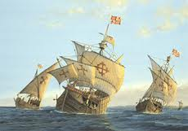
Columbus 1st Voyage
Christopher Columbus left Spain
August 3rd 1492
84 people (including women)
3 Ships (What were the names of those famous 3 ships)

Slide 22
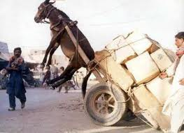
WRONG!!
Everybody thinks the names of these 3 famous ships were the Nina, Pinta, Santa Maria
In actuality only the Santa Maria is the correctly identified ship
In those days ships were named after saints because the sailors thought that God would keep them safe if they named their ship after a saint

Slide 23
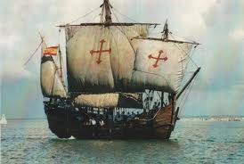
Nina
The Nina was actually named the Santa Clara
Named after St. Claire
The Nina was a nickname given to the ship because it was owned by a Spaniard named Juan Nino
The Santa Clara was a Caravel Ship
It carried 24 men

Slide 24
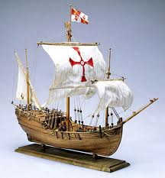
Pinta
Historians are sure that the Pinta was also a nickname of the ship but are not sure what the ships real name was.
This was also a Caravel Ship
Was the fastest ship of the three
It was nicknamed the Pinta because it was painted on the outside (Pinta is Spanish for painted)
It carried 26 men

Slide 25
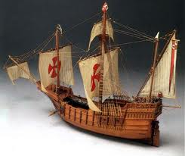
Santa Maria
Santa Maria was the only vessel that was not nicknamed because the sailors felt that the name was too sacred to nickname the ship
Named for St. Mary
The ship was a Carrick
It carried 40 people including Christopher Columbus

Slide 26
Modern Ship Engineering
The Caravel
Ship of Speed
http://www.history.com/topics/columbus-day/videos#columbus-ships-are-marvels-of-engineering

Slide 27
Columbus Begins Sailing
Columbus sailed from Spain to the Canary Islands off the coast of Africa
He docked there to get more supplies and began sailing again on September 6th 1492
The Voyage was to take about 3 weeks

Slide 28
Still Sailing
After almost 5 weeks of sailing Columbus and his men still had not seen land
His men were starting to lose faith in Columbus and they thought they would never see land
His men were angry and wanted to turn back to Spain
Columbus convinced his men to give him 3 more days
http://www.history.com/videos/christopher-columbus-sets-sail#columbus-faces-down-the-mutinous-crew

Slide 29
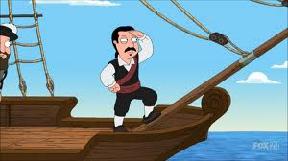
Land Was Sighted
On that 3rd day October 12th at about 2 A.M. land was sighted

Slide 30
Santa Maria Sinks
Navigating the Santa Maria into the new islands the ship strikes a huge rock about 3 miles off the coast
The ship begins taking on water and Columbus realizes it is about to sink
He tries to sail it toward the island but it is too late and the ship sinks

Slide 31
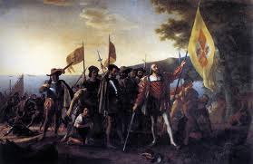
Columbus Lands
Columbus landed his 2 ships on these lands and claimed the land for Spain
He had landed in the Bahamas on the island of San Salvador
He had not landed in North America (in fact he would never set foot in North America)

Slide 32
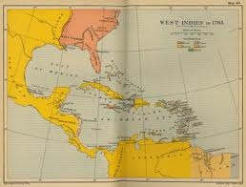
Naming The New Land
Columbus named the new land the West Indies
He named the West Indies because he had sailed west & he believe he had reached India
He had no idea that this was not India

Slide 33
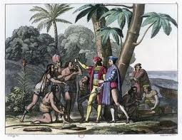
The Natives “Indians”
Within the first couple of days the Natives came to the new White people
Columbus named these people Indians because he thought he was in India
These were really people of the Arawak Tribe

Slide 34
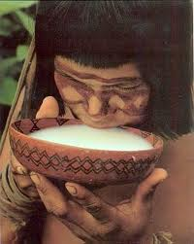
The Natives “Indians”
They began to give gifts to Columbus & his men
They helped save the sailors & cargo from the Santa Maria that was floating in the water
They offered Columbus and his people a place to stay, brought them food and water, and gave them gifts of beads, feathers, & gold

Slide 35
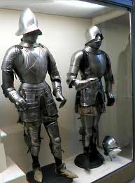
The Natives “Indians”
The Arawak were impressed by Columbus and his crew’s armor, swords, & guns because they had never seen them before
They thought Columbus and his men were White Gods and gave them everything

Slide 36
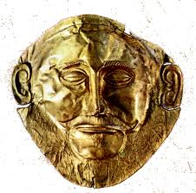
Arawak Jewelry
Within a couple of months Columbus had realized that he had not reached India or Asia like he had hoped
He changed his motives
He saw that the Arawak people were wearing yellow stones as jewelry pieces in their ears and noses
The Arawaks would not trade these pieces but said that they got them through trading with other island nations

Slide 37
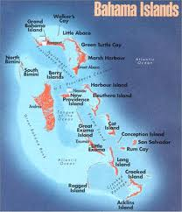
Columbus Starts Exploring
Columbus sets sail again in search of gold
He goes north and finds the island of Cuba
These Natives also wear gold and much more gold

Slide 38
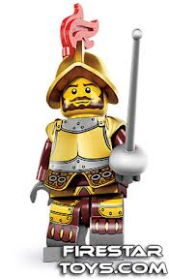
Columbus Starts Exploring
He trades for the gold
He goes around to the different Native tribes trading for gold
He now has enough to go back to Spain
He starts a tiny colony called Navidad (about 40 people)

Slide 39
Columbus Returns to Spain
Columbus goes back to Spain with gold, slaves, and other things he has discovered to present to King Ferdinand & Queen Isabella
He tells of vast gold mines, more gold than could ever be collected
This is a lie as there were small gold mines and the gold that he has gotten was traded for not mined
In reality there is not much gold in the Bahamian Islands at all

Slide 40
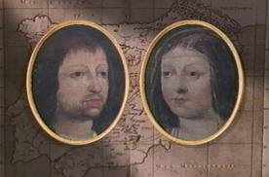
King & Queen are Happy
The King & Queen are delighted by the news
They want the GOLD too
They agree to fund Christopher Columbus on his second voyage
A MUCH BIGGER voyage

Slide 41
Columbus 2nd Voyage
September 24th 1493 he set sail again
This time he had 17 ships
He had over 1,000 men
He had heavily armed soldiers
Their purpose was to start the first colony and discover more gold

Slide 42
Land Sighted
They landed in Dominica on November 3rd 1493
Immediately they began exploring and trying to set up a colony
He set up a colony and made himself governor/ruler
Small gold mines were finally found and Columbus got greedy

Slide 43
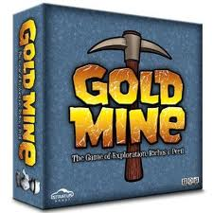
Gold Mines
Originally Columbus men worked the gold mines
But this was a tough job and he was losing many of his men to disease & exhaustion
He decided to start capturing Indians to start mining the gold

Slide 44
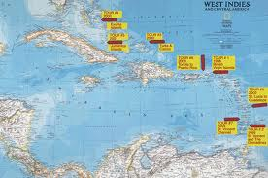
Columbus Raids
Columbus would go to the different Indian villages and capture them by force kidnapping their people to work in the gold mines
Every Indian over 14 years old was forced to mine for gold
He would give the Indians no food and work them to exhaustion

Slide 45
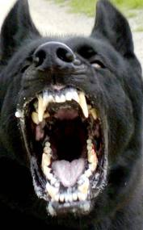
Columbus Gold Mine Penalties
If an Indian did not mine enough gold in one day they would cut off his hands
If Indians would try to escape Columbus would send attack dogs trained to kill
If escaped Indians were brought back alive they were burned

Slide 46
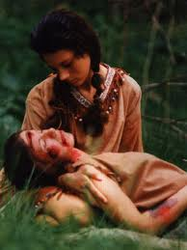
Many Indians Died
After two years 125,000 Native Indians had been killed over gold mining
That was half of all the Indians in the Bahamian Islands

Slide 47
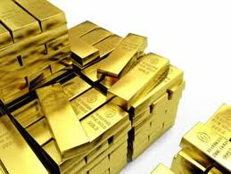
Gold Mines Were Running Out
Columbus gold mines were running out and he still had not raised the money that he had promised
He had to think of a way to make more money

Slide 48
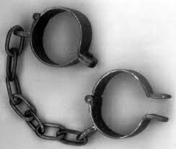
Slavery
Columbus solution was slavery
He went to the different islands capturing Indians and making them slaves to take back to Spain
Some of his colonies people were starting to get angry with him over the treatment of the Indians

Slide 49
Columbus 2nd Voyage
http://www.history.com/videos/christopher-columbus-sets-sail#columbus-quest-for-gold
Columbus 2nd Voyage

Slide 50
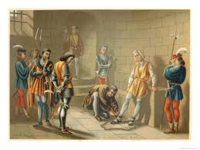
Christopher Columbus Arrested
Christopher Columbus was arrested and sent back to Spain
He arrived in Spain in shackles
He was sent to jail for 6 weeks until he appeared before King Ferdinand & Queen Isabella

Slide 51
Pardon
Ferdinand & Isabella grant Christopher Columbus a pardon
They restore his fame and wealth

Slide 52
What happened to Columbus
Columbus would never rule again
He would make a couple more trips to America
He was hated by everyone there
He died a rich but hated man in 1507
He goes down in history as a her but what do you think of Christopher Columbus

Slide 53
Columbus Book of Privileges
http://www.history.com/topics/columbus-day/videos#columbus-book-of-privileges

Slide 54
Columbus The Real Story
http://www.history.com/topics/columbus-controversy/videos#christopher-columbus-man-and-myth

Slide 55
So Who Really did Discover America
If Columbus never made it to America who discovered America
Nobody really knows
Many experts think many different things
You decide

Slide 56
Did The Vikings Discover America?
http://www.history.com/topics/leif-eriksson/videos#leif-erickson-vs-christopher-columbus
The Vikings Discovered America

Slide 57
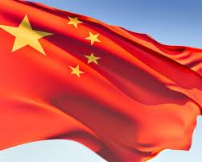
Did China Discover America?
Chinese Discover America
http://www.history.com/videos/christopher-columbus-sets-sail#did-the-chinese-discover-america

Slide 58
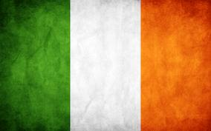
Did Ireland Discover America??
Irish Discover America
http://www.history.com/videos/christopher-columbus-sets-sail#did-the-irish-discover-america

