Slide 1
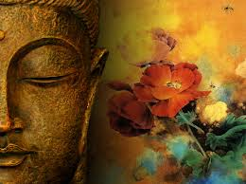
World Religion
Buddhism
500 B.C.E-Today

Slide 2
Essential Standards
6.H.2 Understand the political, economic and/or social significance of historical events, issues, individuals and cultural groups.
6.C.1Explain how the behaviors and practices of individuals and groups influenced societies, civilizations and regions.

Slide 3
Clarifying Objectives
6.H.2.4 Explain the role that key historical figures and cultural groups had in transforming society (e.g., Mansa Musa, Confucius, Charlemagne and Qin Shi Huangdi).
6.C.1.2 Explain how religion transformed various societies, civilizations and regions (e.g., beliefs, practices and spread of Buddhism, Christianity, Confucianism, Hinduism, Islam and Judaism).
6.C.1.3 Summarize systems of social structure within various civilizations and societies over time (e.g., Roman class structure, Indian caste system and feudal, matrilineal and patrilineal societies).

Slide 4
Essential Questions
How were Hinduism & Buddhism different?
How was Siddhartha important to Buddhism?
What does Buddha mean?
How did Buddhism spread throughout the world?
What is NIRVANA?

Slide 5
India & China
Buddhism is a religion that started in India & spread all the way to China
It is now practiced all over the world but mostly in the Eastern part of the world (Asia)

Slide 6
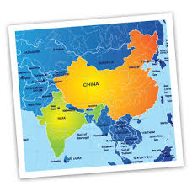
Battle of Hinduism & Buddhism
Buddhism and Hinduism were in constant competition because they were fighting to be “THE” religion of Ancient India
Buddhism taught that the Caste System had nothing do with reaching the afterlife

Slide 7
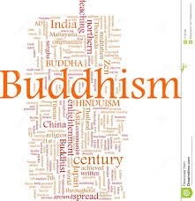
Battle of Hinduism & Buddhism
Buddhism teaches that you need to do a couple of things….
Live by 4 Noble Truths
Follow 8 rules and you wouldn’t have to go through all the being born again stuff

Slide 8
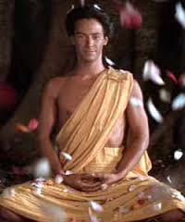
Siddhartha
Buddhism starts with a prince named Siddhartha who lived in India
His parents kept him locked in his palace because of a prophecy that foretold if he left they would lose the kingdom
Pretty much on house arrest even though he hadn’t done anything

Slide 9
Essential Questions
Get with a partner and answer….
How were Hinduism & Buddhism different?
How was Siddhartha important to Buddhism?

Slide 10
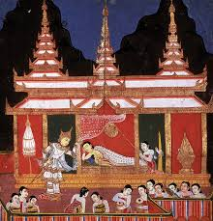
Siddhartha had a good Life
Siddhartha had all the food necessary
Great entertainment
Had already been married to his beautiful cousin
Living the good life
Wanted more

Slide 11
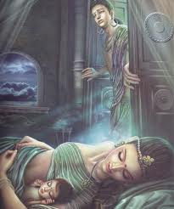
Siddhartha Sneaks Out
He sneaks out of the palace and goes traveling
He starts to realize that life is a combination of SUFFERING
On these travels he encounters an…
Old man
Sick man
Dead man

Slide 12
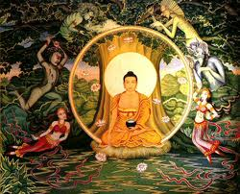
Siddhartha Meditates
Siddhartha becomes so obsessed with trying to figure out why everyone is suffering that he meditates under the same tree for days at a time
One day he figures it out

Slide 13
Siddhartha’s Enlightenment (Nirvana)
Siddhartha finally experiences Enlightenment which he names NIRVANA
NIRVANA is the final goal of Buddhism
NIRVANA is a state of mind where…
No suffering
No personal desire

Slide 14
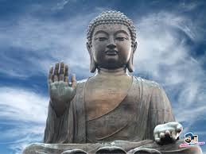
Siddhartha becomes Buddha
Because Siddhartha had reached NIRVANA he begins teaching it to other people
Buddha means TEACHER
He goes around and teaches the 4 Noble Truths (Bible)

Slide 15
Essential Questions
Get with a partner and answer….
What does Buddha mean?
What is NIRVANA?

Slide 16
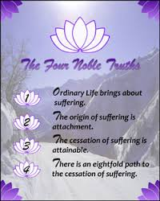
4 Noble Truths (Bible)
The 4 Noble Truths are like the Bible of Buddhism
The 4 Noble Truths are…
All Life is Suffering
Reason for suffering is DESIRE
To stop suffering you must get rid of Desire
To do this you must follow the 8 fold Path

Slide 17
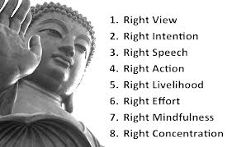
8 Fold Path

Slide 18
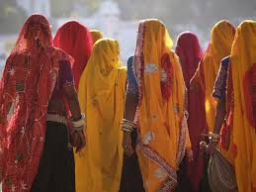
Ancient Indian Begin to Convert to Buddhism
Ancient Indian Begin to Convert to Buddhism
This is because it didn’t involve Karma & it didn’t have anything to do with the Indian Caste System
All you had to do was believe & practice the 8 Fold Path

Slide 19
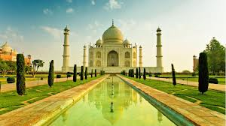
Ancient Indian Begin to Convert to Buddhism
That means that anyone who follows the 8 Fold Path & gets rid of desire can achieve NIRVANA
That meant they wouldn’t have to go through the whole being reincarnated as a fish thing

Slide 20
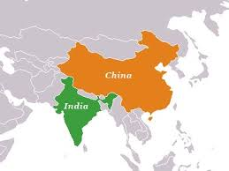
Spread of Buddhism
Buddhism spreads just like all the other religions
It spreads through….
Travelers on trade routes
Missionaries after it had been established

Slide 21
Essential Questions
Get with a partner and answer….
How did Buddhism spread throughout the world?

Slide 22
EOG Question
Which statement shows how trade routes influenced ancient societies?
A) As travel over land became easier, trade by water became unnecessary.
B) As different civilizations traded goods, they also shared cultural values and beliefs.
C) As trade developed, long-distance travel became safe and easy for each civilization.
D) As silk grew popular, it became a common material used in clothing across civilizations.

Slide 23
EOG Question
Exploration and conquests occurred in early World Religion.
How did they affect relations between ancient societies?
A) They caused long-lasting peace with the help of religion.
B) They caused empires to close off access between their societies.
C) They caused outbreaks of violence that closed all trade routes.
D) They caused trade routes and communication to open between societies.

Slide 24
Important Points
6.H.2.4 (Key Historical Figure) Siddhartha was the founder of Buddhism & the first Buddha
6.C.1.2 (Spread of Religion) Buddhism spread through new people on new trading networks & later by missionaries
6.C.1.3 (Social Structure) India operated by the Indian Caste System
6.C.1.2 (Beliefs & Practices) Buddhists have to live by the 4 Noble Truths & 8 Fold Path

