Slide 1
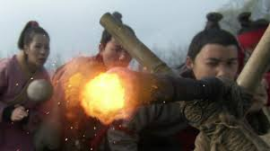
Mongols
Birth of the Gun
Ming Dynasty
1368-1644

Slide 2
Essential Standards
6.H.2 Understand the political, economic and/or social significance of historical events, issues, individuals and cultural groups.
6.E.1 Understand how the physical environment and human interaction affected the economic activities of various civilizations, societies and regions.
6.C.1Explain how the behaviors and practices of individuals and groups influenced societies, civilizations and regions.

Slide 3
Clarifying Objectives
6.H.2.3 Explain how innovation and/or technology transformed civilizations, societies and regions over time (e.g., agricultural technology, weaponry, transportation and communication).
6.E.1.2 Explain how quality of life is impacted by economic choices of civilizations, societies and regions.
6.C.1.1 Analyze how cultural expressions reflected the values of civilizations, societies and regions (e.g., oral traditions, art, dance, music, literature, and architecture).

Slide 4
Essential Questions
What WEAONRY innovation changed China forever & how did it revolutionize (change) China?
How were the Mongols impacting the QUALITY OF LIFE of the Chinese?
What famous piece of architecture was completed during the Ming Dynasty?

Slide 5
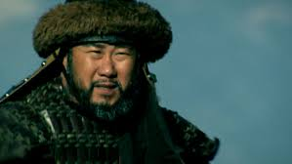
Ming Dynasty
Ming Dynasty is actually a Chinese Dynasty
Why is it in the Mongol Unit then?
This lesson is with the Mongol Unit because the Ming Dynasty ended the Mongols
So the story of the Ming Dynasty is the story of the Decline of the Mongol Empire

Slide 6
Mongols are in Charge
In China the Mongols are in charge and they are brutal
They kill whole villages of people & burn them into the ground
Now the Bubonic Plague has loosened their grip on China just enough for the Chinese to rebel against the Mongols

Slide 7
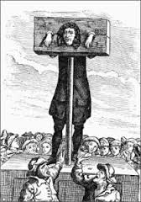
Quality of Life
The QUALITY of LIFE for the Chinese living amongst the Mongols was terrible
The Mongols because of their lack of government had racked up high DEBT
The Mongol LEADERS were RICH while everyone else was poor
Lack of a government structure led to POOR MANAGEMENT of the Mongol Territory

Slide 8
Essential Questions
Get with a partner & answer….
How were the Mongols impacting the QUALITY OF LIFE of the Chinese?

Slide 9
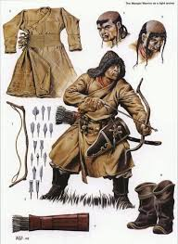
Mongol Horses & Arrows
Mongols run over China by keeping their distance
The skill in archery allows them to kill their Chinese enemies from a distance
Their horses carry them away fast enough that the Chinese cannot get to them fast enough

Slide 10
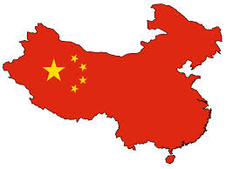
Bad Times in China
Chinese people have nothing to eat
Chinese have no clothing
Mongols have gained control of their trade goods
Mongols are in control of everything

Slide 11
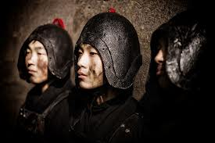
Red Turbines
Red Turbines are a gang of Chinese warriors
Chinese people flock to join the Red Turbines to rebel against the Mongols
They are trained and become experts in Kung Fu (Chinese Martial Arts)

Slide 12
Red Turbines
They know if they don’t defeat the Mongols they will all be killed
But they have a secret weapon that nobody knows about

Slide 13
Guns
Gunpowder invented by the Chinese almost 300 years earlier up until this point had only been used to scare enemies
A young Red Turbine warrior realizes they can make a weapon from this gun powder
http://www.history.com/shows/mankind-the-story-of-all-of-us/videos/mankind-the-story-of-all-of-us-gunpowder-to-guns?m=51896f71b138f
http://www.history.com/shows/mankind-the-story-of-all-of-us/videos/mankind-the-story-of-all-of-us-weapons?m=518971d79ac04

Slide 14
Guns
He designs a weapon he calls Human Thunder
A small stone that is propelled through the air by the explosion of gun powder
The world’s first GUN is born
The future of warfare has just been rewritten

Slide 15
Essential Questions
Get with a partner & answer….
What WEAONRY innovation changed China forever & how did it revolutionize (change) China?

Slide 16
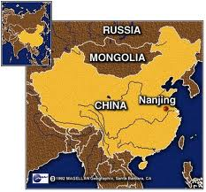
City of Nan Jing
City of Nan Jing was the Mongol capital city in China
It was where the most Mongols live
It was the city that the Red Turbine rebels had to take if they wanted to defeat the Mongols

Slide 17
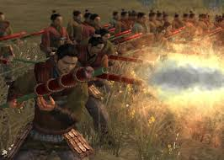
Red Turbines Attack
Red Turbines attack the Mongols for the first time
They bring their guns
Although guns were not very accurate at this time in history the Red Turbines bring hundreds

Slide 18
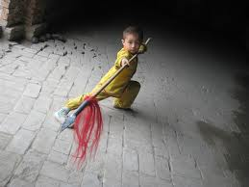
Mongols Have No Idea what Hit Them
Mongols run into the city & those that fight are killed by guns
It allows the Red Turbines to get into the city where they can defeat the Mongols using hand to hand combat

Slide 19
Kung Fu
Once they are in the city the Chinese are able to get close enough to the Mongols to use their Kung Fu hand to hand combat
They easily defeat the Mongols and drive them from Nan Jing
http://www.youtube.com/watch?v=xwwQ0ziF2s8
http://www.youtube.com/watch?v=B9FA0xQoZ8M

Slide 20
Next 12 Years
Over the next 12 years the Chinese drive the Mongols out of China and back to Mongolia where they came from
They do this using GUNS

Slide 21
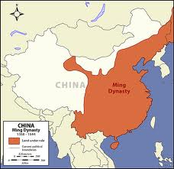
Ming Dynasty
The leader of the Red Turbines becomes Emperor of China
He names the new Dynasty the Ming Dynasty because Ming means light in Chinese
The Mongols were the darkness and Red Turbines the “LIGHT” of new China

Slide 22
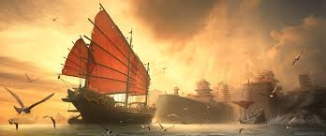
City of Nan Jing
City of Nan Jing becomes the new Chinese Capital of the new Ming Dynasty
Nan Jing becomes the Emperor’s city where he lives

Slide 23
Great Wall of China
The Great Wall of China is finally finished to make sure that the Mongols never invade China again
Over 5,500 miles long & 20,000 towers
Finally completed over 1000 years after it was started
http://www.history.com/topics/great-wall-of-china/videos/deconstructing-history-great-wall-of-china
http://www.history.com/topics/great-wall-of-china/videos/deconstructing-history-great-wall-of-china

Slide 24
Essential Questions
Get with a partner & answer….
What famous piece of architecture was completed during the Ming Dynasty?

Slide 25
EOG Questions
poor management by leaders
hoarding of wealth
too much debt
How did the economic factors listed affect the ancient empires?
A) Empires weakened and were eventually destroyed.
B) Empires forced wealthy citizens to forfeit money in taxes.
C) Armies searched other empires for new leaders to govern.
D) Armies of the empires were sent to other lands to increase wealth.

Slide 26
Important Points
6.H.2.3 (Weaponry Innovation) Chinese invent the first GUNS and use them to defeat the Mongols & drive them out of China
6.E.1.2 (Quality of Life) The Mongols lack of GOVERNMENT STRUCTURE & high DEBT leads to a POOR quality of life for their people
6.C.1.1 (Architecture) The Chinese finished the Great Wall of China for protection so that enemies would never again be able to do what the Mongols had done

