Slide 1
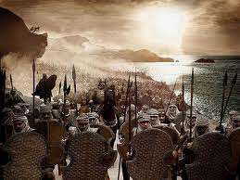

Slide 2
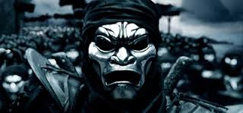
Ancient Civilizations of Mesopotamia
Ancient Persia
539-330 B.C.E.

Slide 3
Essential Standard
6.H.2- Understand the political, economic and/or social significance of historical events, issues, individuals and cultural groups.
6.C&G.1- Understand the development of government in various civilizations, societies and regions.
6.C.1- Explain how the behaviors and practices of individuals and groups influenced societies, civilizations and regions.
6.G.1- Understand geographic factors that influenced the emergence, expansion and decline of civilizations, societies and regions (i.e. Africa, Asia, Europe, and the Americas) over time.
6.E.1Understand how the physical environment and human interaction affected the economic activities of various civilizations, societies and regions.

Slide 4
Clarifying Objective
6.H.2.3 Explain how innovation and/or technology transformed civilizations, societies and regions over time (e.g., agricultural technology, weaponry, transportation and communication).
6.H.2.1 Explain how invasions, conquests and migrations affected various civilizations, societies and regions (e.g., Mongol invasion, The Crusades, the Peopling of the Americas, Alexander the Great, Cyrus the Great).
6.H.2.4 Explain the role that key historical figures and cultural groups had in transforming society (e.g., Mansa Musa, Confucius, Charlemagne and Qin Shi Huangdi, Cyrus the Great, Xerxes).

Slide 5
Clarifying Objective
6.C&G.1.1 Explain the origins and structures of various governmental systems (e.g., democracy, absolute monarchy and constitutional monarchy).
6.C&G.1.2 Summarize the ideas that shaped political thought in various civilizations, societies and regions (e.g., divine right, equality, liberty, citizen participation and integration of religious principles).
6.C.1.2 Explain how religion transformed various societies, civilizations and regions (e.g., beliefs, practices and spread of Buddhism, Christianity, Confucianism, Hinduism, Islam, Zoroastrianism and Judaism).

Slide 6
Clarifying Objective
6.G.1.4 Explain how and why civilizations, societies and regions have used, modified and adapted to their environments (e.g., invention of tools, domestication of plants and animals, farming techniques and creation of dwellings).
6.E.1.1 Explain how conflict, compromise and negotiation over the availability of resources (i.e. natural, human and capital) impacted the economic development of various civilizations, societies and regions (e.g., competition for scarce resources, unequal distribution of wealth and the emergence of powerful trading networks).

Slide 7
The Persians
The Persians started out as a nomadic people in the current country of Iran (desert)
In the beginning of their civilization they were an agricultural society
However under 3 great emperors they became the largest & most feared military group in the ancient world
Here is their story

Slide 8
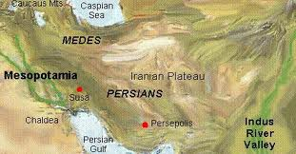
There were 3
In Mesopotamia there were two civilization sprouting up
The Medes to the North, Babylonia & Persia to the South
There would be only room for one great empire in the region

Slide 9
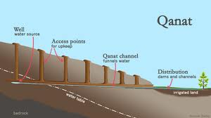
Qanat Irritation System
The Persians needed a water source for their crops
They utilized an irrigation technique called the Qanat
Because Persia started in present day Iran mountains were there
Because of the altitude of the mountains snow & ice would accumulate at the top
They used those mountains downward slope to draw water from the top of the mountains

Slide 10
SLOPE
Remember from Math class that the slope has the equation of…
Rise/Run
This meant that the Persian engineers had to figure out how to stabilize the slope
This means move the water at exactly the same speed all the way down the mountain
Engineers had to build to slow the water down or speed it up depending on the slope of the mountain

Slide 11
Qanat Irritation System
1 unit in elevation for every 100 horizontally
That is rise/run or the slope
If you mess the slope up you will not hit the aquifer (ground water)
http://www.youtube.com/watch?v=La76Yl1wuGM

Slide 12
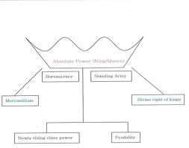
Absolute Monarchy
An Absolute Monarchy is operated by a King/Emperor who has control over everything
The King/Emperor is not restricted by a constitution of any sort
He/she can make any ruling for any reason whenever he/she wants to

Slide 13
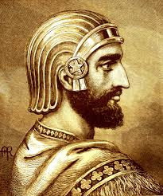
Cyrus The Great
559-530 B.C.E.
Created the Persian Empire
Military & Political genius
He was an excellent organizer of men & benevolent to his enemies

Slide 14
Cyrus The Great
The Jews called him Shiok (anointed one)
Ionians (enemies) just & worthy lawgiver & ruler
His own people called him Father

Slide 15
RESPECT
What made Cyrus the Great such a great leader was he respected the religions & customs of the lands he conquered
The conquered civilizations became part of Persia but Cyrus the Great allowed/tolerated them to continue to live as their own civilizations
He refused to enslave the people he conquered

Slide 16
Zoroastrianism
In Zoroastrianism the King ruled Persia because the greatest god asked him to do this for him
Zoroastrianism teaches that there is one supreme god (monotheistic)
The religion believes in water & fire & earth being the universal signs of purity

Slide 17
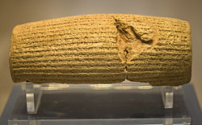
Human Rights & Cyrus Cylinder
The Cyrus Cylinder is Cuneiform text written on a cylindrical shaped clay
It was written by the Babylonians and states high praise Cyrus the Great
Cyrus the Great believed in treating his enemies fairly even after conquering them

Slide 18
Defeating Medes
Cyrus the Great comes to power and defeats the Medes civilization
The Medes civilization becomes part of the Persian Empire

Slide 19
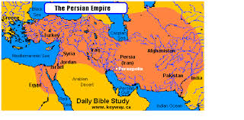
Conquering Babylon
Cyrus the Great expands his empire by invading and capturing the great civilization of ancient Babylonia
Shortly after the capture he issues the Edict of Restoration

Slide 20
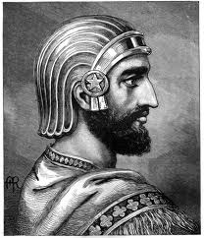
Edict of Restoration
The Jews had been living in Babylon since Nebakanezer destroyed their temple in Jerusalem
Cyrus the Great issued a decree (law) called the Edict of Restoration
This decree (law) freed the Jews and allowed them to go back to Jerusalem
For this the Jews referred to Cyrus the Great as Shiok

Slide 21
Expanding his Empire
Before being able to able to expand his empire to the largest empire in the Near East Cyrus the Great died in battle in 530 B.C.E.
This would usher in the new great emperor of the Persian Empire
The cousin of Cyrus the Great Darius

Slide 22
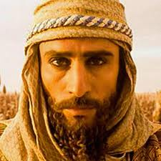
Emperor Darius
There was a great power struggle for the Persian throne after the death of Cyrus the Great
Finally Darius rose to power and became the next great Persian Empire
Under Darius the Persian Empire built a system of great roads, they had a system of mail delivery, he created different provinces with different governors

Slide 23
Emperor Darius
All of Darius’s reforms united the empire and kept it together despite a huge population increase from conquered lands
One of the first things he did was build a capital city all to his own

Slide 24
Presepolis
Presepolis became the new Persian capital city under Darius
Great Engineering Challenge…
60 ft. walls
Adorned in Gold & Silver
Huge Stone Platform
Had to level the area
Grand City
http://www.youtube.com/watch?v=gav5S_osQ9A

Slide 25
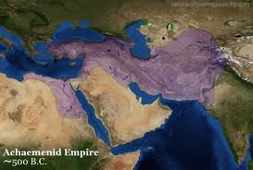
Persian Empire Grows Again
Darius extends & conquers more lands & expands the empire from the east to west
The Persian Empire grew to staggering size…
Iran
Afghanistan
Pakistan
Armenia
Turkey
Syria
Lebanon
Jordan
Palestine
Central Asia
Parts of India

Slide 26
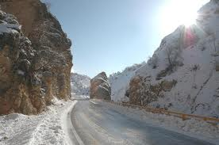
The Royal Road
Darius wanted to connect the huge Persian Empire
He built a massive stone road called “The Royal Road”
Over 1500 miles long this road extended from Northern part of Africa to India

Slide 27
The Royal Road
This road extended over mountains, lakes, rivers, deserts
The Royal Road was linked by 118 rest stations along the road from East to West (every 11 miles)
Travelers could eat & sleep & switch to fresh horses which made this road popular & successful

Slide 28
Darius’s Canal
Darius was obsessed on the riches that North Africa & Egypt
He builds a huge canal which he names Darius’s Canal
It opens up new trade routes and enables the Persians to eventually conquer Egypt later in history

Slide 29
Emperor Darius Dies
On the way back from the loss to the Greeks/Athenians at the Battle of Marathon Darius decides to return home to Presepolis
He never makes it there as he is killed quelling a rebellion

Slide 30
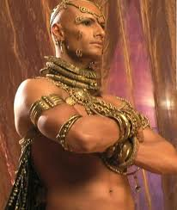
Xerxes Becomes King
Xerxes was the son of Emperor Darius
He had been the King in waiting his whole life knowing that when his father died he would become King of Persia
He was not like Cyrus the Great or his father Emperor Darius as he was bent on World domination

Slide 31
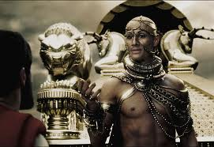
Xerxes the Military Leader
Xerxes wanted to become the Greatest Military Leader
He is instant on defeating the Greeks and avenging his father’s loss at the Battle of Marathon

Slide 32
Xerxes Defeats Greece
Xerxes defeats the Spartans at Thermopylae in 480 B.C.E. brining over 200,000 warriors, the largest army the world has ever seen and marches to Greece capital city of Athens & burns it to the ground
Xerxes wants to finish off the Greeks
He decides to launch an all out Naval assault at the Battle of Salamis

Slide 33
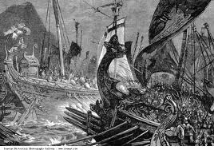
Xerxes Loses at Salamis
Xerxes massive navy suffers another defeat at the Battle of Salamis from the Greeks very similar to his father’s defeat by the Greeks at the Battle of Marathon
All but one ship was lost. The one ship to escape was captained by the only woman naval captain in the Persian navy
To this Xerxes was very proud of her stating “My men are becoming women & my women are becoming men”.

Slide 34
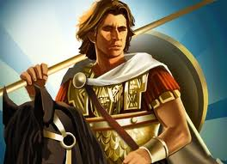
The Final Blow to Persia
Alexander the Great of Macedonia (Greece) deals the Persians their final blow
In 330 B.C.E. Alexander the Great was at the gates of Presepolis
They defeated the Persians and burned Presepolis to the ground
This marked the end of the Great Persian Empire

Slide 35
Important Points
6.H.2.3 (Transportation & Communication) The Royal Road transformed the Persian Empire because it connected so the whole empire could communicate & trade with each other
6.H.2.1 (Invasions & Conquests) Invasions & Conquests by Cyrus the Great, Darius, & Xerxes expanded the Persian Empire
6.H.2.4 (Important Historical Figures) Cyrus the Great became an important historical figure for freeing the Jews from Babylonia through his Edict of Restoration
6.C&G.1.1 (Absolute Monarchy) The Persian Empire operated under Absolute Monarchy where the King (Cyrus the Great, Darius, & Xerxes) had all the power
6.C&G.1.2 (Liberty) Cyrus the Great was known for giving the people he conquered their freedom to continue to practice their religion & customs which made him a popular ruler
6.C.1.2 (Religion Zoroastrianism) The Persian Empire marked the first time where a civilization was monotheistic
6.G.1.4 (Farming Technology) The Persians used Qanat Irritation System to water their crops taking water from the mountains
6.E.1.1 (Conflict/Unequal Distribution of Wealth) The Persians invaded and created conflict with neighboring civilizations. By taking them over they accumulated more wealth than other civilizations in Mesopotamia

