Slide 1
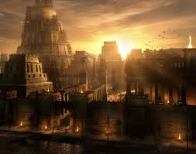

Slide 2
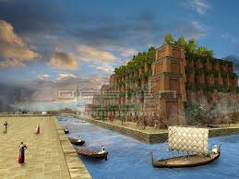
Ancient Civilizations of Mesopotamia
Ancient Babylonia
1894-539 B.C.E.

Slide 3
Essential Standards
6.G.2 Apply the tools of a geographer to understand the emergence, expansion and decline of civilizations, societies and regions.
6.H.2 Understand the political, economic and/or social significance of historical events, issues, individuals and cultural groups.
6.C.1 Explain how the behaviors and practices of individuals and groups influenced societies, civilizations and regions.
6.C&G.1 Understand the development of government in various civilizations, societies and regions.

Slide 4
Clarifying Objectives
6.G.2.1 Use maps, charts, graphs, geographic data and available technology tools to draw conclusions about the emergence, expansion and decline of civilizations, societies and regions
6.H.2.4 Explain the role that key historical figures and cultural groups had in transforming society (e.g., Mansa Musa, Confucius, Charlemagne and Qin Shi Huangdi, Hammurabi & Nebakanezer)

Slide 5
Clarifying Objectives
6.C.1.2 Explain how religion transformed various societies, civilizations and regions (e.g., beliefs, practices and spread of Buddhism, Christianity, Confucianism, Hinduism, Islam and Judaism).
6.C.1.1 Analyze how cultural expressions reflected the values of civilizations, societies and regions (e.g., oral traditions, art, dance, music, literature, and architecture).

Slide 6
Clarifying Objectives
6.C&G.1.1 Explain the origins and structures of various governmental systems (e.g., democracy, absolute monarchy and constitutional monarchy).
6.C&G.1.2 Summarize the ideas that shaped political thought in various civilizations, societies and regions (e.g., divine right, equality, liberty, citizen participation and integration of religious principles)
6.C&G.1.4 Compare the role (e.g. maintain order and enforce societal values and beliefs) and evolution of laws and legal systems (e.g. need for and changing nature of codified system of laws and punishment) in various civilizations, societies and regions.

Slide 7
Lesson Preface
The Ancient Babylon & Ancient Assyrian & Ancient Persia lessons are a little bit different because they happened during the same time period. These were the next two great civilizations after Sumer to occupy the Fertile Crescent Region of Mesopotamia. They were friends at first but later became enemies and fought each other (frienimies)

Slide 8
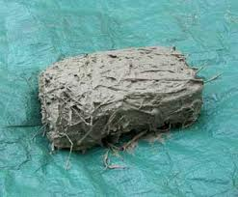
Ancient Mesopotamia
Mesopotamian Civilizations survived because of the water resources known as the Tigris & Euphrates Rivers
Mesopotamian cultures used mud bricks to build with

Slide 9
Ancient Mesopotamia
The Tigris & Euphrates Rivers opened up trade within all of the civilizations around the Mesopotamian Region
The SAIL & BOAT became very important to trade & transport of goods
The SAIL & BOAT allowed different civilizations to trade over long distances

Slide 10
Ancient Babylonia
Ancient Babylon sits on the Euphrates River
It is located in present day Iraq
It was home to the Jewish exile, one of the 7 wonders of the ancient world & had some of the most fertile soil in all the world

Slide 11
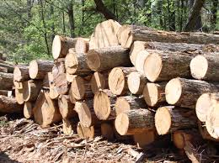
Scarcity of Resources
Ancient Babylonians did not have access to many natural resources…
Timber
Metal
Wine
Stone
They did however grow a lot of crops & produce textiles which they traded for the things they didn’t have
Babylonians were dependent on other civilizations for timber, metal, wine & stone

Slide 12
Capital City Babylon
The Capital city of Babylonia was called Babylon
It was a grand and huge city
It was guarded by the Gate of Ishtar
It is still be excavated today by archeologists
http://www.youtube.com/watch?v=BU4CujyYEps

Slide 13
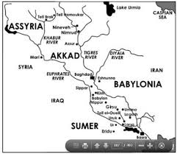
Sumer & Babylonia
In the last lesson we learned of the emergence, expansion & decline of the world’s first civilization Sumer
They were taken over by the Babylonians in about 1700 B.C.E.
Before their take over the peoples of Sumer & Babylon were friends
This was known as the time of King Hammurabi

Slide 14
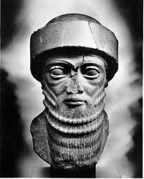
Hammurabi
King Hammurabi came to power when the Sumerian gods Anu & Enlil entrusted information to a third god, Babylonian god Marduk that Hammurabi was destined to become a powerful King
It was a few years later that Hammurabi became the first King of Babylon

Slide 15
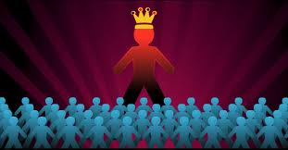
Absolute Monarchy
King Hammurabi was an Absolute Monarch but he didn’t want it to be that way
He wanted to set up a code of rules for all to follow
This would be the first set of written laws

Slide 16
Hammurabi the Lawmaker
Hammurabi was a relatively peaceful king
He worked to maintain order in his small but growing kingdom
He worked to come up with the first set of written rules (the first ever laws)

Slide 17
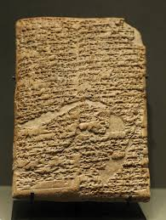
Hammurabi’s Code
This set of laws was called Hammurabi’s Code
A code was a law
Hammurabi’s Code lists a consequence for every action

Slide 18
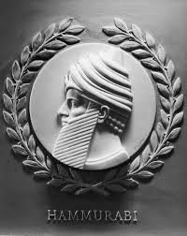
Problem with Hammurabi’s Code
The only issue with Hammurabi’s Code is although it seemed fair it really was not
If you did something to break the code to a Noble you REALLY got punished
If you did something to break the code to a Slave you didn’t get much of a consequence

Slide 19
Hammurabi’s Code
http://www.youtube.com/watch?v=ZO1r2dvLSKo
http://www.youtube.com/watch?v=_w5NGOHbgTw

Slide 20
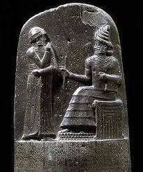
King Hammurabi’s Classical Period
Under Hammurabi’s leadership Babylonia enjoyed a Classical Period
A Classical Period is a period of time where the culture of a civilization is expanded and the citizens learn & discover rather than fight & conquer
During the Babylonian Classical Period many Babylonians expanded their ways of art, dance, & much more culture to reflect those of previous cultures

Slide 21
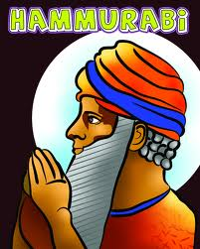
Hammurabi’s Death
Upon King Hammurabi’s death in 1750 there was a fight for the throne of Babylon
The mountain people known as the Kassites took control of Babylon

Slide 22
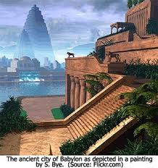
Kassites Control of Babylon
After King Hammurabi the Kassites controlled the Great civilization of Babylonia for the next 500 years
There is little known information about this time period
The information we do know has been found on Cuneiform stone/mud tablets in modern day Iraq

Slide 23
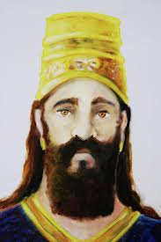
King Nebakanezer I
After the Kassite Period was over the Babylonians again regained power in the Babylonian Region
They named Nebakanezer I King of Babylonia
He brought back Babylonian religion & culture especially by reinforcing Murduk as the main god

Slide 24
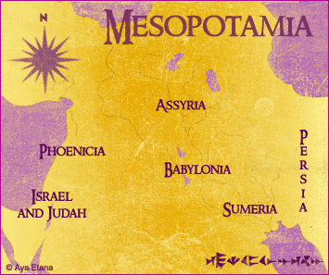
Babylonians & Assyrians become Enemies
It is not clear why but around 800 B.C.E the Babylonians & Assyrians begin to fight each other
The Assyrians were much more of a warrior culture & marched right into the Babylonian capital city of Babylon and captured it
Babylon was then under Assyrian control

Slide 25
Babylonians & Assyrians become Enemies
The Babylonians fought back & other groups joined the fight
The Chaldeans, Elamites, Assyrians all battled for Babylonia control

Slide 26
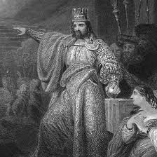
Nebakanezer II
When the fighting was over the Chaldeans controlled Babylonia
They named their new King after a King that had previously ruled Babylonia
They named their new King Nebakanezer II

Slide 27
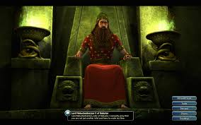
Nebakanezer II
Nebakanezer means “O god Nabu”
Nabu is the god of wisdom in Babylonian culture
Nabu is the son of Murduk
Murduk is the first god or god of gods in Babylonian culture

Slide 28
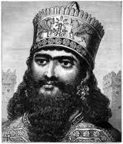
Nebakanezer II Sacks Assyria
Nebakanezer II was Babylonia’s greatest King besides Hammurabi
He led military campaigns and after years of fighting defeated the enemy his father could not
He defeated the Assyrians

Slide 29
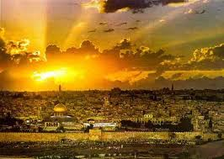
Nebakanezer II
Nebakanezer II wanted to be ALL POWERFUL and god like
He built the Tower of Babel (Ziggurat to Murdak)
He also built the famed Hanging Gardens of Babylon (7 wonders of the Ancient World)
He also attacked and sacked the city of Jerusalem on March 16th 605 B.C.E.

Slide 30
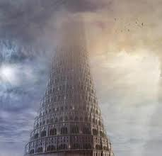
Tower of Babel
Nebakanezer II builds a great tower which he names the Tower of Babel
This is a Ziggurat to the god Murduk honoring him
The Tower of Babel is a symbol of Nebakanezer II becoming extremely power hungry and arrogant thinking he himself was favorable to the gods (God didn’t like this)

Slide 31
Tower of Babel
At the top of the Tower of Babel there was a blue temple called the Temple of Murduk
Climbing to the Temple of Murduk meant climbing into the heavens & the stars
At the top in the temple is where Murduk lived
Tower of Babel was really a Ziggurat about 300 ft high
http://www.youtube.com/watch?v=5yEPWGUCQYE (3:30-4:09)

Slide 32
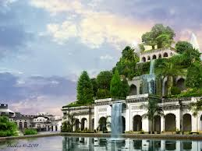
Hanging Gardens of Babylon
The Hanging Gardens of Babylon is one of the 7 Ancient Wonders of the World
It was built by Nebakanezer II for his new bride who was from a mountainous region of Babylon (probably a Kassite)

Slide 33
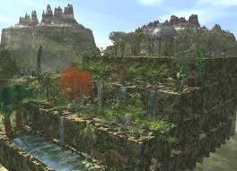
Hanging Gardens of Babylon
She came to the throne with Nebakanezer II but soon became very homesick and depressed for the natural beautiful gardens of her homeland
To cure her homesickness Nebakanezer II would build a manmade garden even more grand than the ones of his wife’s homeland

Slide 34
Hanging Gardens of Babylon
Nebakanezer II had his engineers use stone as a base for the plants and then put straw and mud together to build the garden & then put soil on top of it
He then used a water wheel with buckets for irrigation of the gardens
This garden was so beautiful that it is still sought after by many, many archeologists and is one of the 7 wonders of the Ancient World
http://www.youtube.com/watch?v=Kfg1YE-BqTc

Slide 35
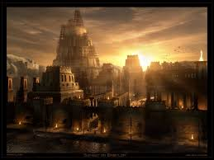
The Hated Place of Exile
Nebakanezer II attacked the city of Jerusalem and brought the Jews to Babylon and held them in captivity for years
Babylon became the city known as the “Hated Place of Exile” by the Jews

Slide 36
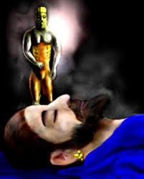
Nebakanezer II Dream
Nebakanezer was having trouble sleeping and having disturbing dreams
He kept seeing a statue cut from stone
Then the statue broke into the different pieces even though it was not struck by a human hand

Slide 37
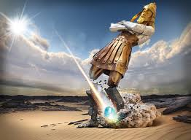
Nebakanezer II Dream
The statues…
Head was made of gold (represented Babylon)
Chest made of Silver (Persia)
Thighs made of Brass (Greece)
Legs made of Iron (Rome)
Feet made of Clay (The fall of those civilizations)

Slide 38
Nebakanezer II Dream
Nebakanezer II brought in wise men & sorcerers from all over his kingdom to try to interpret his dream
Only a man named Daniel could interpret the dream

Slide 39
Nebakanezer II Dream
Daniel told Nebakanezer II that the statue in his dream represented the powerful civilizations that existed now & in the future
He said that the gold head he saw represented Babylon

Slide 40
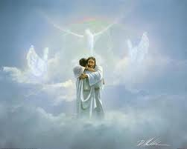
Nebakanezer II Dream
Daniel went onto say that there will be a new Kingdom (Christ’s Kingdom) that will last forever & all these other Kingdoms will be smashed & defeated
Christ’s Kingdom will rule forever

Slide 41
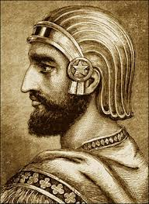
Downfall/Decline of Babylonia
Shortly after in 539 B.C.E. Cyrus the Great of Persia captures the city of Babylon and frees the Jews

Slide 42
Important Points
6.C.1.1 Babylonians showed their architectural culture by building the Tower of Babel & the Hanging Gardens of Babylon
6.C&G.1.1 Ancient Babylonia government was an Absolute Monarchy where the King had total control
6.C&G.1.2 Hammurabi believed he had a Divine Right from the gods to become King of Babylonia
6.C&G.1.4 Hammurabi devolved the first Written Code of Laws in World History
6.G.2.1 Maps show us that Mesopotamia became an area dominated by 3 Civilizations during this time period (Babylonia, Assyria, & Persia)
6.H.2.4 Hammurabi became a key figure in World History because he invented Hammurabi’s Code which was the first set of Written Rules
6.C.1.2 Ancient Babylonians were polytheistic believing in many different gods

