Slide 1
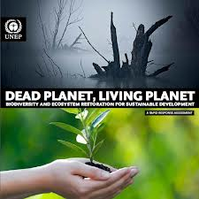
Ecosystems
Abiotic Factors
&
Plants & Animals

Slide 2
Essential Standards
6.L.2 Understand the flow of energy through ecosystems and the responses of populations to the biotic and abiotic factors in their environment.

Slide 3
Clarifying Objective
6.L.2.3 Summarize how the abiotic factors (such as temperature, water, sunlight, and soil quality) of biomes (freshwater, marine, forest, grasslands, desert, Tundra) affect the ability of organisms to grow, survive and/or create their own food through photosynthesis.

Slide 4
Essential Questions
How do physical conditions such as temperature, water sunlight, & soil quality in different biomes affect the ability of plants & animals to grow & survive?
What are the 7 different Biomes?
What is an Abiotic Factor?

Slide 5
Biotic & Abiotic Factors in Ecosystems
Biotic Factors are all factors that are living in an ecosystem or biome
Abiotic Factors are all factors that are NONLIVING in an ecosystem or biome
In this lesson we will focus on ABIOTIC factors

Slide 6
Abiotic Factors
Abiotic Factors are NONLIVING conditions that either help organisms grow or kill them
These Abiotic Factors include…
Temperature
Amount of Water
Sunlight
Soil Quality
http://www.youtube.com/watch?v=MdlwPtKg-VI
2:38-3:29

Slide 7
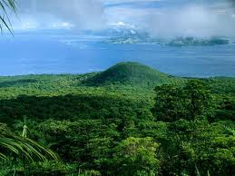
Biomes
Biome- Community of plants & animals that occupies a specific habitat
There are 7 main Biomes
Aquatic (Fresh Water/Marine)
Estuary
Grassland
Forest
Desert
Tropical
Tundra/Taiga

Slide 8
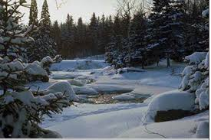
Biomes
Each of the different Biomes need the right conditions for all organisms to grow & survive
The Biomes need to be able to pass ENERGY from one living thing to another
That starts with the right conditions for plants to go through Photosynthesis

Slide 9
Essential Questions
Get with a partner and answer….
What are the 7 different Biomes?
What is an Abiotic Factor?

Slide 10
Plant Growth & Survival
In order for a plant to grow & survive it must go through Photosynthesis
This is how the plant will make food for it’s self
This is also how it will pass energy through an ecosystem
http://www.youtube.com/watch?v=E1pp_7-yTN4
0:00-1:03

Slide 11
Conditions must be perfect
Plants depend on all of the Abiotic factors to be just right
They need the right…
Temperature
Amount of Water
Sunlight
Soil Quality

Slide 12
What if things go Wrong?
If one of those 4 things is not right it will not allow the plant to go through photosynthesis
This will kill the plant
This will stop flow of energy in the Ecosystem
http://www.youtube.com/watch?v=MdlwPtKg-VI
3:30-4:08

Slide 13
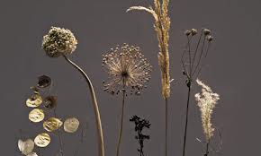
How are Animals Affected
Remember how Energy is transferred through Ecosystems
If plants (producers) are not able to produce energy than all animals will die
Animal survival DEPENDS on plants

Slide 14
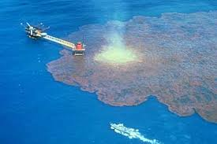
Abiotic Stresses
Abiotic Stresses are NONLIVING FACTORS that are BAD for plants
It is when conditions of the 4 factors are BAD
Abiotic Stresses always affect 4 factors
Here are some examples

Slide 15
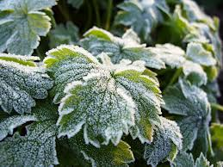
Temperature
Abiotic Stresses having to do with Temperature would be
Too HOT: This would dry out the plant and take too much water
Too COLD/FREEZE: the water inside the plant cell freezes and breaks the cell

Slide 16
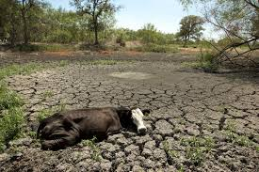
Amount of Water
Abiotic Stresses having to do with Amount of Water would be
Too much Water: Flood and the plants would drown
Too Little Water: Drought and the plants would die from lack of water
Contaminated Water: (Oil Spill/Pollution) Plants will get the contaminants inside them and die

Slide 17
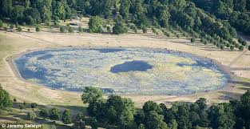
Sunlight
Abiotic Stresses having to do with Sunlight would be
Too Much Sunlight: (Radiation) Damage the Chloroplast & will not be able to go through Photosynthesis
Too Little Sunlight: will not be able to go through Photosynthesis

Slide 18
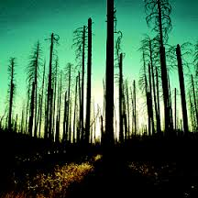
Soil Quality
Abiotic Stresses having to do with Soil Quality would be
Acid Rain: Acid Rain occurs because of pollution and kills plants
Too Much Salt: Sometimes the soil becomes too salty for plants to grow

Slide 19
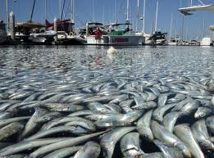
BAD AFFECTS
All of these affects will be VERY BAD on all organisms survival
The Abiotic conditions have to be just right for organisms to grow & survive

Slide 20
Essential Questions
Get with a partner and answer….
How do physical conditions such as temperature, water sunlight, & soil quality in different biomes affect the ability of plants & animals to grow & survive?

Slide 21
EOG Questions
How could acid rain affect the trees living in a forest?
A) It could strengthen the leaves of the trees in the forest.
B) It could alter the soil quality, adding toxins that harm the trees.
C) It could remove chemicals in the soil that harm the trees in the forest.
D) It could change the soil quality, providing nutrients to the trees.

Slide 22
Important Points
Abiotic Factors are NONLIVING conditions that affect organisms ability to grow & survive
Each Biome needs the right Abiotic conditions to grow & survive
Abiotic Factors that must be perfect are…
Temperature
Amount of Water
Sunlight
Soil Quality
Abiotic Stresses are NONLIVING FACTORS that are BAD for plants & animals
Abiotic Stresses prevent plants from going through Photosynthesis
Energy cannot be passed

